Slide 1
Modelling the Spread of Infectious Diseases
Raymond Flood
Gresham Professor of Geometry

Slide 2
Overview
Compartment models
Reproductive rates
Average age of infection
Waves of infection
Jenner, vaccination and eradication
Beyond the simple models

Slide 3
Compartment Models
S is the compartment of susceptible people
I is the compartment of infected people
R is the compartment of recovered people
Susceptibles
S
Infecteds
I
Recovereds
R

Slide 4
Compartment Model – add births
b is the birth rate, N is the total population = S + I + R
Births = bN UK: b = 0.012, N = 60,000,000
bN = 720,000
Susceptibles
S
Infecteds
I
Recovereds
R

Slide 5
Compartment Model – add deaths
b is the birth rate, N is the total population = S + I + R
Births = bN
Susceptibles
S
Infecteds
I
Recovereds
R
Natural and disease
induced death
Natural death
Natural death

Slide 6
Modifications of the compartment model
Latent compartment
Maternal antibodies
Immunity may be lost
Incorporate age structure in each compartment
Divide compartments into male, female.

Slide 7
Compartment Model – add deaths
b is the birth rate, N is the total population = S + I + R
Births = bN
Susceptibles
S
Infecteds
I
Recovereds
R
Natural and disease
induced death
Natural death
Natural death

Slide 8
Reproductive rates
Basic reproductive rate, R₀, is the number of secondary cases produced on average by one infected person when all are susceptible.

Slide 9
Reproductive rates
Basic reproductive rate, R₀, is the number of secondary cases produced on average by one infected person when all are susceptible.
Infection | Basic Reproductive rate, R₀
Measles | 12 – 18
Pertussis | 12 – 17
Diphtheria | 6 – 7
Rubella | 6 – 7
Polio | 5 – 7
Smallpox | 5 – 7
Mumps | 4 – 7
Smallpox: Disease, Prevention, and Intervention,. The CDC and the World Health Organization

Slide 10
Reproductive rates
Effective reproductive rate, R, is the number of secondary cases produced on average by one infected person when S out of N are susceptible.
Then
R = R₀ $\frac{S}{N}$ assuming people mix randomly.
R greater than or equal to 1 disease persists
R less than 1 disease dies out

Slide 11
Compartment Model - add transfer from Susceptibles to Infecteds
b is the birth rate, N is the total population = S + I + R
Births = bN
RI
Susceptibles
S
Infecteds
I
Recovereds
R
Natural and disease
induced death
Natural death
Natural death

Slide 12
Aside on rates
If the death rate is δ per week then the average time to death or the average lifetime is 1/δ weeks.
If the infection rate is β per week then the average time to infection or the average age of acquiring infection is 1/β weeks.

Slide 13
Average age of infection
If the disease is in a steady state then R = 1 with each infected producing another infected before recovering or dying.
Remember R = R₀ $\frac{S}{N}$ so 1 = R₀ $\frac{S}{N}$ giving R₀ = $\frac{N}{S}$

Slide 14
Average age of infection
If R = 1 then the disease is in a steady state with each infected producing another infected before recovering or dying.
Remember R = R₀ $\frac{S}{N}$ so 1 = R₀ $\frac{S}{N}$ giving R₀ = $\frac{N}{S}$
The number of people entering compartment S, the number being born must equal the number of people leaving it that is becoming infected so I = bN

Slide 15
Average age of infection
If R = 1 then the disease is in a steady state with each infected producing another infected before recovering or dying.
Remember R = R₀ $\frac{S}{N}$ so 1 = R₀ $\frac{S}{N}$ giving R₀ = $\frac{N}{S}$
The number of people entering compartment S, the number being born must equal the number of people leaving it that is becoming infected so I = bN
R₀ = $\frac{N}{S}$ = $\frac{I}{bS}$ = $\frac{1}{b}$ / $\frac{1}{I/S}$
birth rate = death rate and $\frac{I}{S}$ is infection rate

Slide 16
Average age of infection
If R = 1 then the disease is in a steady state with each infected producing another infected before recovering or dying.
Remember R = R₀ $\frac{S}{N}$ so 1 = R₀ $\frac{S}{N}$ giving R₀ = $\frac{N}{S}$
The number of people entering compartment S, the number being born must equal the number of people leaving it that is becoming infected so I = bN
R₀ = $\frac{N}{S}$ = $\frac{I}{bS}$ = $\frac{1}{b}$ / $\frac{1}{I/S}$
birth rate = death rate and $\frac{I}{S}$ is infection rate
R₀ = $\frac{average lifetime in the population}{average age at which infection is acquired}$

Slide 17
Average age at infection, A, for various childhood diseases in different geographical localities and time periods
Source: Anderson & May, Infectious Diseases of Humans, Oxford University Press, 1991.

Slide 18
Source: Anderson and May, The Logic of Vaccination, New Scientist, 18 November, 1982

Slide 19
Model of waves of disease
S(n + 1) = S(n) + bN - R₀ $\frac{S(n)}{N}$ I(n)
where N is the population size and b is now the birth-rate per week, because a week is our time interval.
I(n + 1) = R₀ $\frac{S(n)}{N}$ I(n)

Slide 20
Measles: birth rate 12 per 1000 per year

Slide 21
Measles: birth rate 36 per 1000 per year

Slide 22
Inter-epidemic period
Period = 2 π $\sqrt{Aτ}$
A = average age on infection
τ = average interval between an individual acquiring infection and passing it on to the next person
 | A in years | τ in years | Period in years
Measles | 4 – 5 | 1/25 | 2 – 3
Whooping cough | 4 – 5 | 1/14 | 3 – 4
Rubella | 9 - 10 | 1/17 | 5

Slide 23
Edward Jenner 1749–1823

Slide 24
In The Cow-Pock—or—the Wonderful Effects of the New Inoculation! (1802), James Gillray caricatured recipients of the vaccine developing cow-like appendages

Slide 25
Critical vaccination rate, p_{c}
Need to vaccinate a large enough fraction of the population to make the effective reproductive rate, R, less than 1.
As R = R₀ $\frac{S}{N}$ need to reduce S so that R₀ $\frac{S}{N}$ is less than 1.
Need to make the fraction susceptible,$\frac{S}{N},$ less than $\frac{1}{R0}$
So vaccinate a fraction of at least 1 - $\frac{1}{R0}$ of the population.
Critical vaccination rate, p_{c} is greater than 1 - $\frac{1}{R0}$

Slide 26
Critical vaccination rate, p_{c}
Need to vaccinate a large enough fraction of the population to make the effective reproductive rate, R, less than 1.
As R = R₀ $\frac{S}{N}$ need to reduce S so that R₀ $\frac{S}{N}$ is less than 1.
Need to make the fraction susceptible,$\frac{S}{N},$ less than $\frac{1}{R0}$
So vaccinate a fraction of at least 1 - $\frac{1}{R0}$ of the population.
Critical vaccination rate, p_{c} is greater than 1 - $\frac{1}{R0}$
Measles and whooping cough R₀ is about 15 so p_{c} about 93%
Rubella R₀ is about 8 so p_{c} about 87%

Slide 27
Graph of critical vaccination rate against basic reproductive rate for various diseases.
Keeling et al, The Mathematics of Vaccination, Mathematics Today, February 2013.

Slide 28
Source: Anderson and May, The Logic of Vaccination, New Scientist, 18 November, 1982

Slide 29
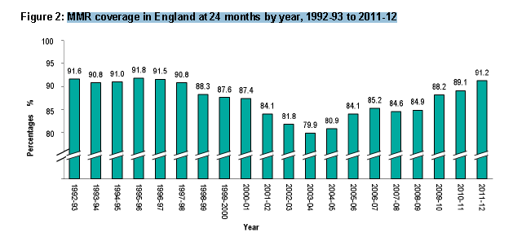
Measles: vaccination rates
Source: http://www.hscic.gov.uk/catalogue/
PUB09125/nhs-immu-stat-eng-2011-12-rep.pdf
Source: Anderson and May, The Logic of Vaccination, New Scientist, 18 November, 1982

Slide 30
Vaccinating below the subcritical level increases the average age at which infection is acquired.
New infection rate is smaller with vaccination
Average age of infection after vaccination
= $\frac{Average age of infection before vaccination}{1 – p}$

Slide 31
Beyond the simple models
The Mathematics of Vaccination
Matt Keeling, Mike Tildesley, Thomas House and Leon Danon
Warwick Mathematics Institute

Slide 32
Other factors and approaches
Vaccines are not perfect
Optimal vaccination
Optimal vaccination in households
Optimal vaccination in space

Slide 33
Vaccines are not perfect
Proportion get no protection
Partial protection - leaky vaccines
Reduce susceptibility
Reduce infectiousness
Increase recovery rate

Slide 34
Optimal vaccination
Suppose period of immunity offered by the vaccine is short
Examples
HPV against cervical cancer
Influenza vaccine

Slide 35
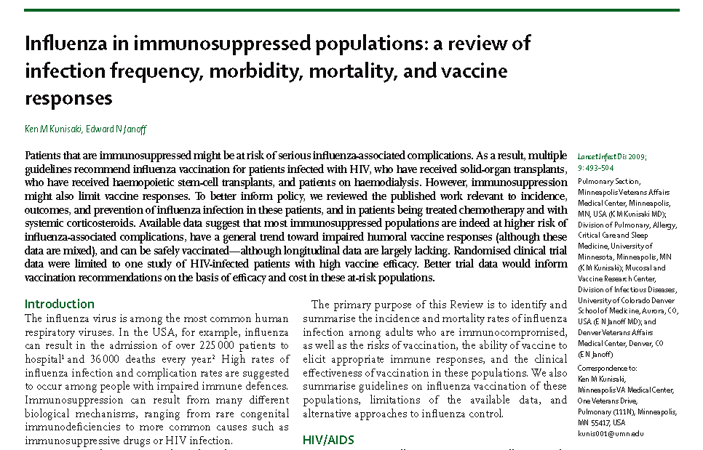
Optimal vaccination in households
The Lancet Infectious Diseases, Volume 9, Issue 8, Pages 493 - 504, August 2009

Slide 36
Vaccination in space
Red is infected
Green is vaccinated
Light blue is the ring
Dark blue is susceptible
Notice telling people to keep off
the North York Moors during the 2001 Foot and Mouth epidemic

Slide 37
Thank you for coming!
My next year’s lectures start on
16 September 2014

