Slide 1
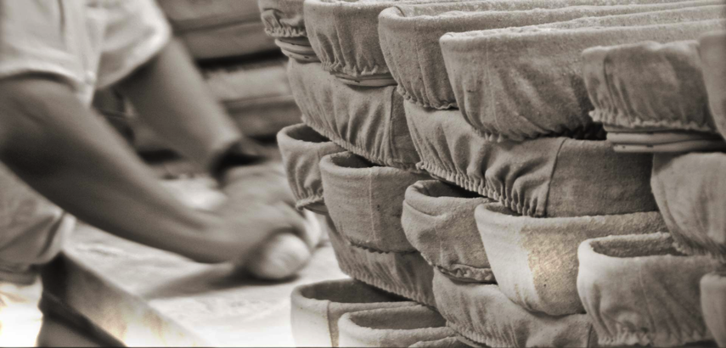
The Rise and fall of Sourdough: 6,000 Years of Bread
Eric Pallant
Allegheny College

Slide 2
My sourdoughs come to England

Slide 3
And sneak past security this way

Slide 4
How did we get from this to this?
Historical Sourdough.
Bread or Olympics flag?

Slide 5
Hunting is men’s work

Slide 6
Prehistory: Gathering seeds was difficult

Slide 7
Seed gathering was women’s work

Slide 8
Invention of Agriculture

Slide 9
Goat grass, an early wheat ancestor

Slide 10
Agriculture begins all over Fertile Crescent ~ 10,000 years before present

Slide 11
Civilization begins with Domestication

Slide 12
Ancient Egypt

Slide 13
Sourdough bread feeds pyramid builders

Slide 14
How to feed 10,000 pyramid workers

Slide 15
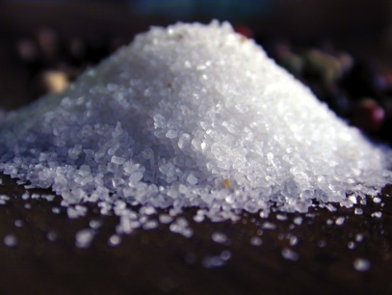
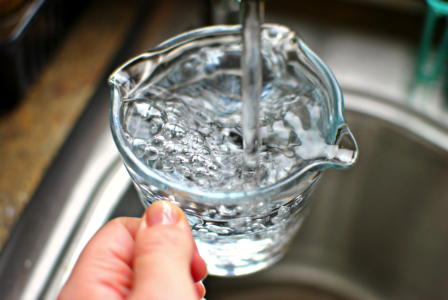
Making Bread Requires Only Four Ingredients
Wheat flour
Water
Salt
Leaven

Slide 16
First leaven is sourdough – 6,000 years ago
Sourdough is a collection of wild yeasts and bacteria that fall into a glop of water and flour

Slide 17
Sourdough bread feeds ancient Romans

Slide 18
Bread and Circuses

Slide 19
Pacification

Slide 20
Ancient Roman Grain Production

Slide 21
Hadrian’s Wall

Slide 22
Newcastle Art Museum

Slide 23
A revolt in the east – Jesus feeds 5,000
Victoria and Albert Museum

Slide 24
The Last Supper, Jesus declares…

Slide 25
Jesus promised an end to spiritual and corporeal hunger

Slide 26
The Body of Jesus was sourdough bread

Slide 27
Sourdough sharing was not lost on the followers of Christ

Slide 28
Nestorian (Eastern Orthodox) Eucharist uses original sourdough

Slide 29
Sourdough bread meant survival in Middle Ages

Slide 30
Breughel Harvest

Slide 31
The Real Deal - Serfdom

Slide 32
Famine and Disease were always nearby

Slide 33
Medieval Communal Ovens

Slide 34
1730s Turgot map of Paris

Slide 35
Let them eat cake

Slide 36
In urban Europe price of bread matters

Slide 37
Baguette = Antoinette

Slide 38
Yeast first recognized in 1600s - 1800s
Von Leewonhoek’s microscopes
Louis Pasteur’s science

Slide 39
Did Great Britain Ruin Good Bread?

Slide 40
London, 1806. Pop: 885,000

Slide 41
Industrial Revolution Changes Everything

Slide 42
If textiles can be made by machine…

Slide 43
Spinning Jenny vs. Continuous Oven

Slide 44
And all those new city folk need fast food

Slide 45
Yeast becomes fast and reliable

Slide 46
Faster than yeast: Aerated Bread Company

Slide 47
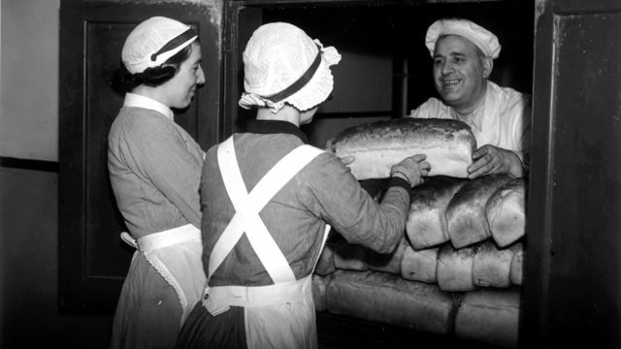
Chorleywood Bread Process

Slide 48
Chorleywood Bread Process

Slide 49
Ingredients in Bread
Hovis
Wonder Bread (US)

Slide 50
But UK started Real Bread Campaign

Slide 51
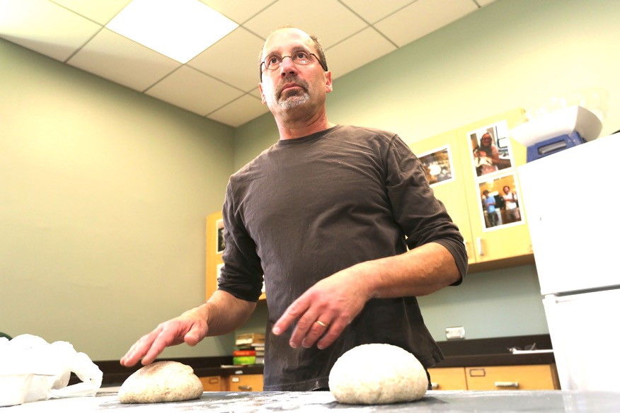
I’m in UK as a Fulbright Scholar …
Continue research on my book, Culture: A Short History of the World in a Fresh Loaf of Sourdough

Slide 52
And to share sourdough starters

Slide 53
Map of my starters

Slide 54
Bagels and Pizza – flour, water, salt, sourdough

Slide 55
Baguettes and Whole meal Pita

Slide 56
Sourdough boule and Fougasse

