Slide 1
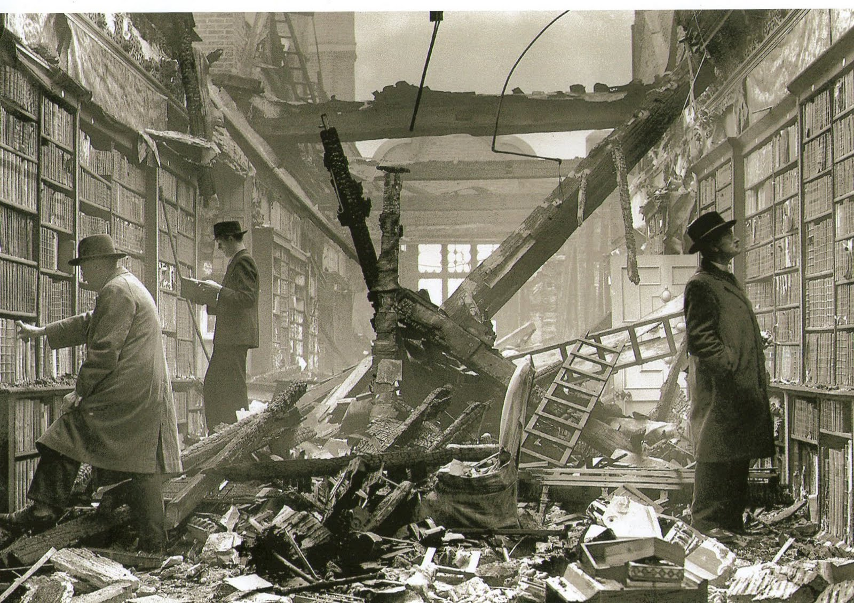
Making History Online
Tim Hitchcock,
University of Sussex
Robert Shoemaker
University of Sheffield
Holland House library after an air raid, 1940 Ref: BB83/04456 © English Heritage

Slide 2
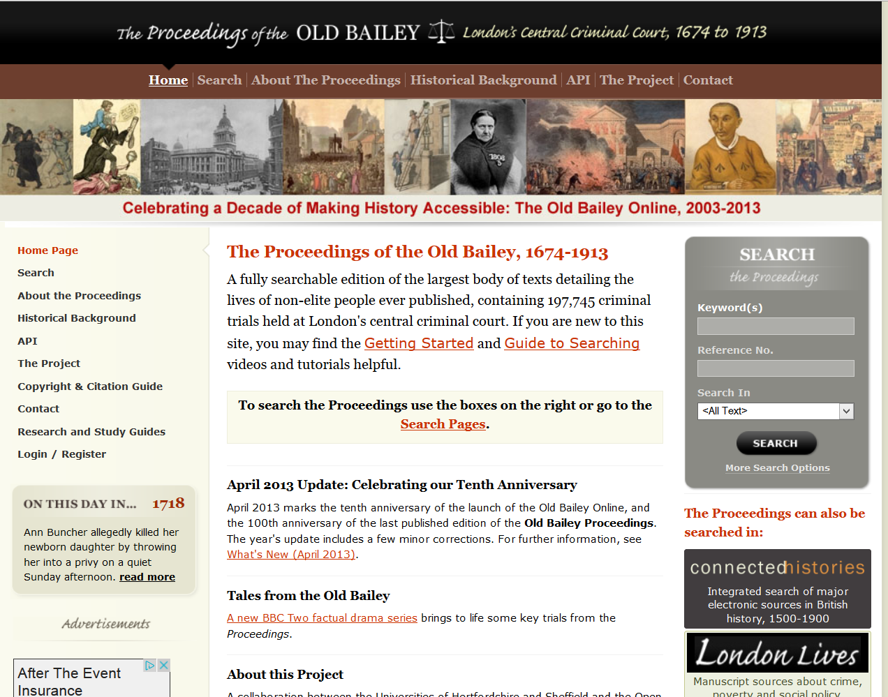
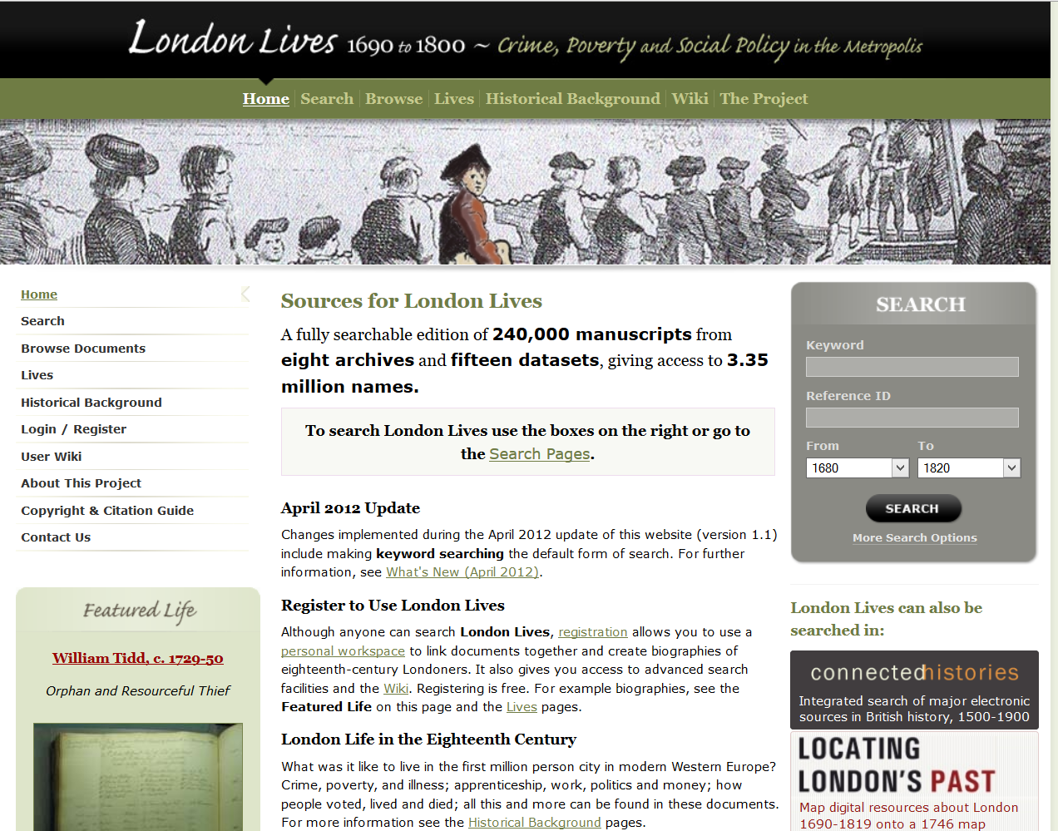
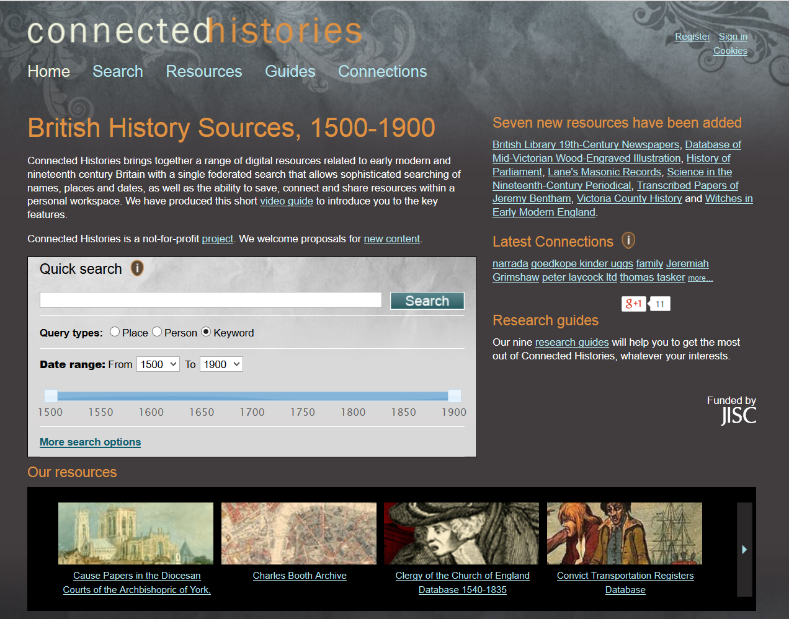
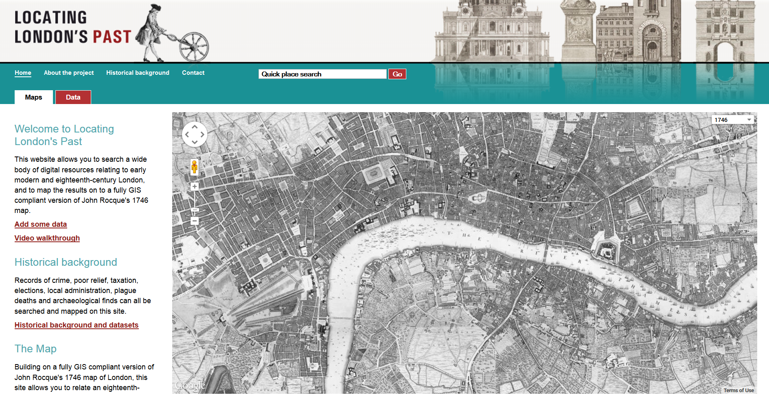
Version 1.0, 2003
2010
2011
2010

Slide 3
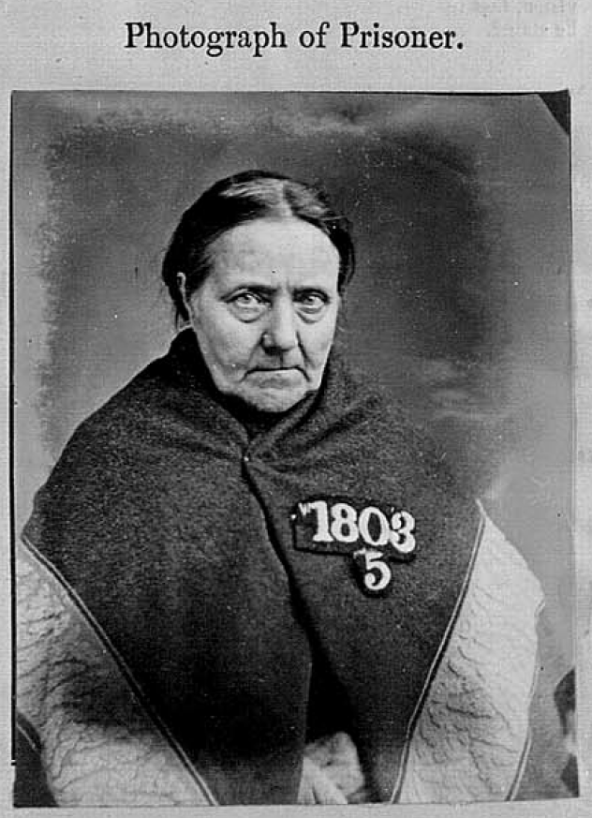
Sarah Durrant Convicted to two years imprisonment at Wandsworth Gaol, for the theft of £2000 worth of banknotes on 9 January 1871.

Slide 4
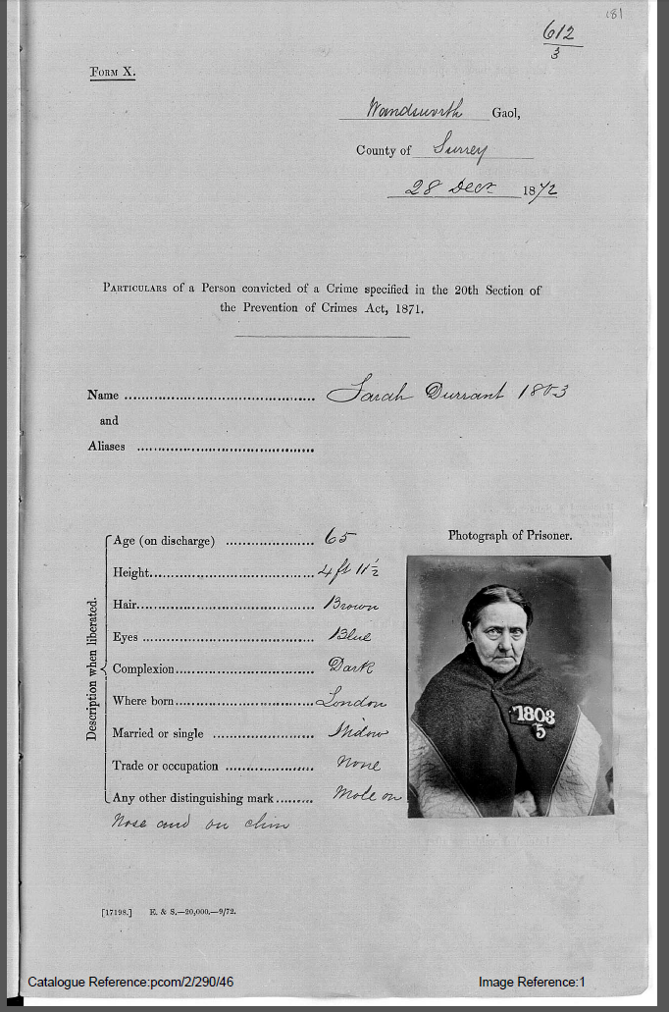
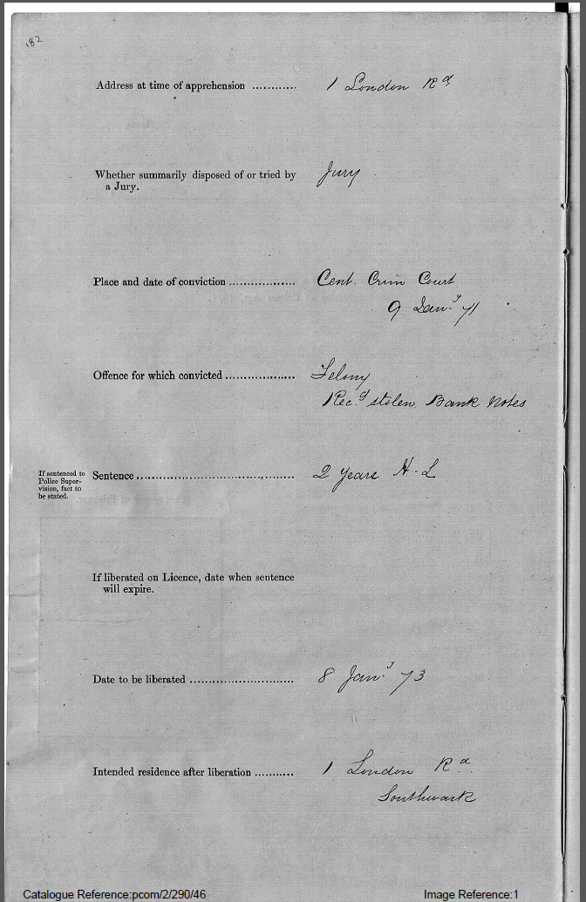
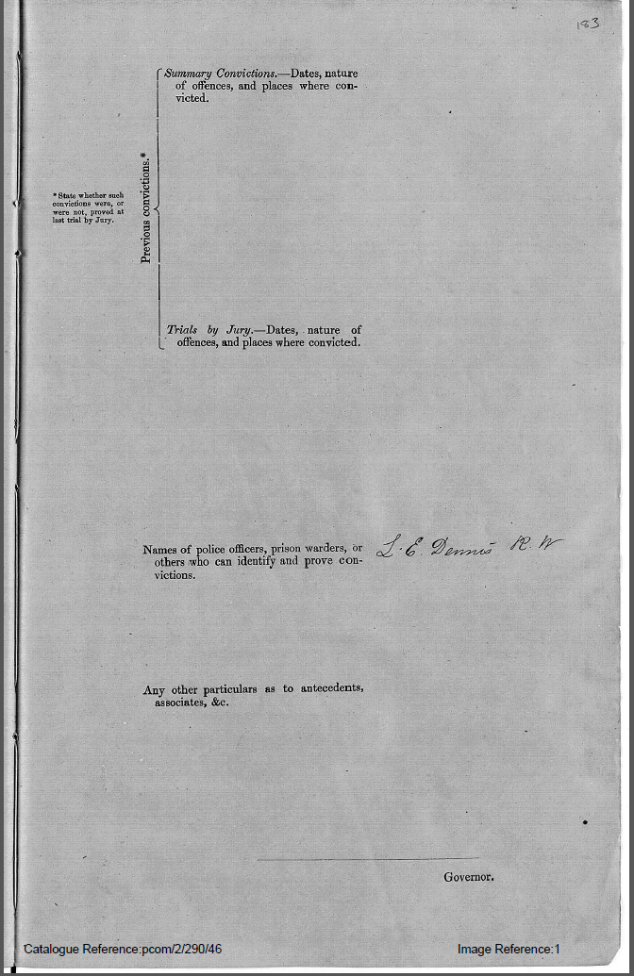

Slide 5
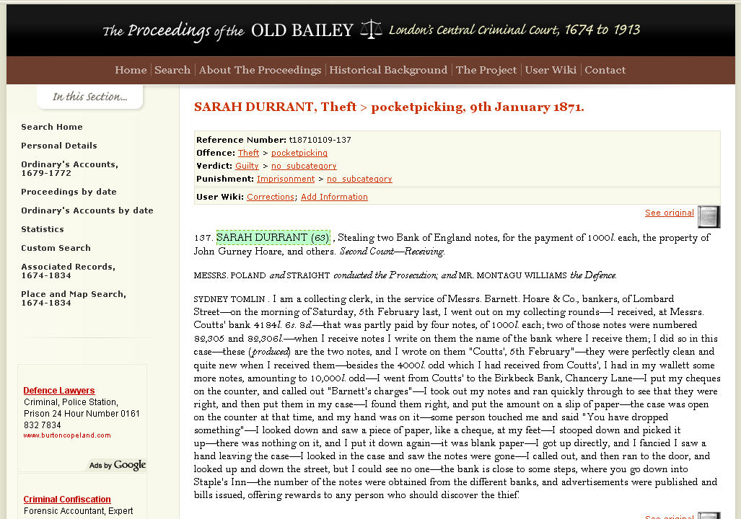

Slide 7
Sarah Durrant,
63, widow...

Slide 8
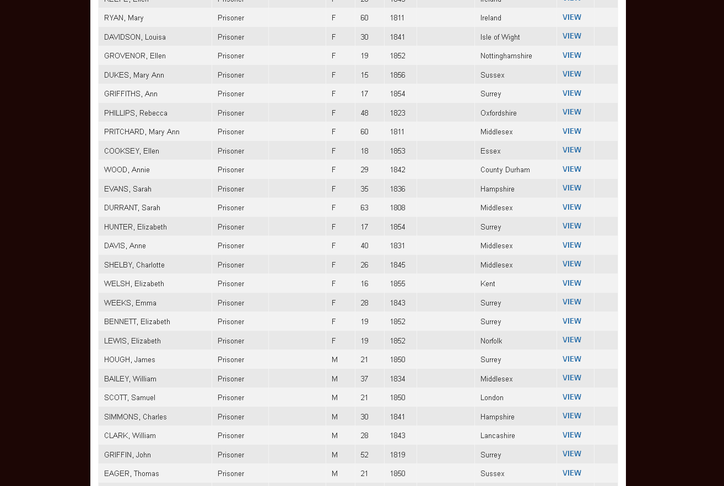
Census enumeration page for Wandsworth House of Correction, 1871.

Slide 9
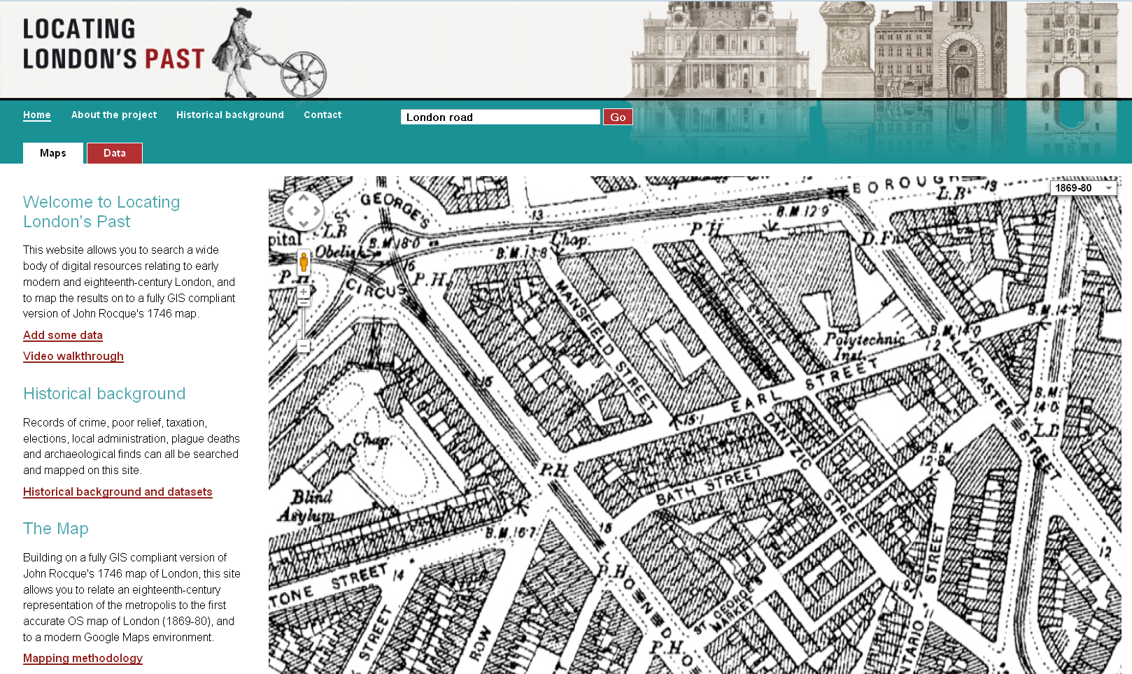
No. 1 London Road

Slide 10
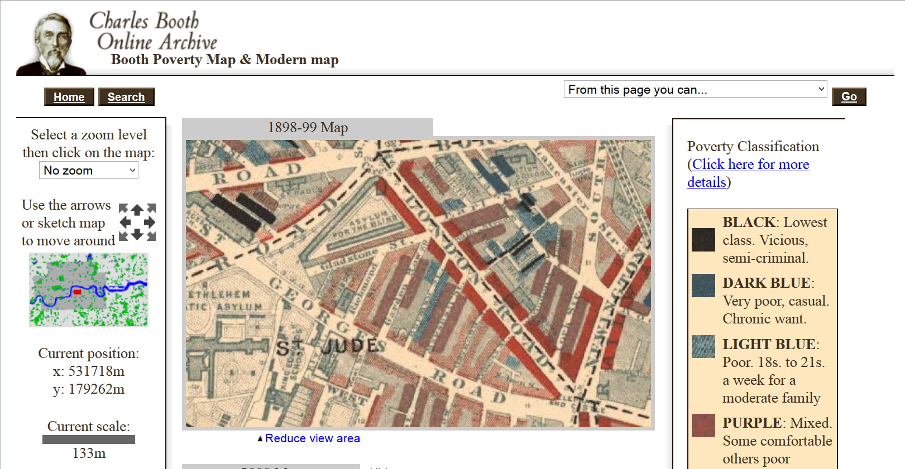
No. 1 London Road

Slide 11
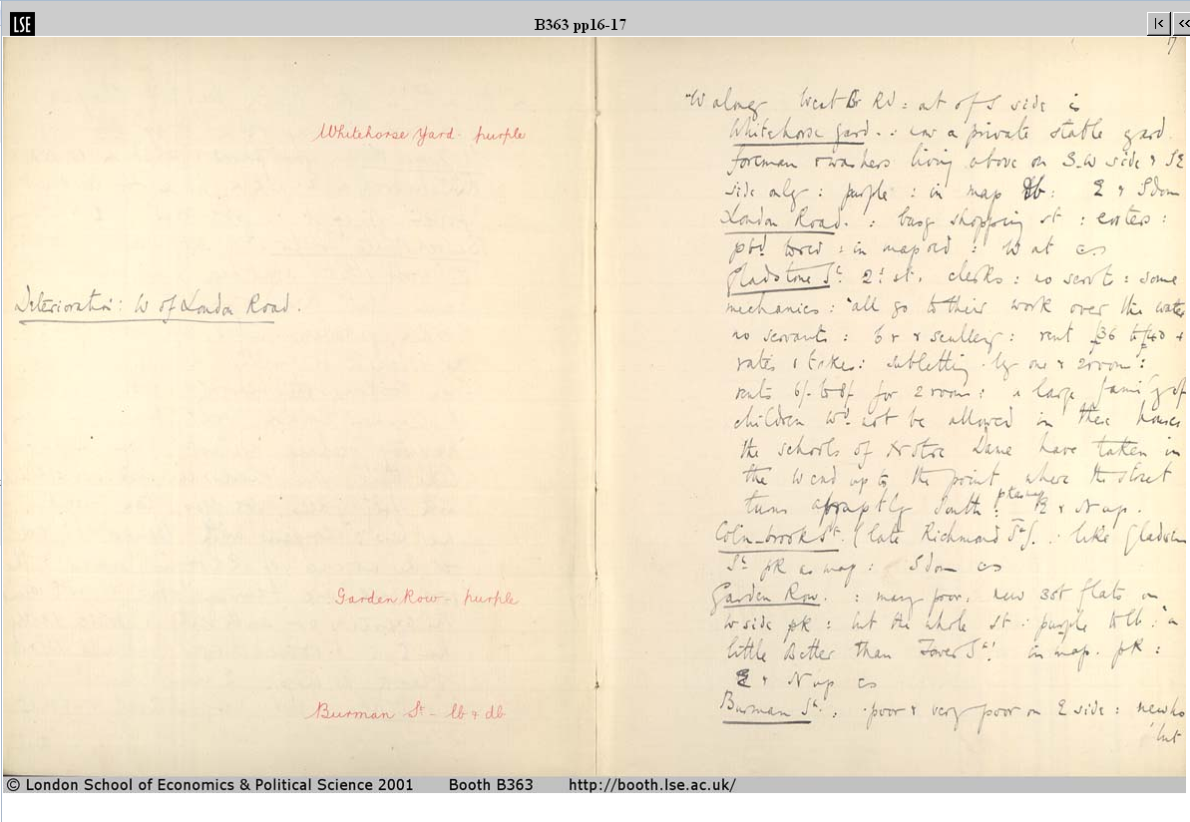
London Road

Slide 12
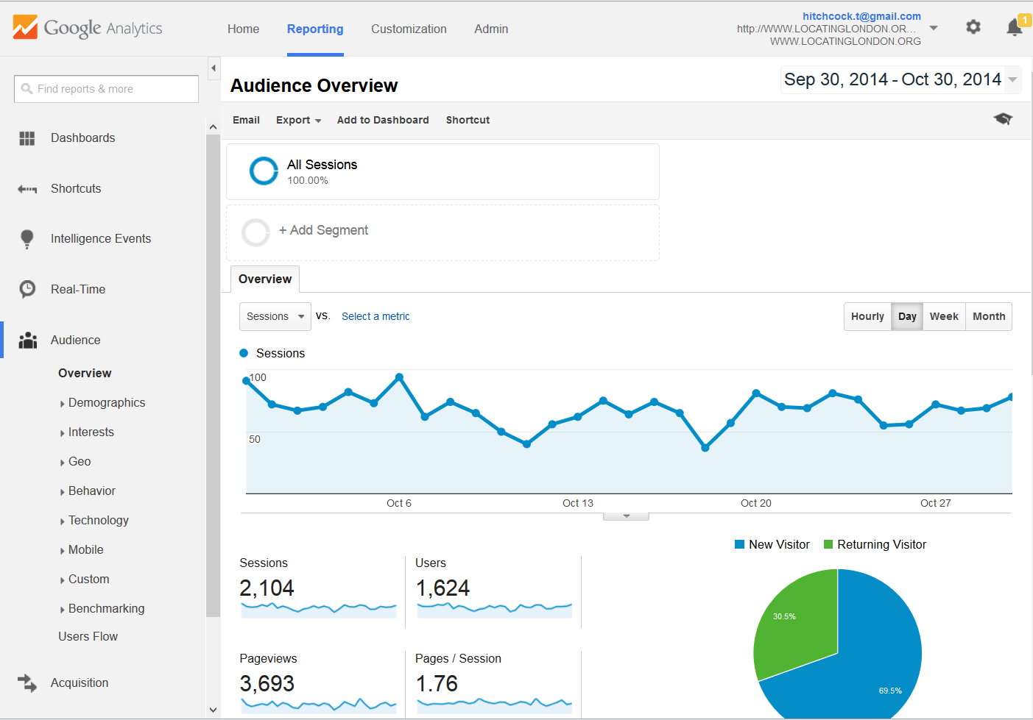
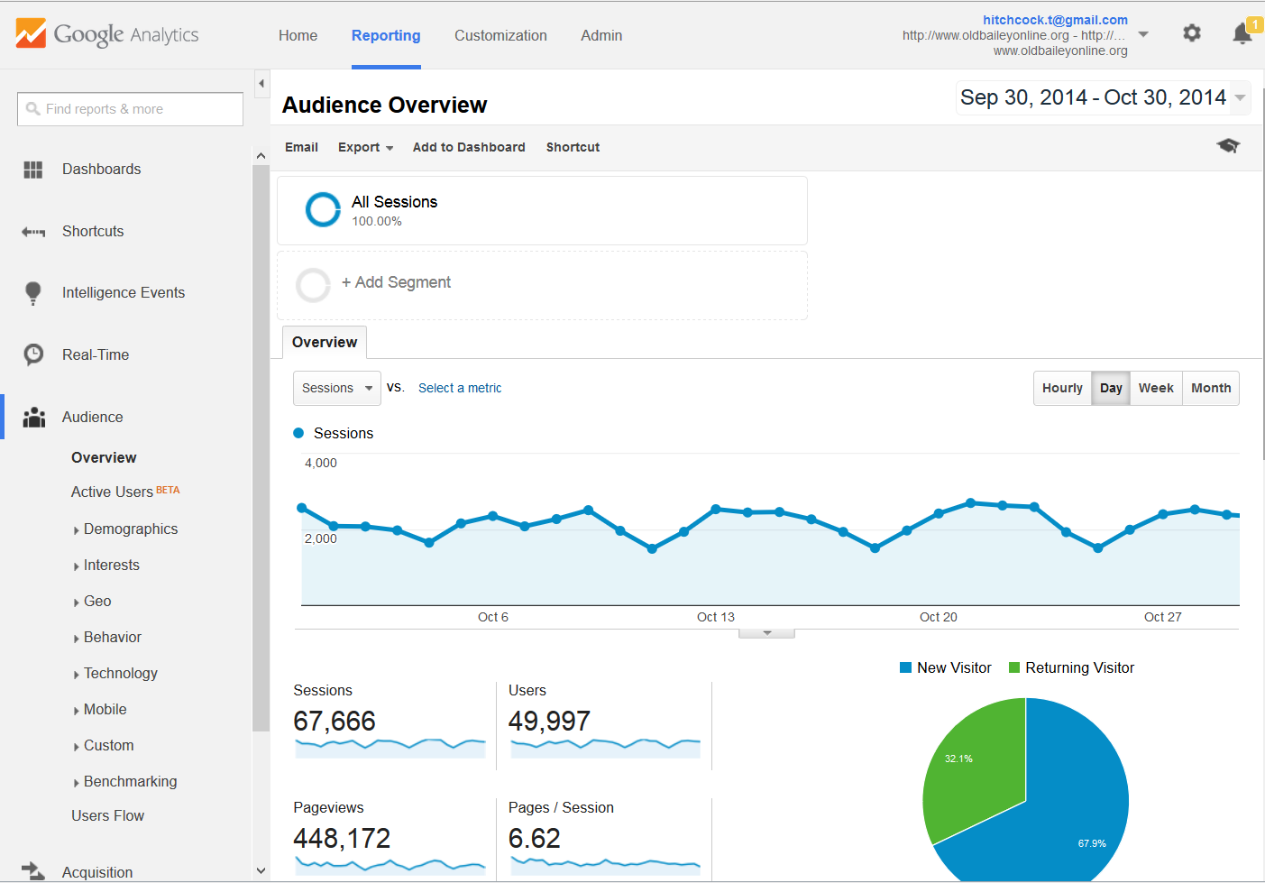
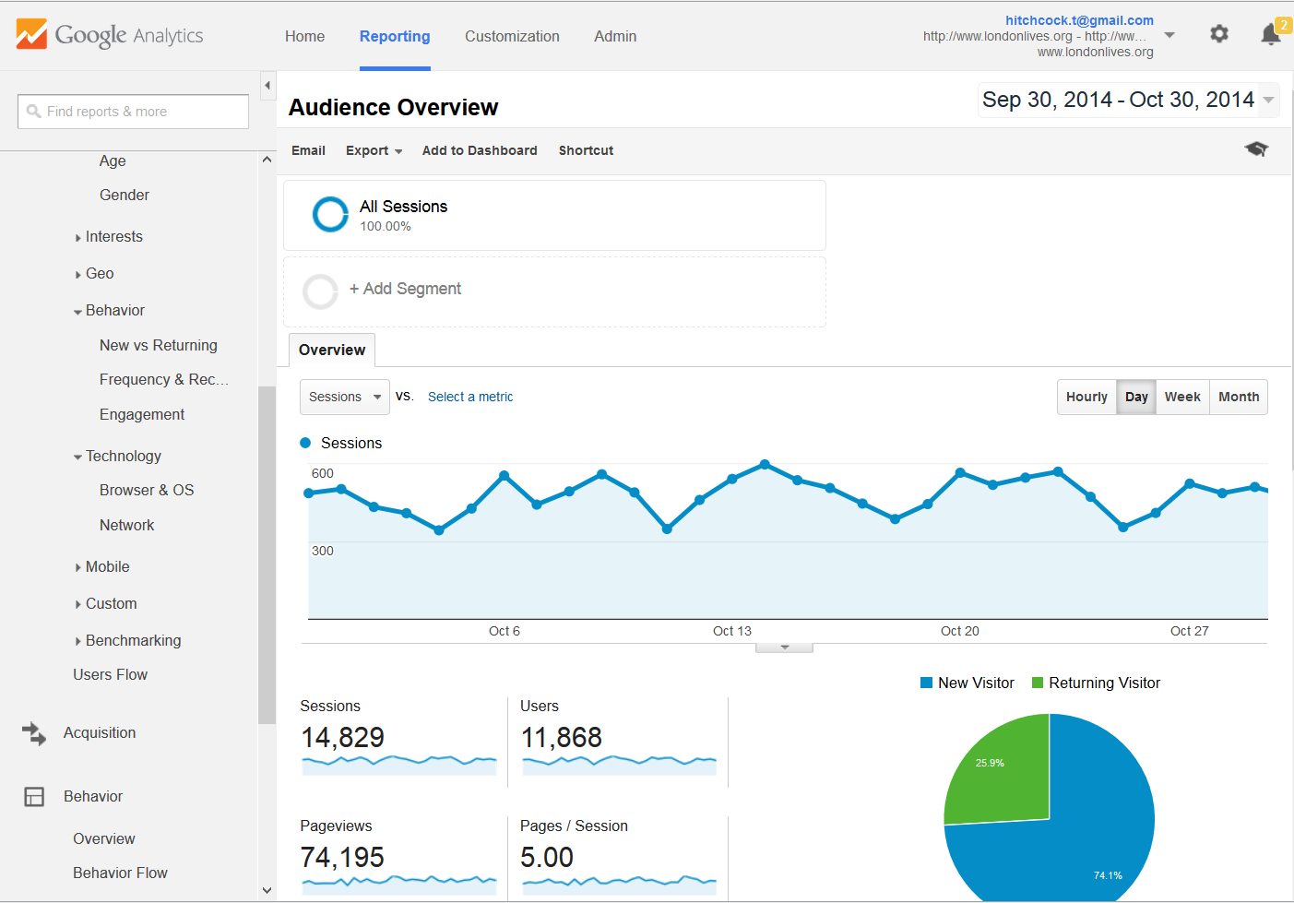

Slide 13
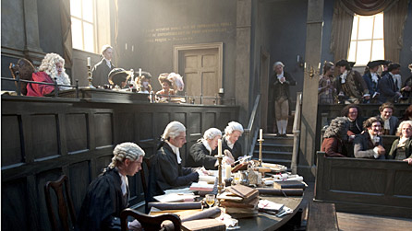

Slide 14
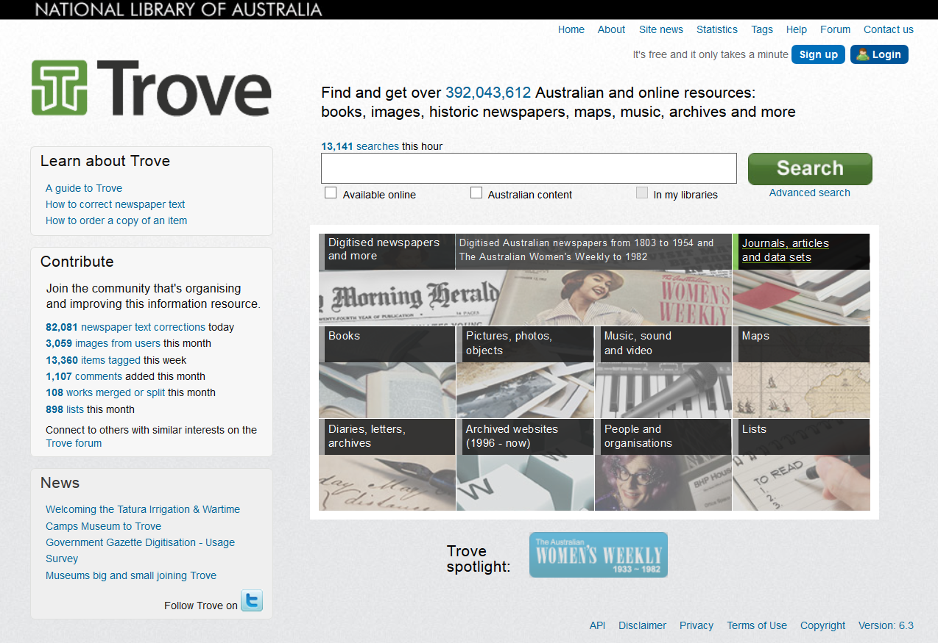
http://trove.nla.gov.au/

Slide 15
http://blogs.ucl.ac.uk/transcribe-bentham/

Slide 16
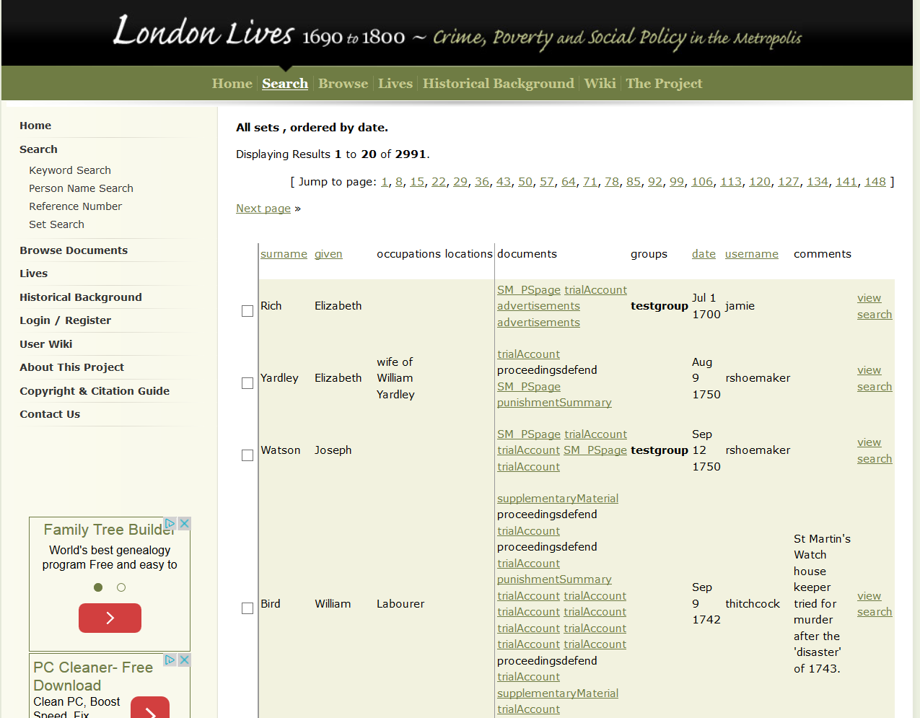
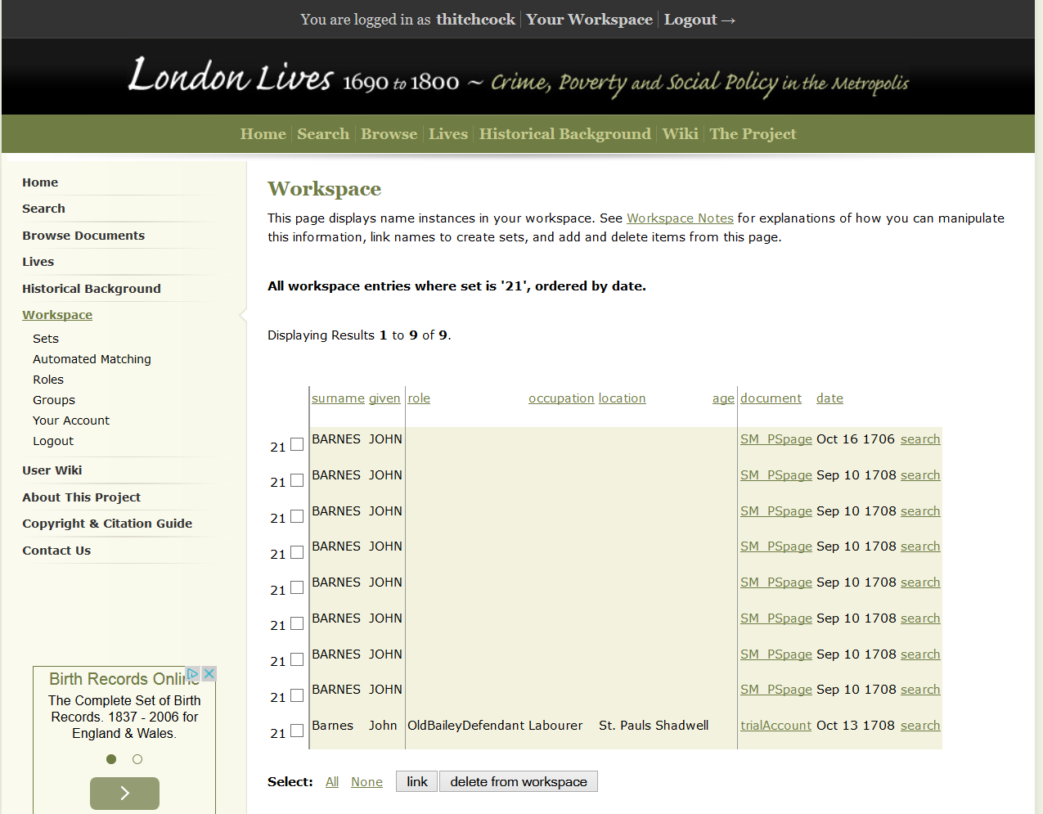
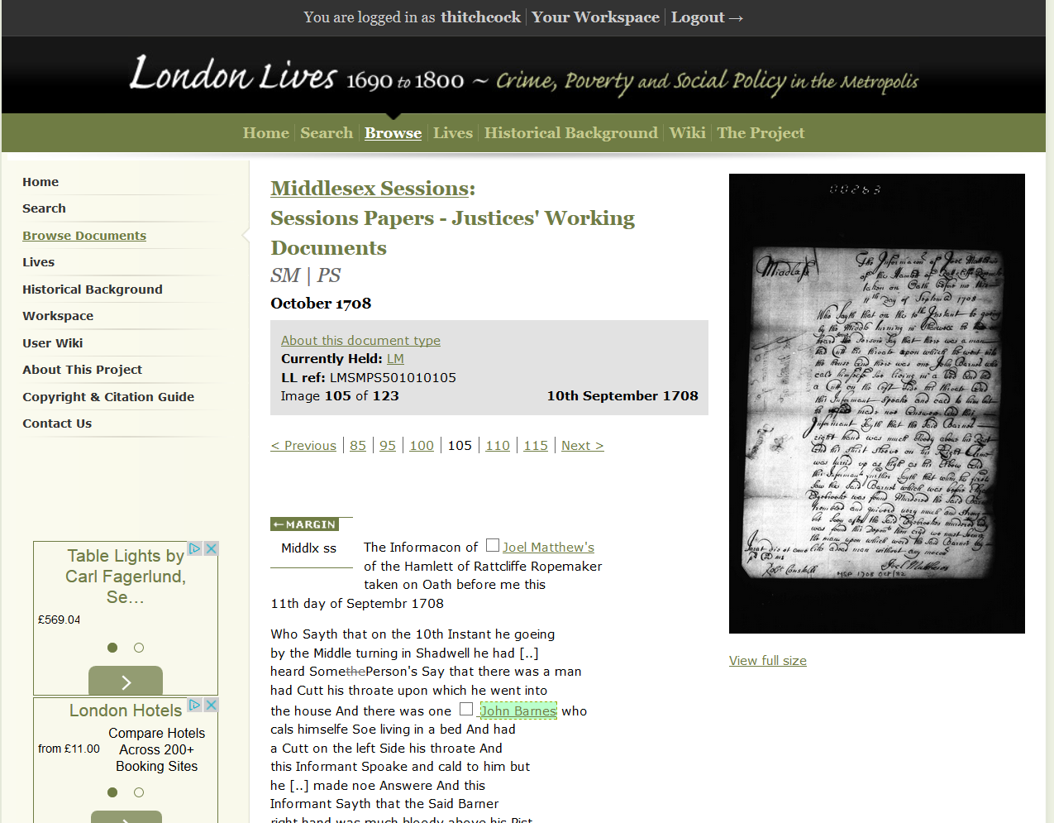
http://www.londonlives.org/

Slide 17
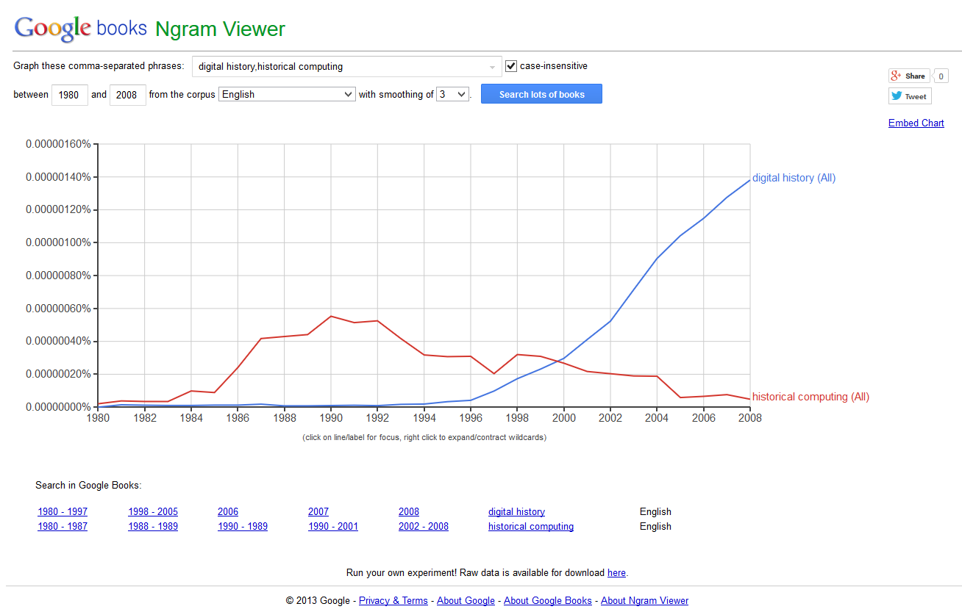
‘digital history’ (blue), and ‘historical computing’ (red), 1980-2008
https://books.google.com/ngrams/

Slide 18
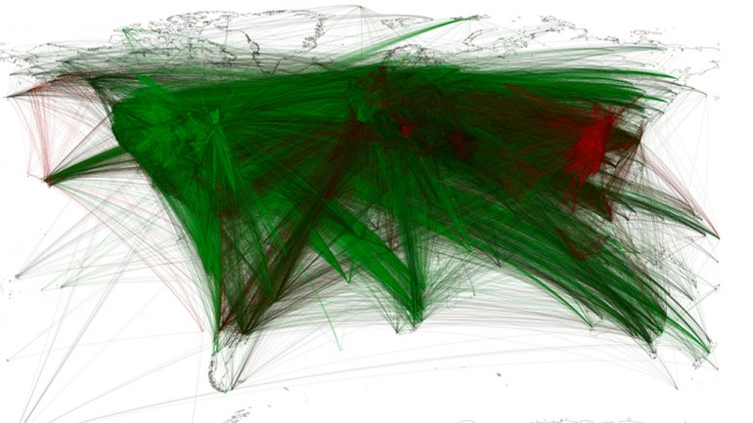
Global geocoded tone of all New York Times content from 1946

Slide 19
http://www.prochronism.com/

Slide 20
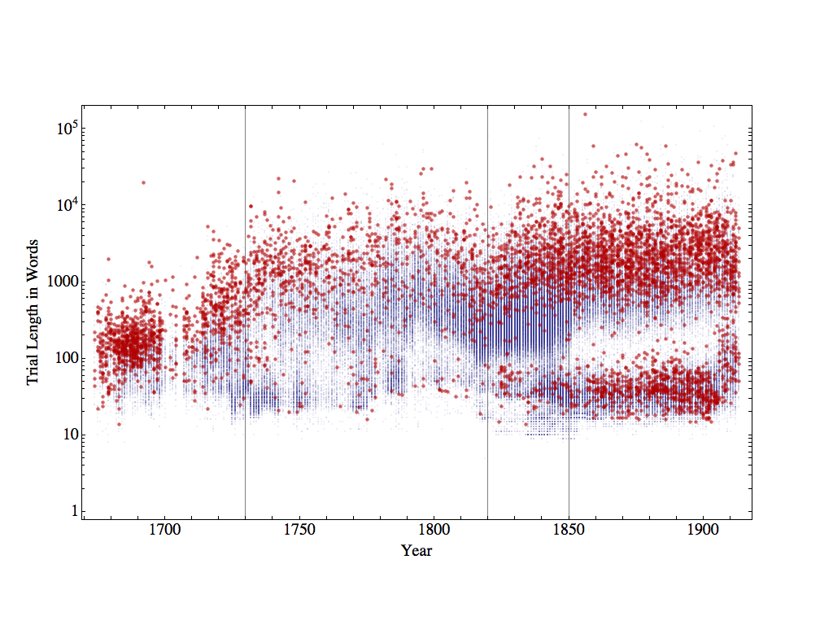
Distribution of trial lengths in words for ‘killing’ displayed in red; all other trials in grey. ‘Killing’ includes all trials tagged as including the offences of, ‘Infanticide’, ‘murder’, ‘petty treason’, ‘manslaughter’, and ‘killing: other’, by the Old Bailey online.

Slide 21
Distribution of trial lengths in words for ‘killing’ displayed in red; all other trials in grey. ‘Killing’ includes all trials tagged as including the offences of, ‘Infanticide’, ‘murder’, ‘petty treason’, ‘manslaughter’, and ‘killing: other’, by the Old Bailey online.

Slide 22
Distribution of trial lengths in words for ‘killing’ displayed in red; all other trials in grey. ‘Killing’ includes all trials tagged as including the offences of, ‘Infanticide’, ‘murder’, ‘petty treason’, ‘manslaughter’, and ‘killing: other’, by the Old Bailey online.
Sarah Durrant

Slide 23
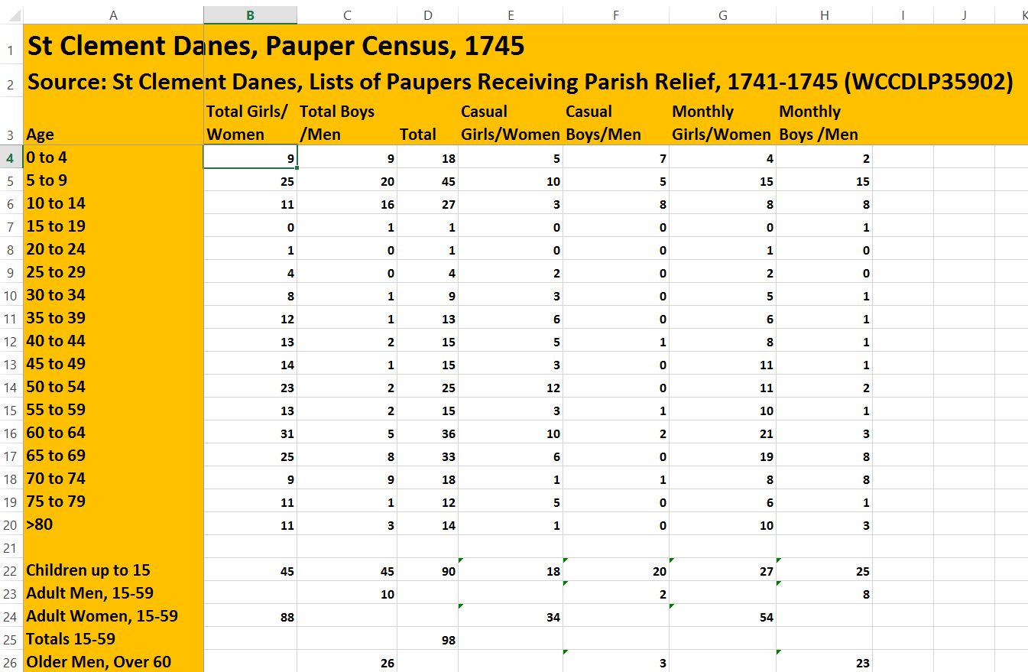
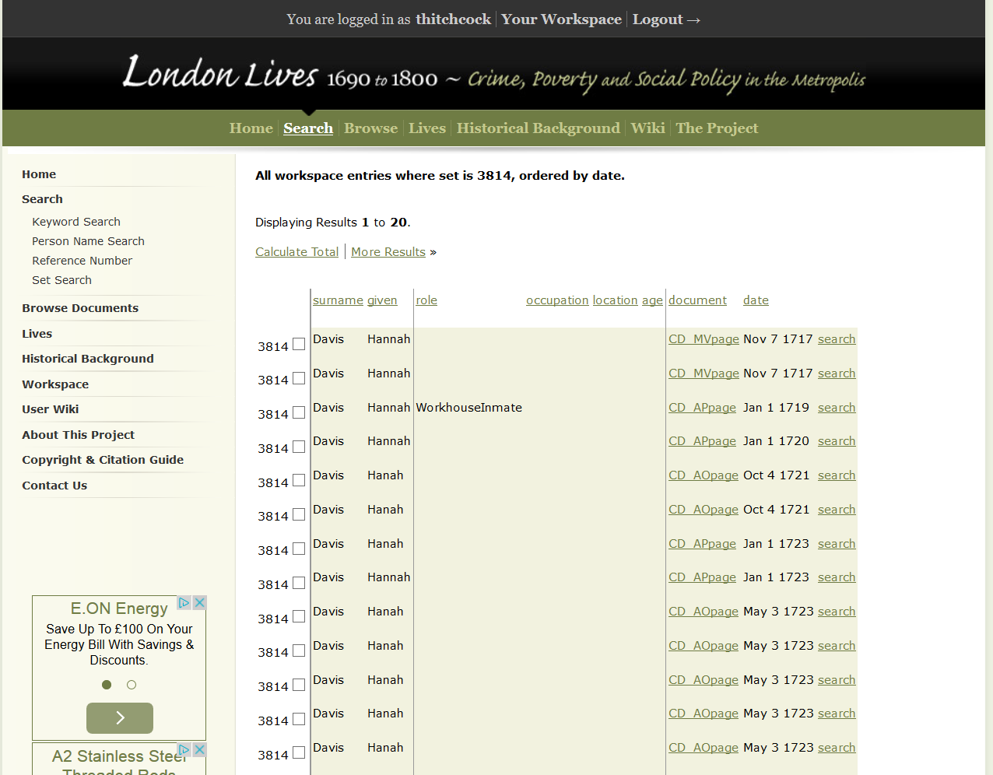
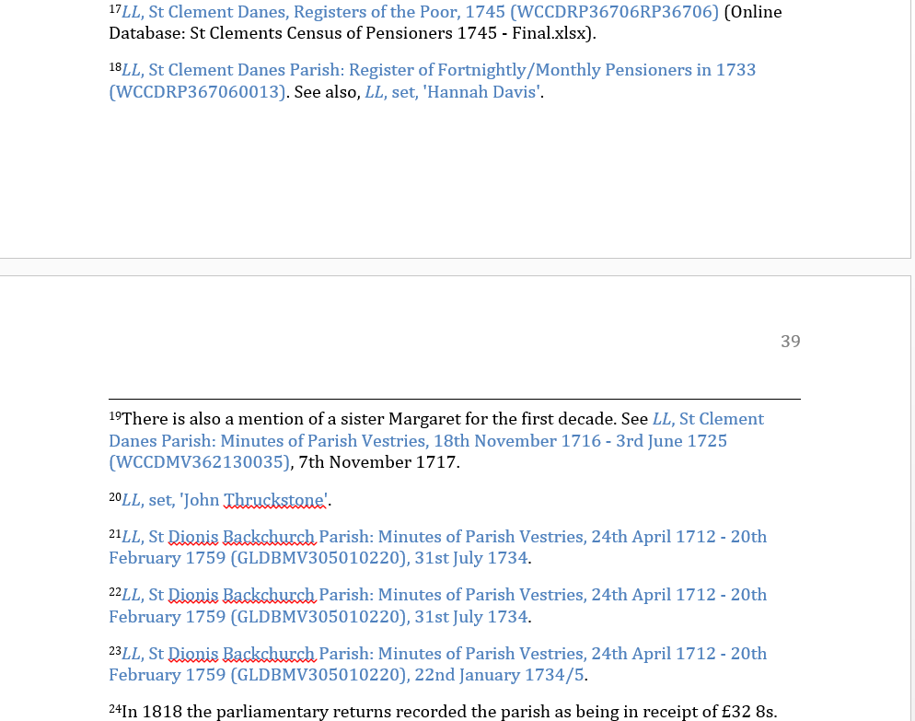
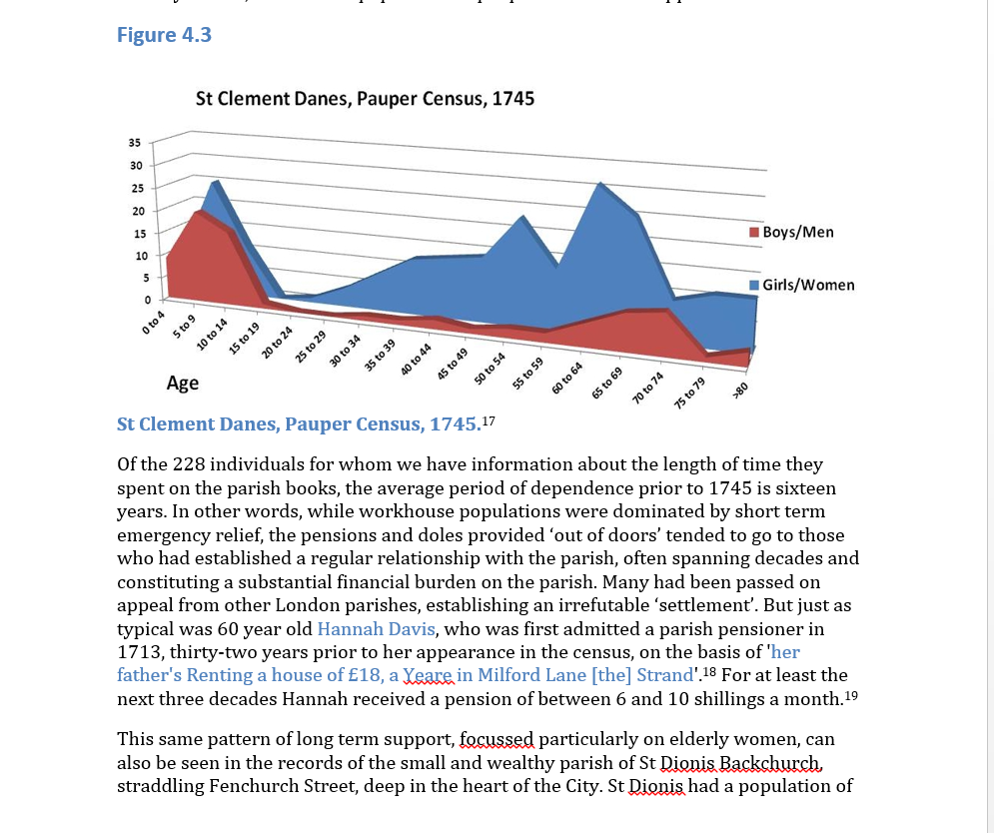
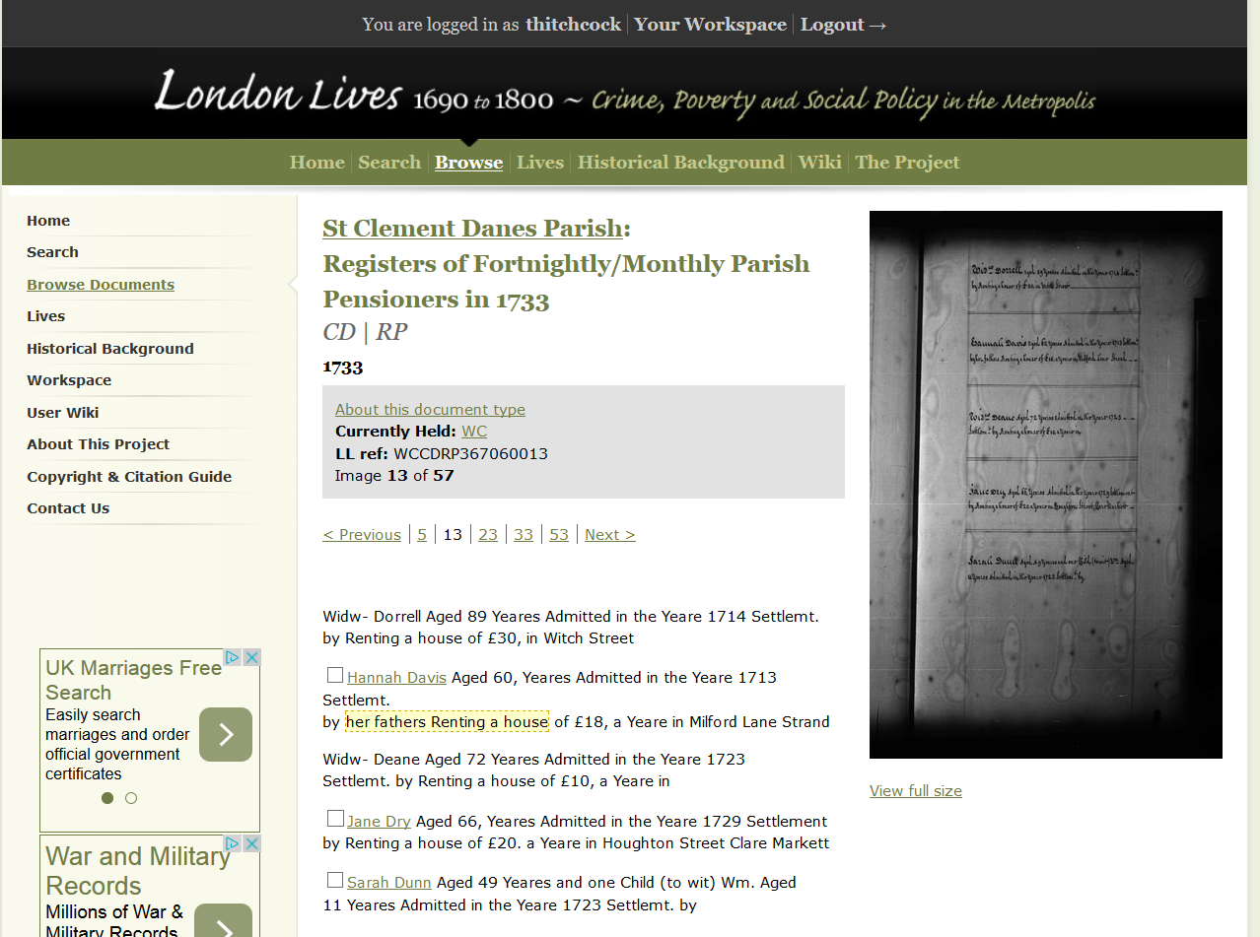

Slide 24
http://www.historymatters.group.shef.ac.uk/

Slide 25
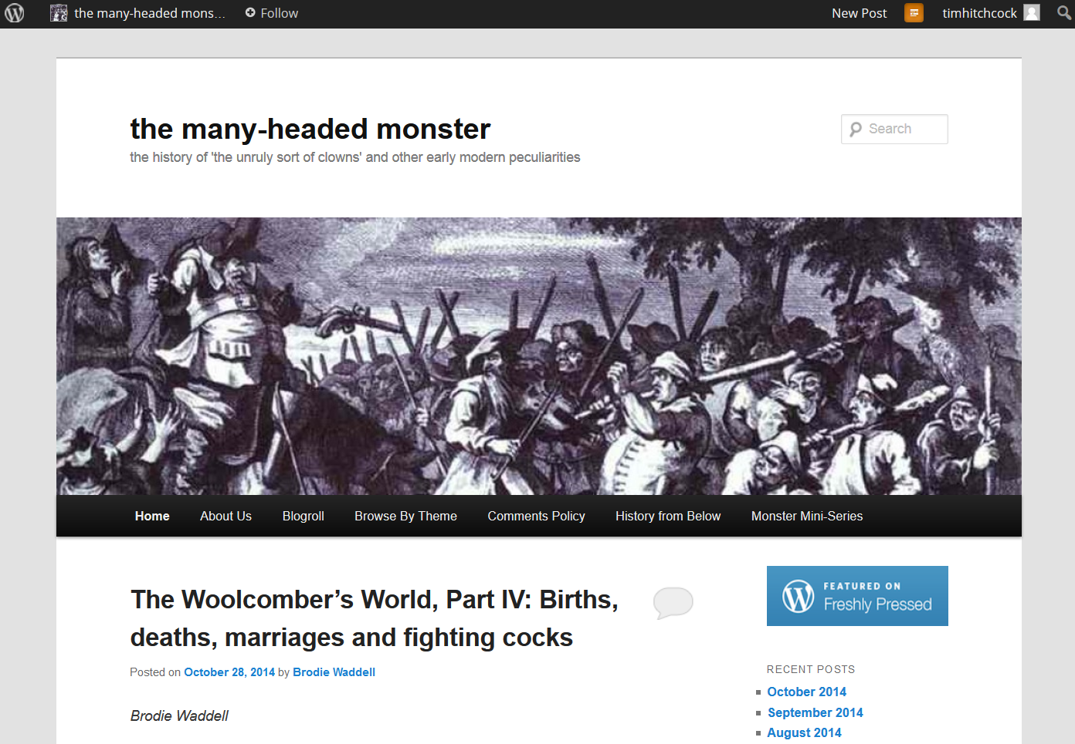
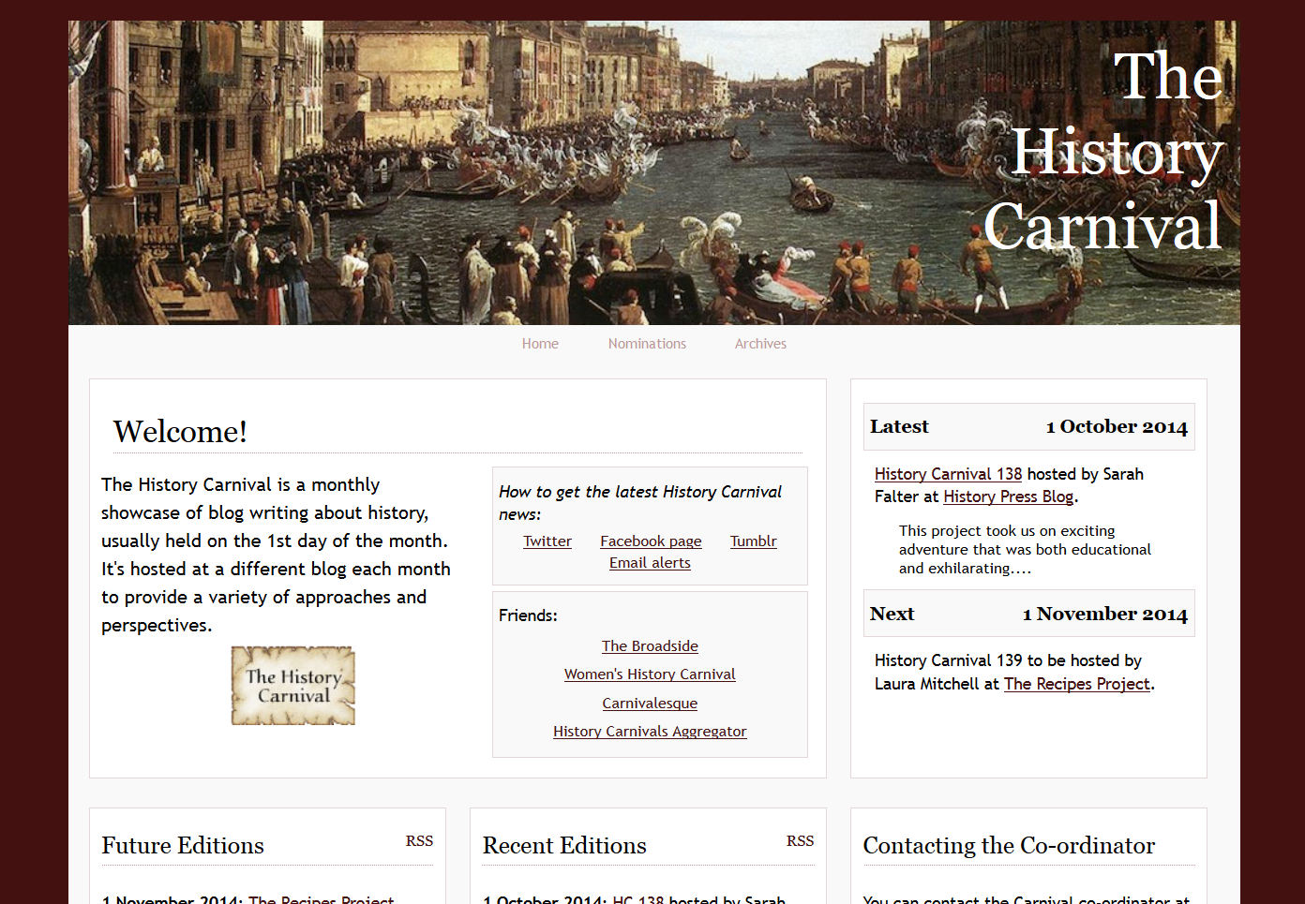
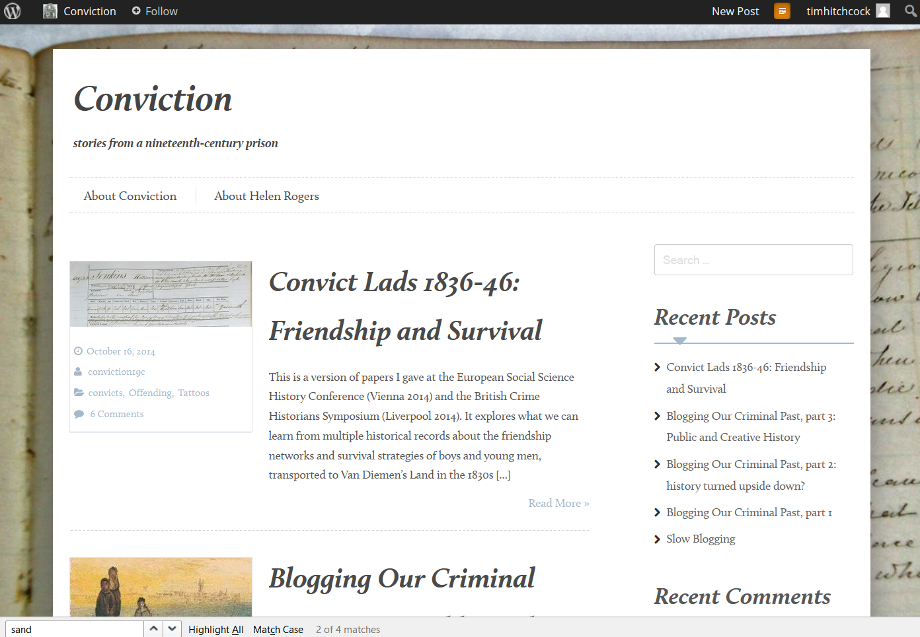
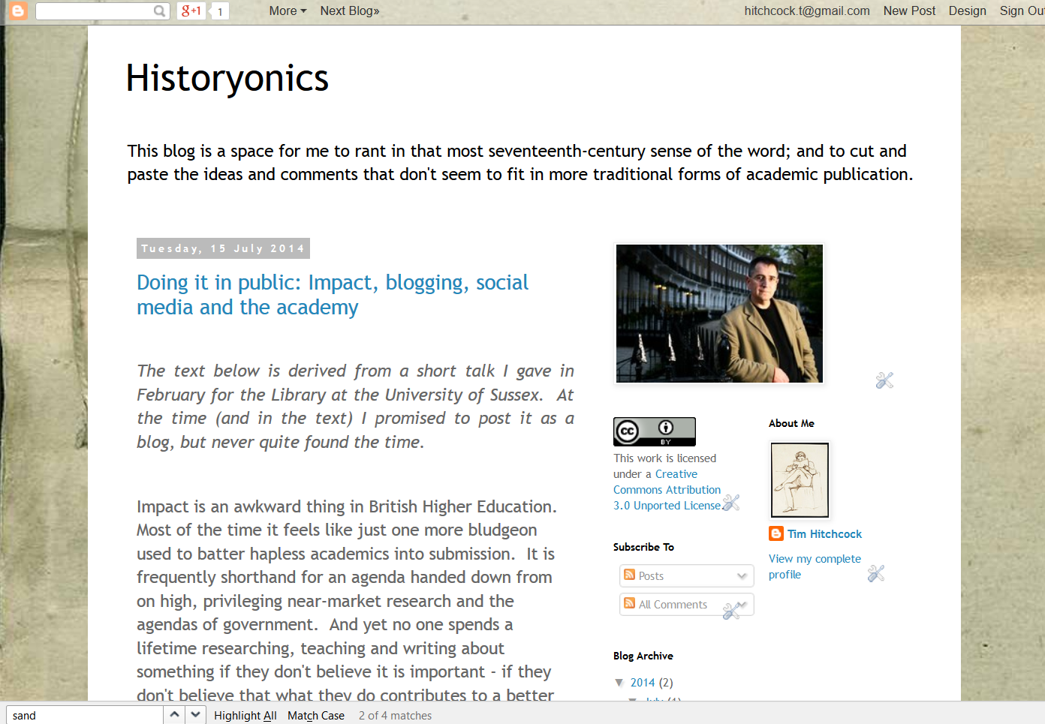
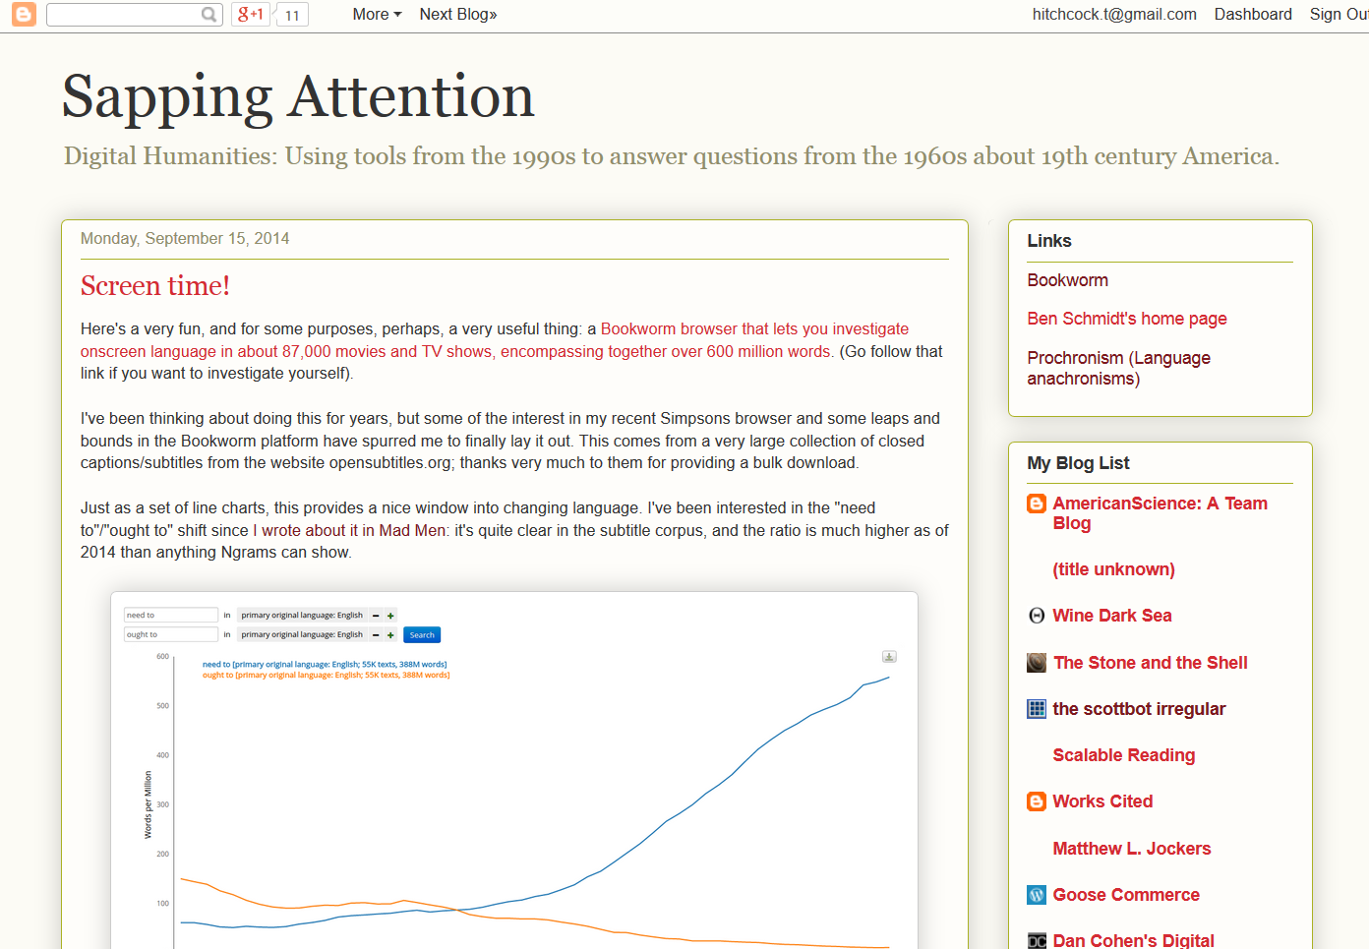
http://manyheadedmonster.wordpress.com/
http://historycarnival.org/
http://historytoday-navickas.blogspot.co.uk/
http://convictionblog.com/
http://historyonics.blogspot.co.uk/
http://sappingattention.blogspot.co.uk/

Slide 26
http://www.pinterest.com/pin/96334879505254519/

Slide 27
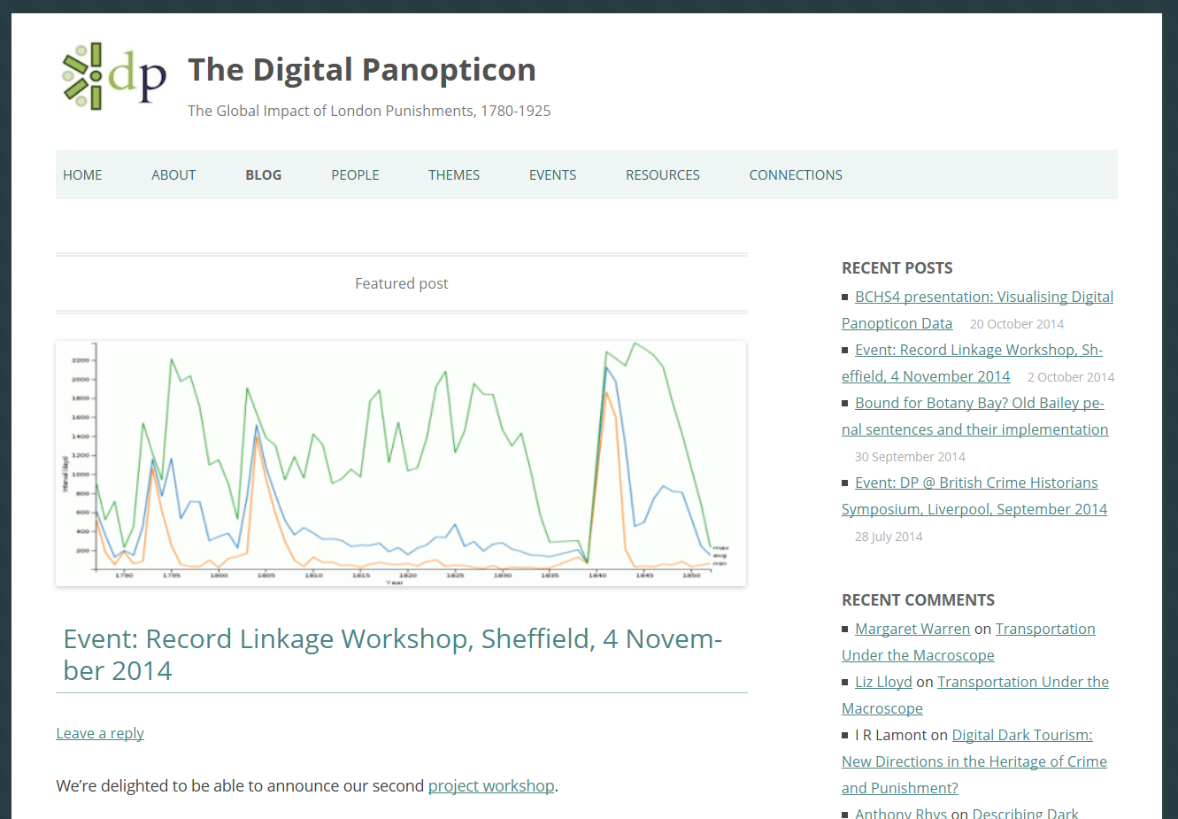
http://www.digitalpanopticon.org

Slide 28
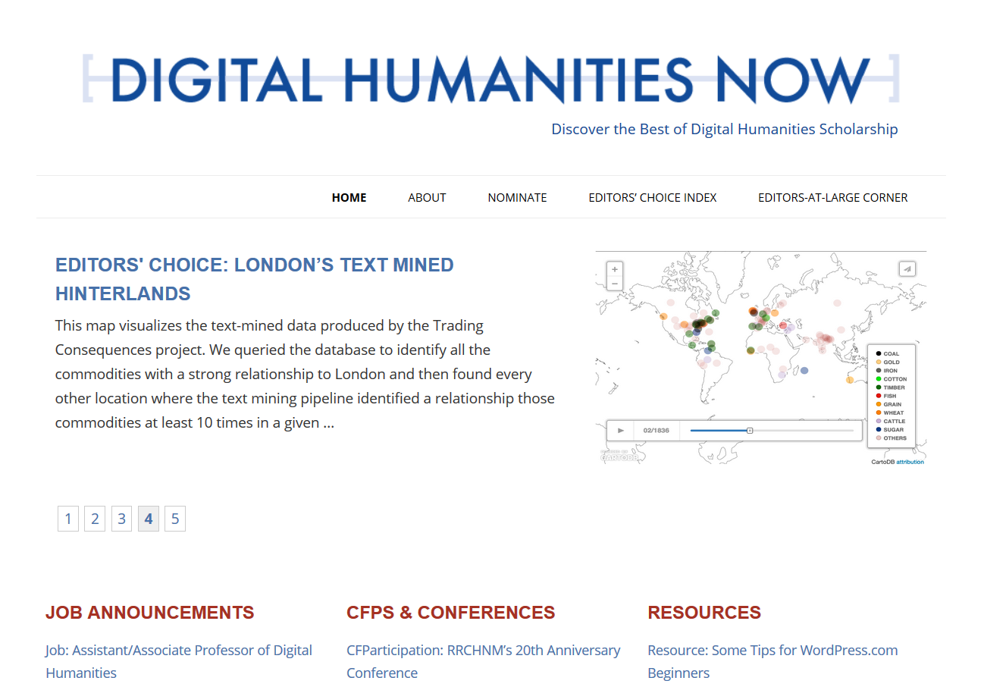
http://www.pbs.plymouth.ac.uk/solon/journal.htm
http://digitalhumanitiesnow.org/

Slide 29
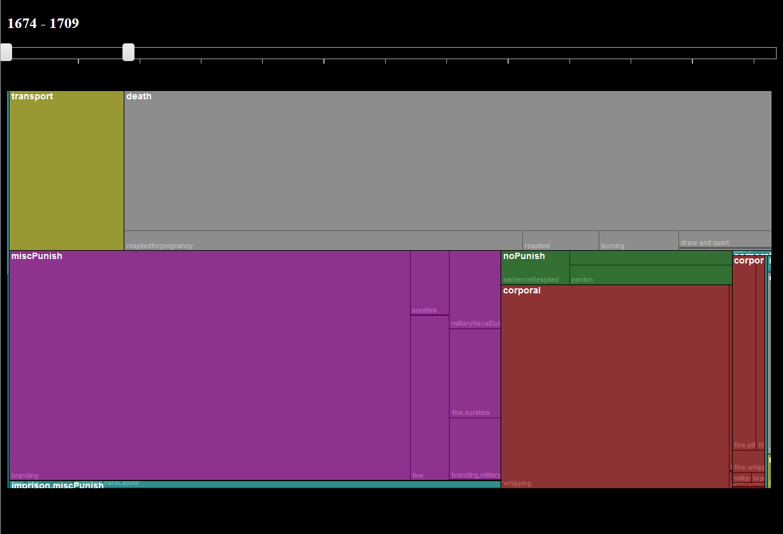
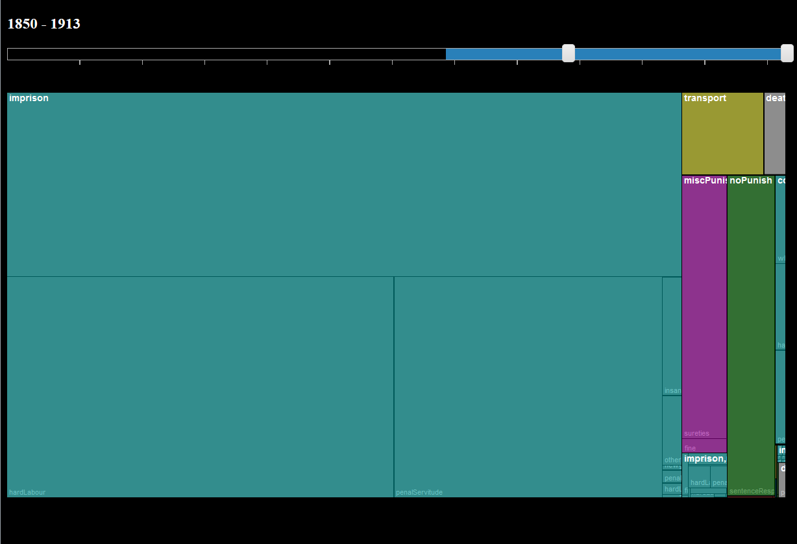
http://hrionline.ac.uk/digipan/ob_pun_treemap_v2.html
1674-1709
The Distribution of
Punishment Sentences,
1674- 1709 vs 1850-1913
1900-1913

Slide 30
http://hrionline.ac.uk/digipan/ob_pun_treemap_v2.html
1674-1709
The Distribution of
Punishment Sentences,
1674- 1709 vs 1850-1913
1900-1913
Sarah Durrant

Slide 31
Destinations of transportees by decade

Slide 32
Société Typographique de Neuchâtel http://fbtee.uws.edu.au/stn/interface/

Slide 33
Sales destinations for the Encyclopédie

Slide 34
Questions?

