Slide 1
Echoes of the Big Bang
Carolin Crawford
Gresham Professor of Astronomy
NASA, ESA
Notes:
Planck/ESA

Slide 2
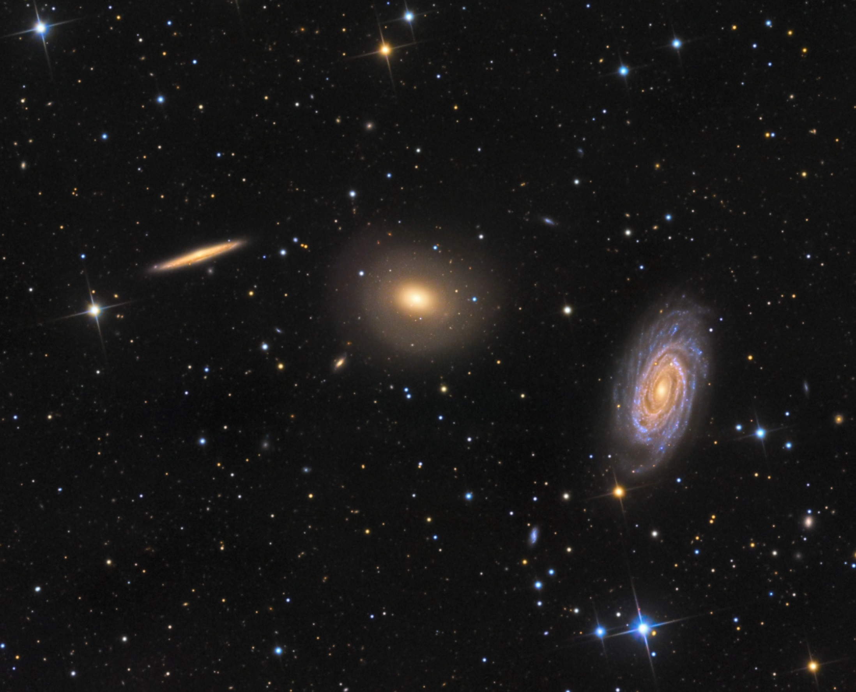
Stephen Leshin
Notes:
Credit Stephen Leshin

Slide 3
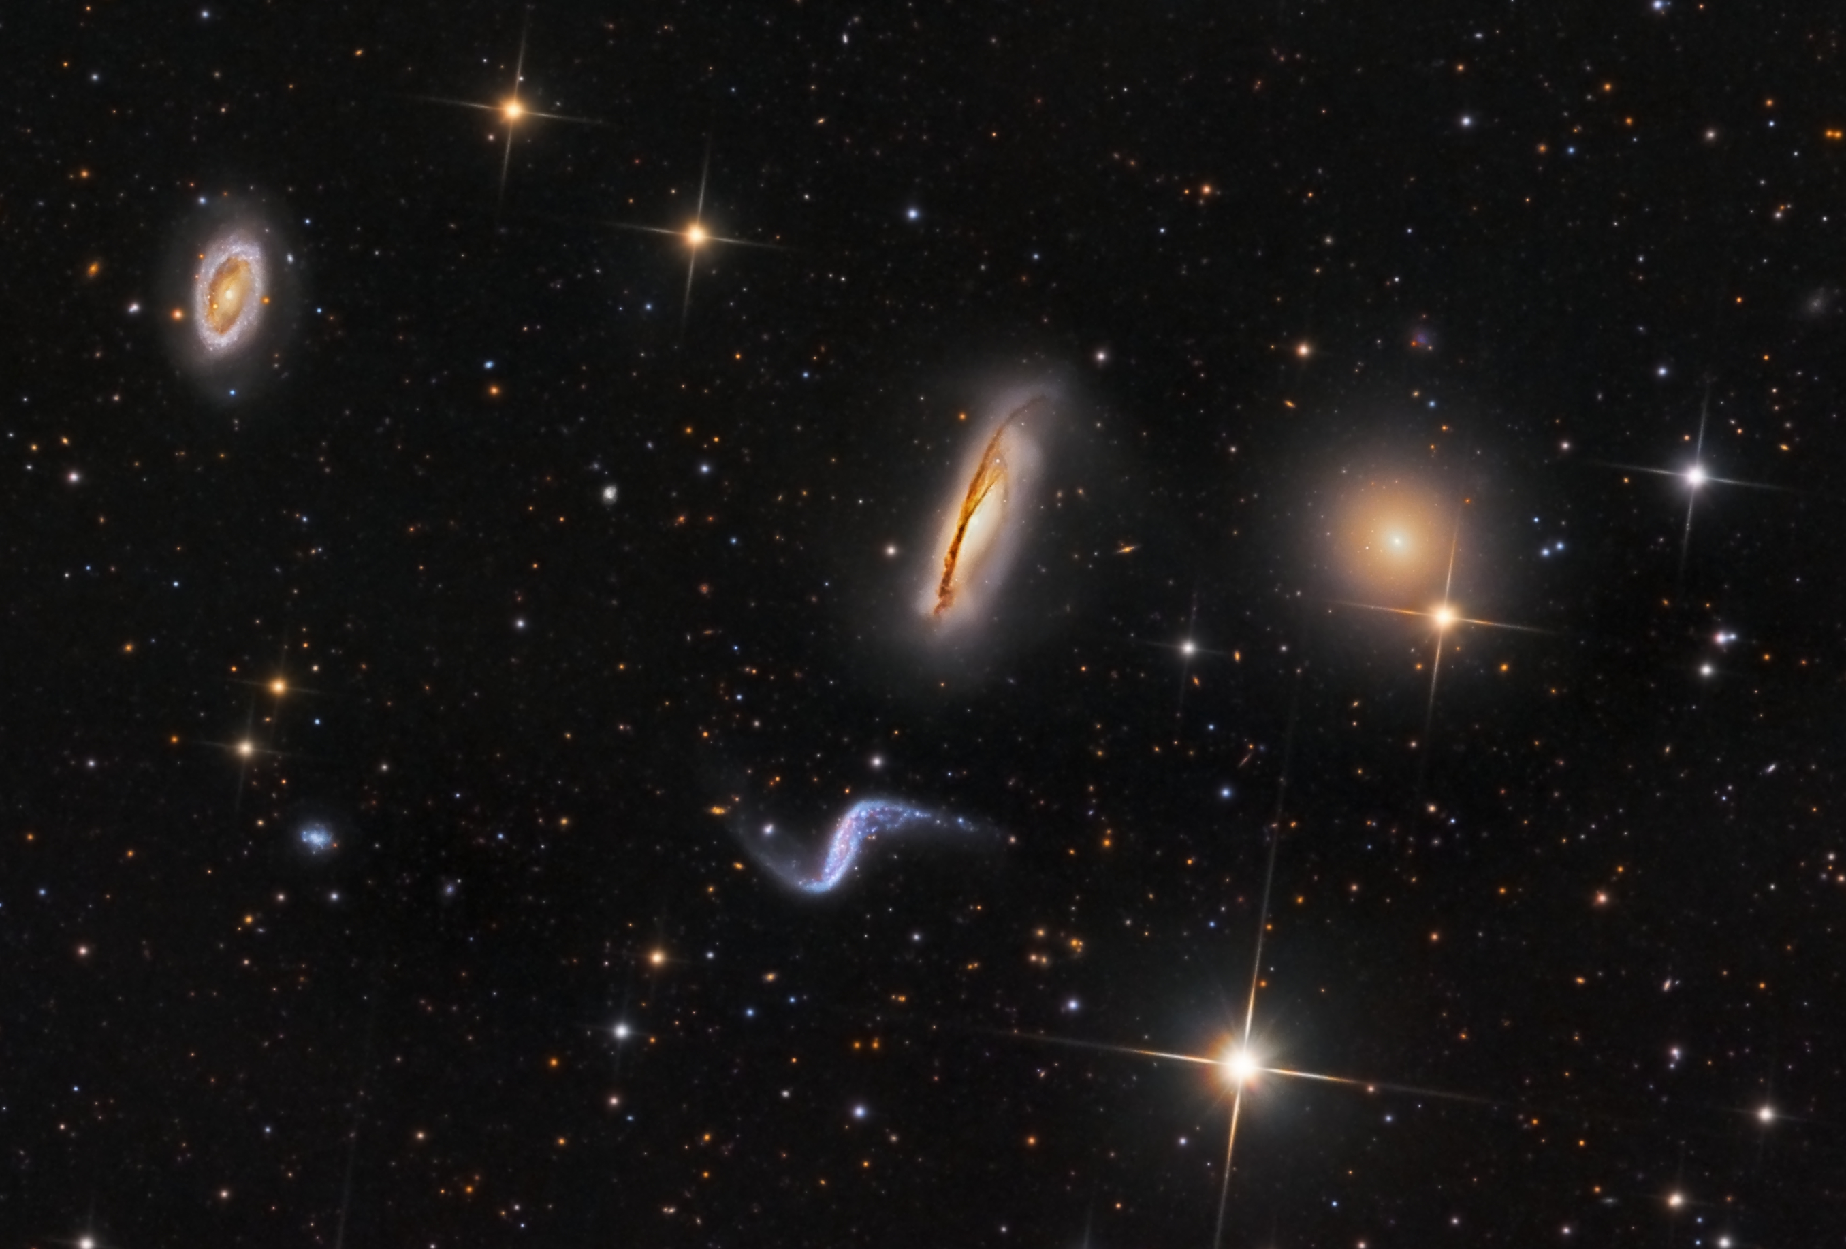
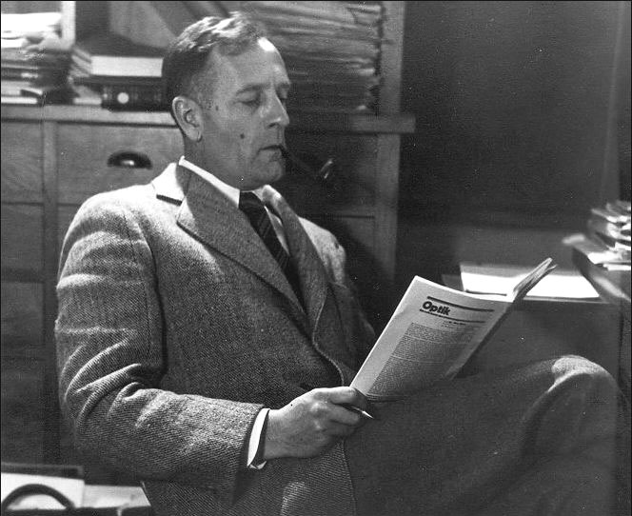
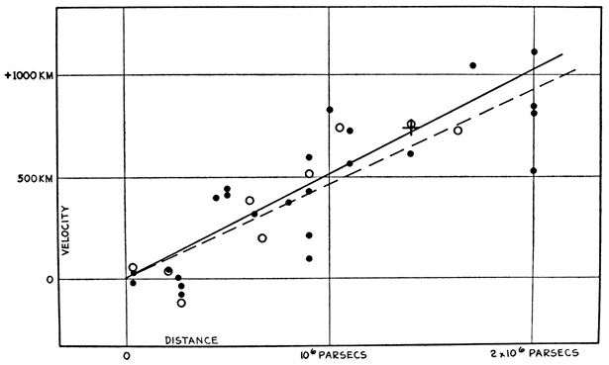
Edwin Hubble
Stephen Leshin
Notes:
Credit for background image : Stephen Leshin

Slide 4
Stephen Leshin
Notes:
Credit for background image : Stephen Leshin

Slide 5
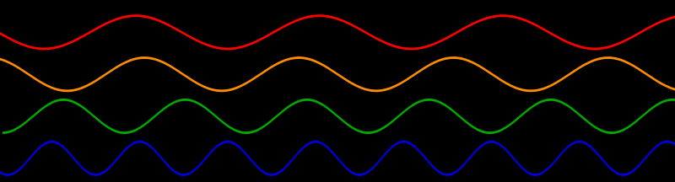
micro-wave
γ-rays
X-rays
UV
IR
radio
short wavelength
long wavelength

Slide 6
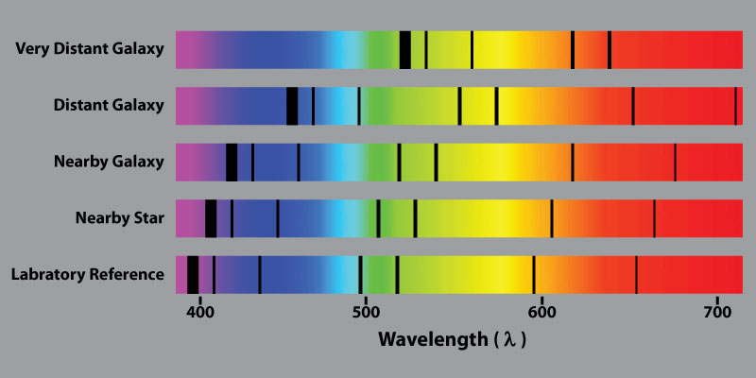
space-exploratorium.com
Notes:
http://space-exploratorium.com/

Slide 7
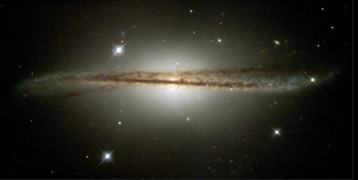
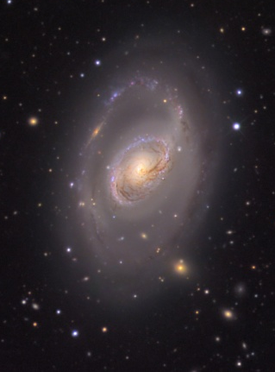
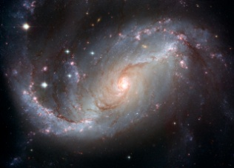
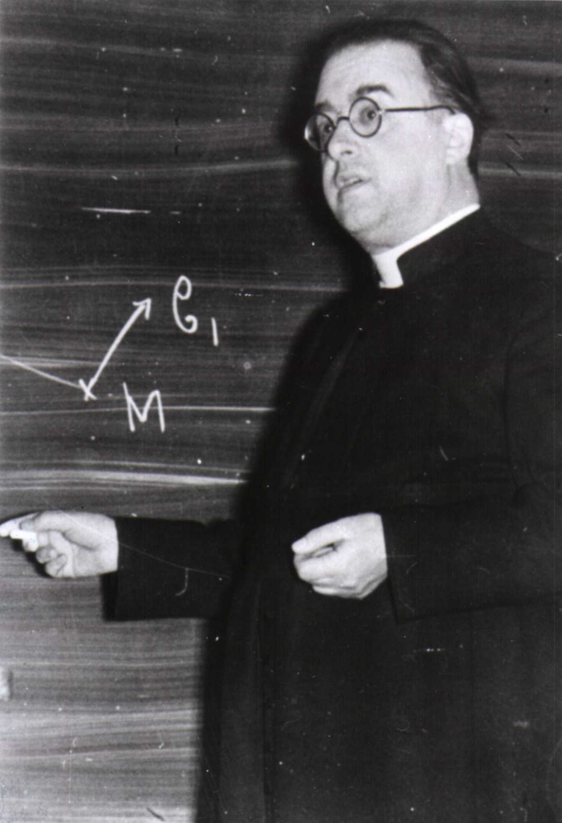
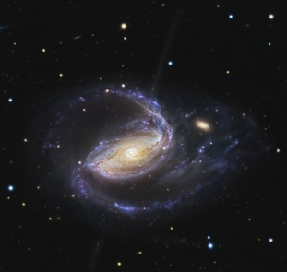
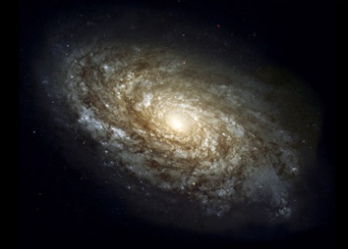
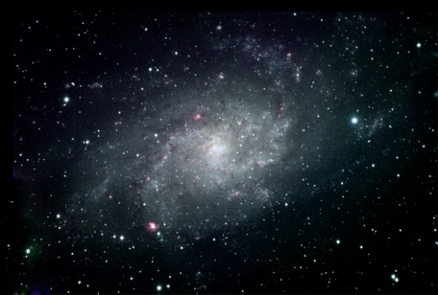
The ‘Big Bang’
Georges Lemaitre
Fred Hoyle
The ‘primeval atom’

Slide 8
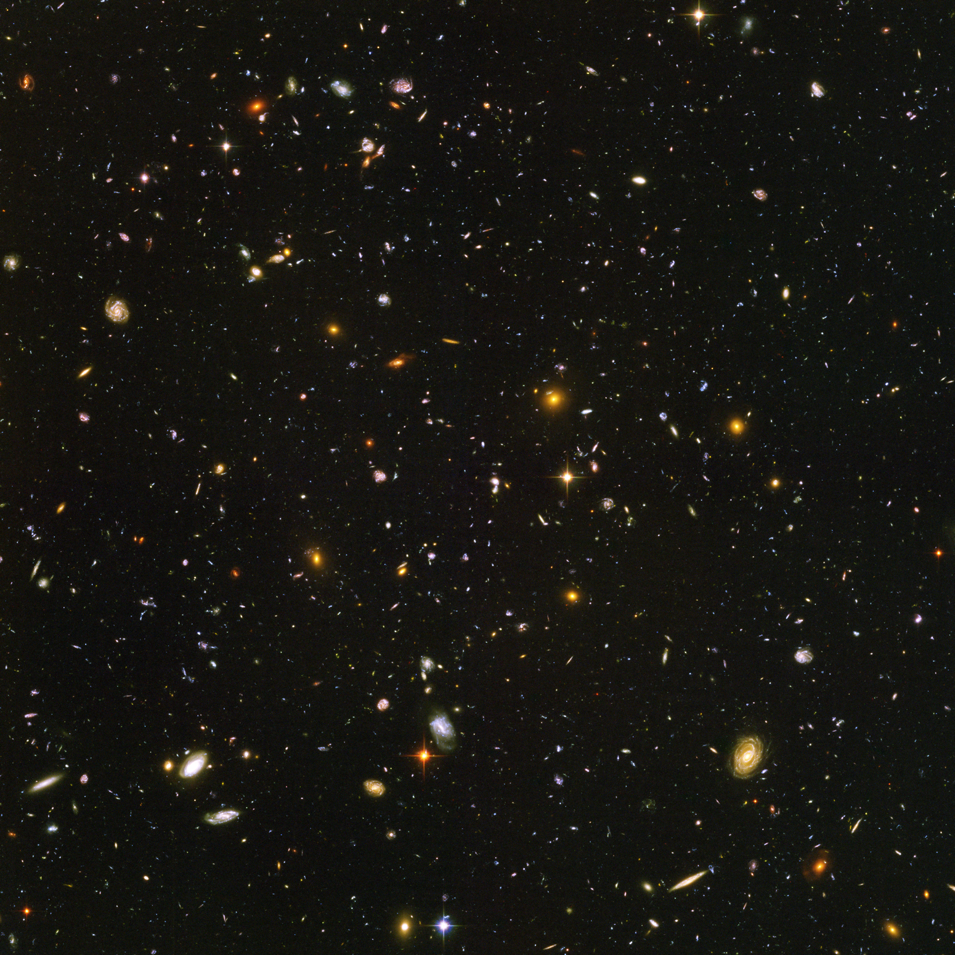
Cosmological principle
The Universe is isotropic and homogeneous
Georges Lemaitre
Fred Hoyle
NASA/ESA/Illingworth et al
Notes:
Background image: NASA, ESA, G. Illingworth (University of California, Santa Cruz), R. Bouwens (University of California, Santa Cruz, and Leiden University)

Slide 9
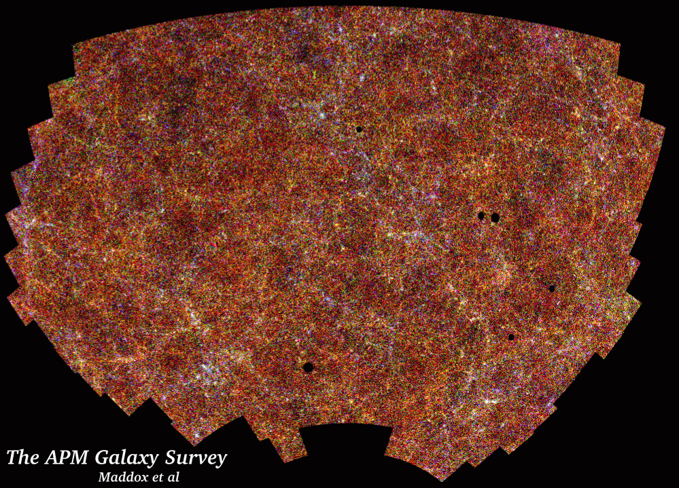
Maddox et al
Notes:
APM Galaxy Survey Maddox et al

Slide 10
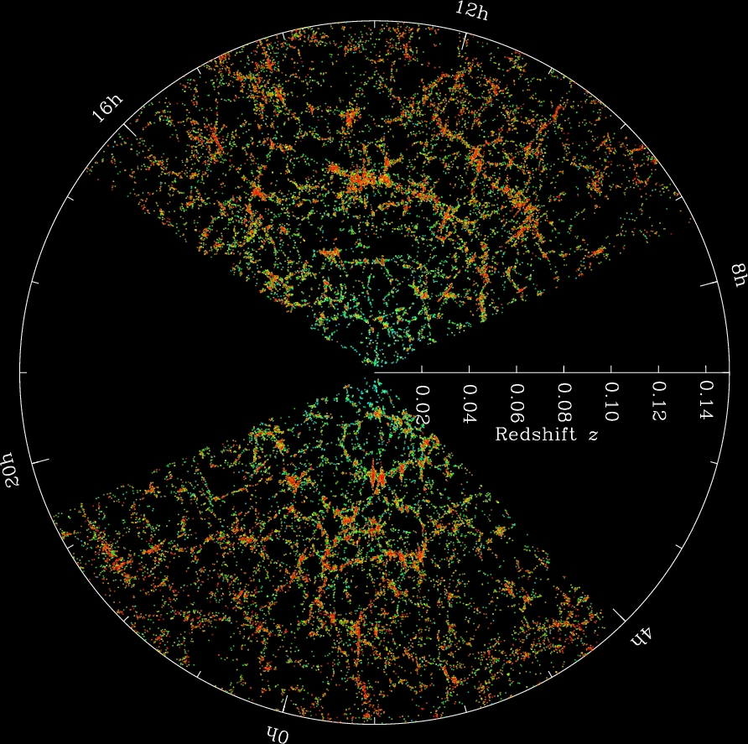
SDSS / Blanton
Notes:
Credit: M. Blanton and the Sloan Digital Sky Survey.

Slide 11
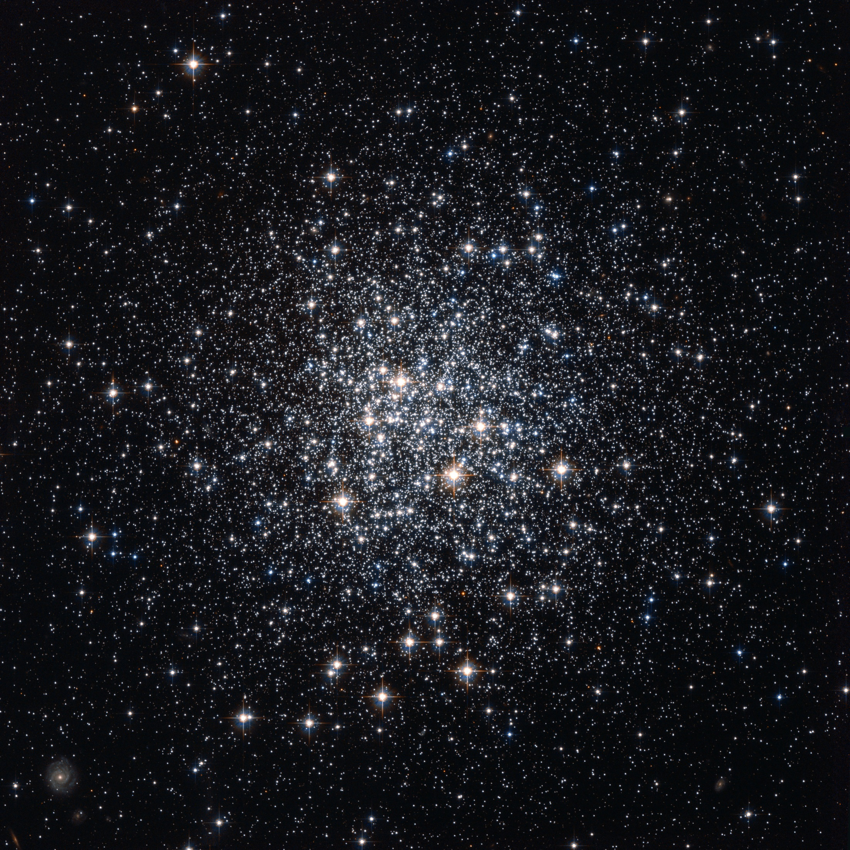
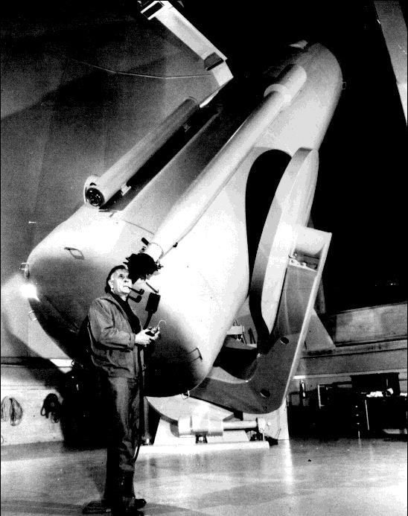
1.8 billion years
NASA/ESA
Notes:
Background image
Credit: NASA, ESA, Hubble, HPOW

Slide 12
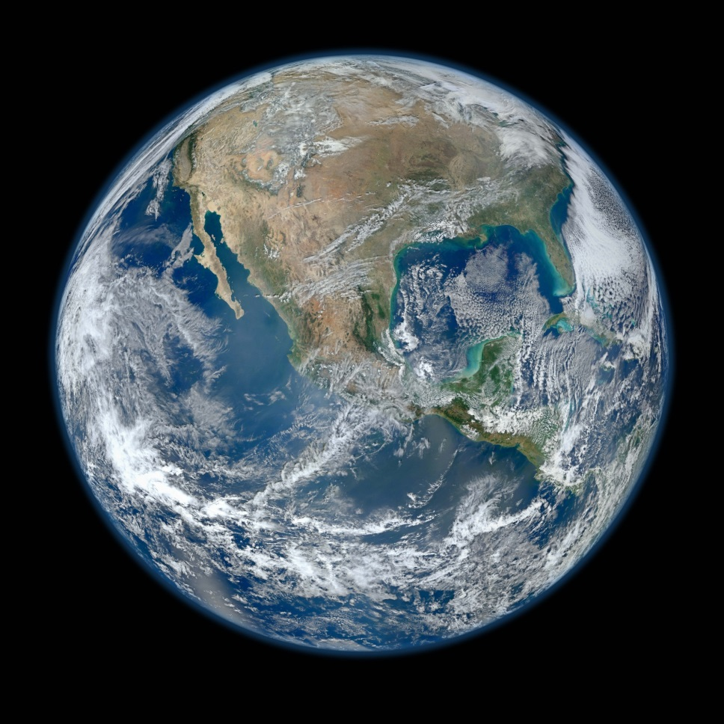
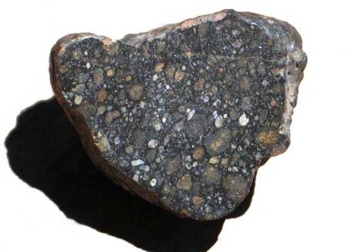
1.8 billion years
3-4 billion years
NASA/NOAA/GSFC/Suomi NPP/VIIRS/Norman Kuring
Notes:
Earth image: NASA/NOAA/GSFC/Suomi NPP/VIIRS/Norman Kuring

Slide 13
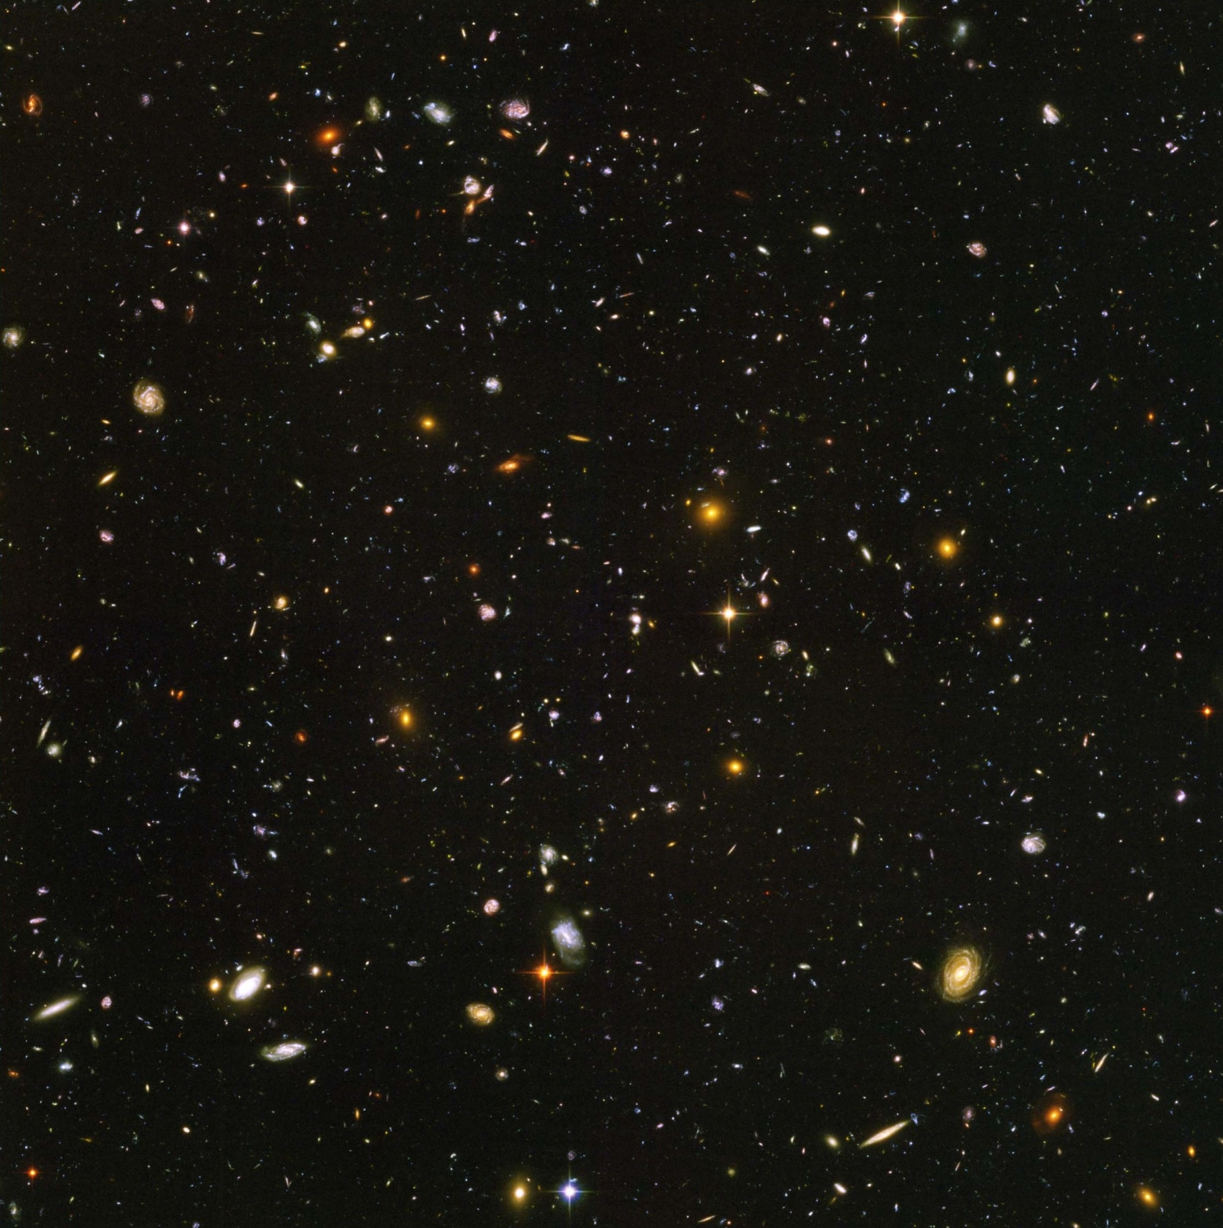
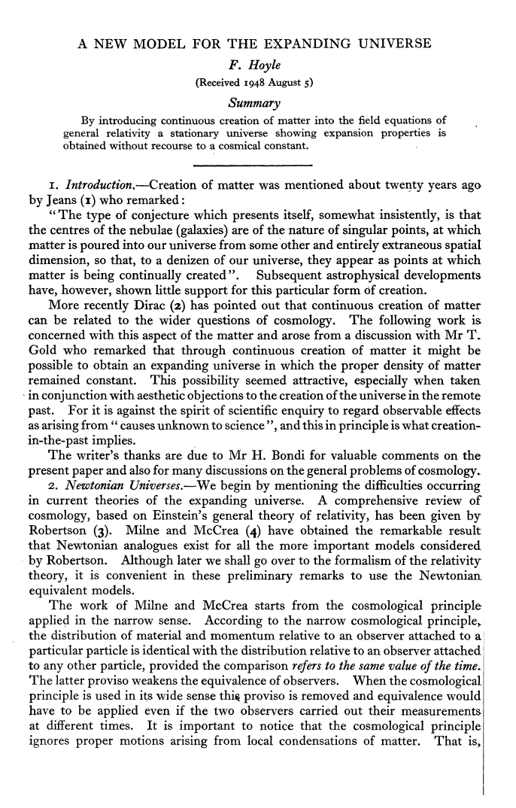
Cosmological principle
The Universe is isotropic and homogeneous
…in time as well as space
NASA/ESA/Illingworth et al

Slide 15
Radio source number counts
Steady State Universe
Time and place are unimportant
The distant Universe resembles the local
Big Bang Universe
Time is important; the Universe changes and evolves
The distant Universe is younger than the local
Observed distant radio sources as they were in the past
count numbers of radio sources at different brightnesses

Slide 16
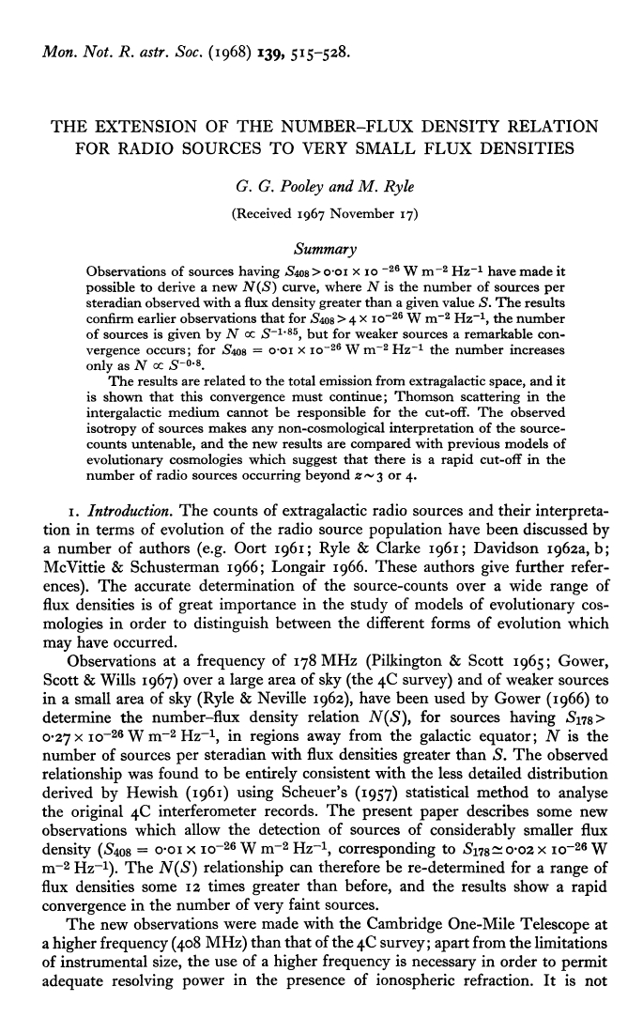
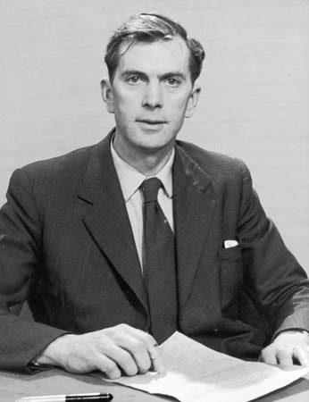
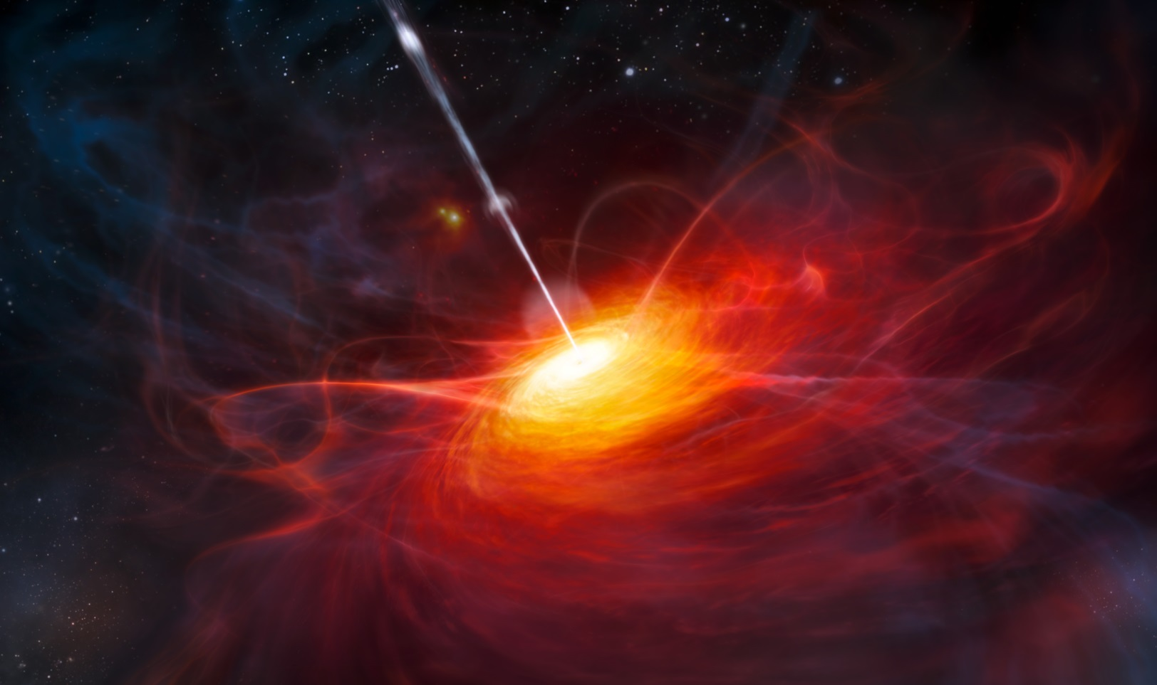
Martin Ryle
ESO/M Kornmesser
Notes:
Credit: for quasar drawing ESO/M. Kornmesser

Slide 17
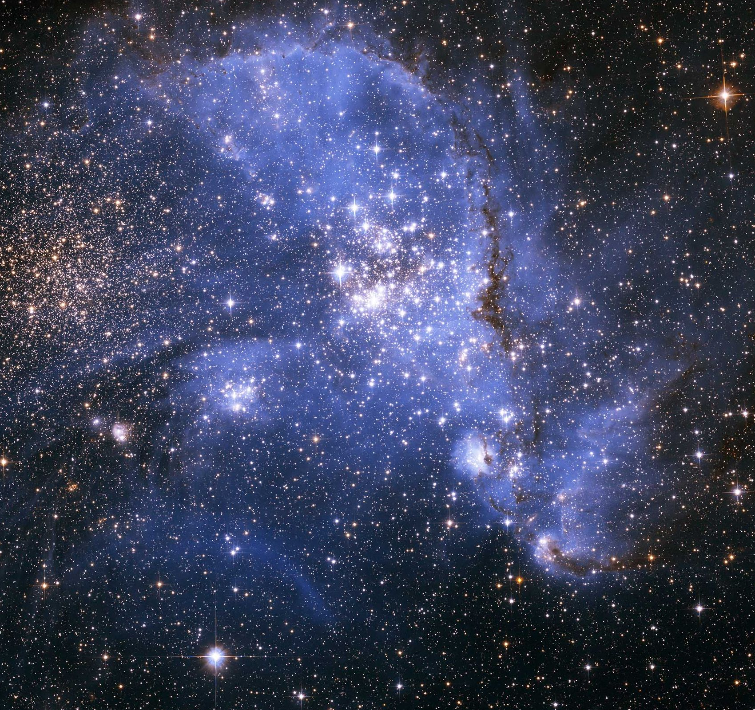
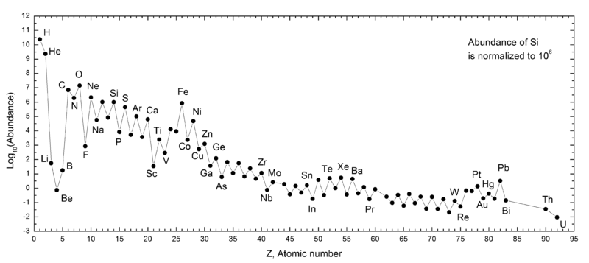
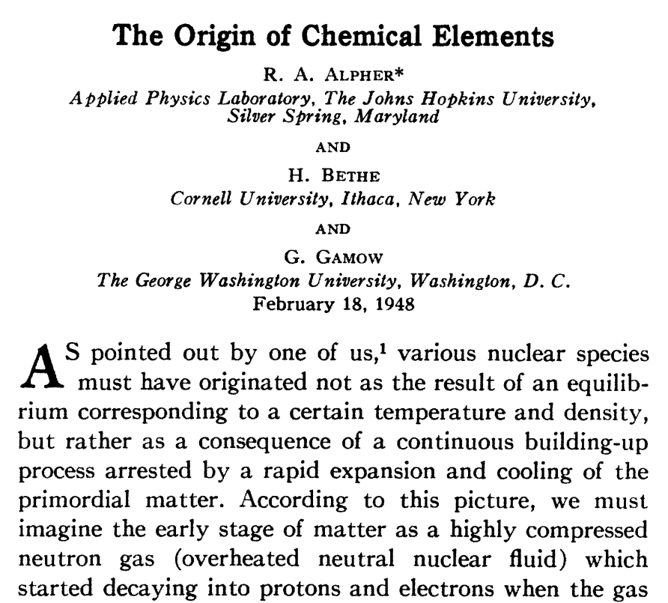
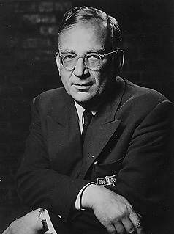
George Gamow
The origin of the chemical elements
NASA/ESA/Nota
Notes:
Credit: NASA, ESA and A. Nota (STScI/ESA) background image
Plot of estimated abundances of the chemical elements of the solar system from Wikipedia

Slide 18
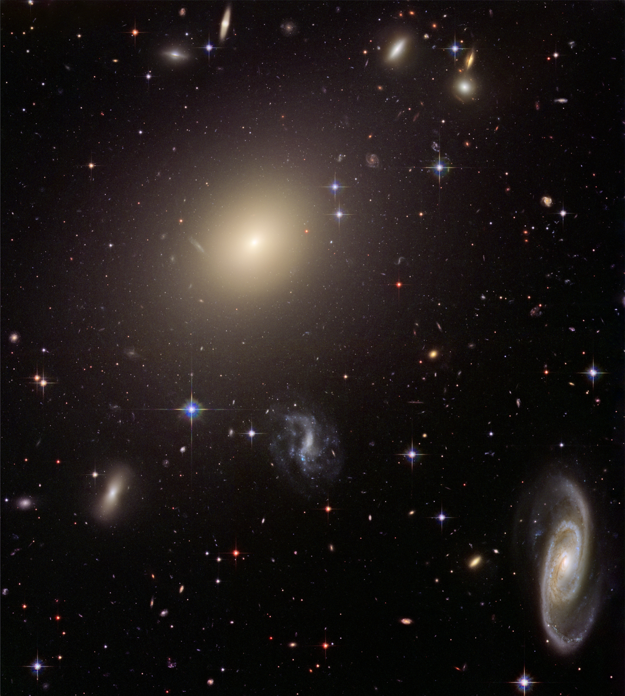
The Helium problem
NASA/ESA
Notes:
Credit: NASA, ESA, and The Hubble Heritage Team (STScI/AURA)

Slide 19
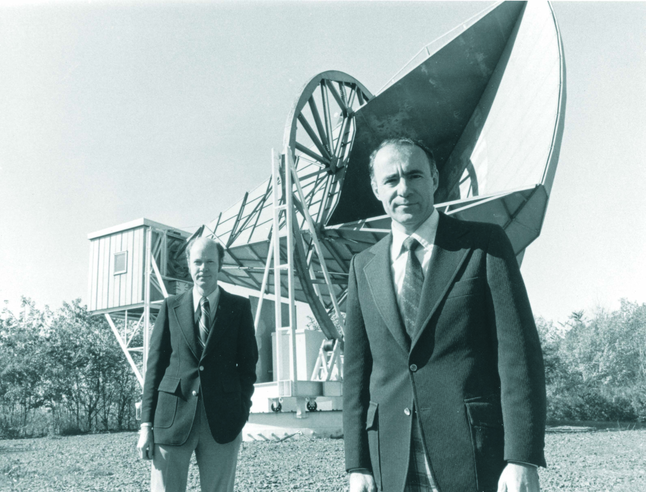
The discovery of the
cosmic microwave
background
Arno Penzias & Robert Wilson

Slide 20
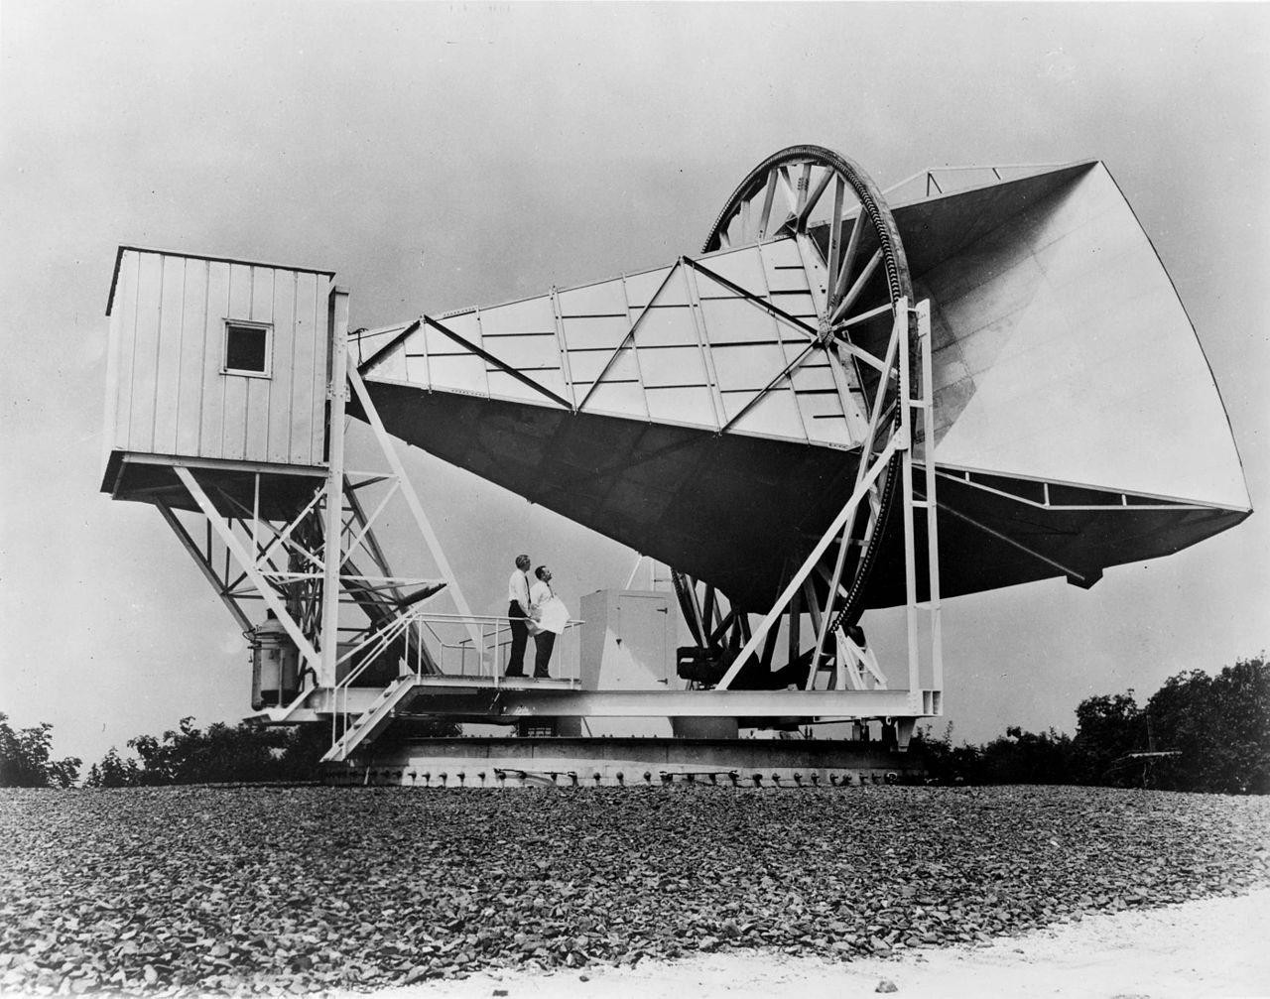
Notes:
NASA

Slide 21
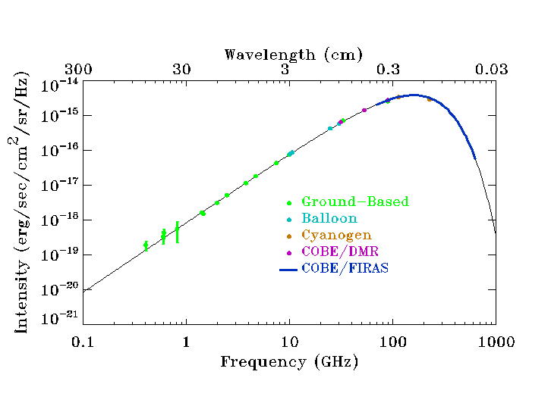
Intensity
0.03 0.3 3 30 300
Wavelength (cm)
NASA
Notes:
nasa

Slide 22
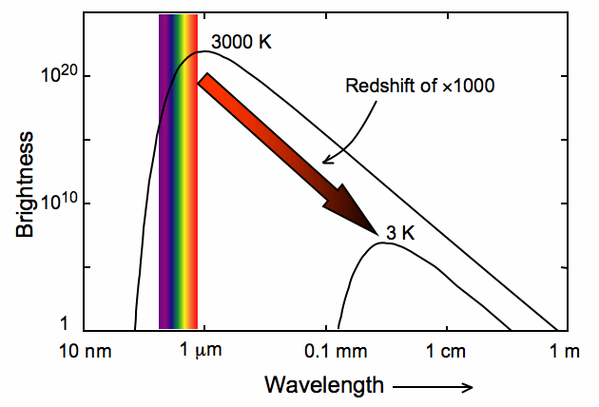
Notes:
Provenance of plot unknown, apologies

Slide 23
Intensity
0.03 0.3 3 30 300
Wavelength (cm)
NASA

Slide 24
Notes:
Provenance of plot unknown, apologies

Slide 25
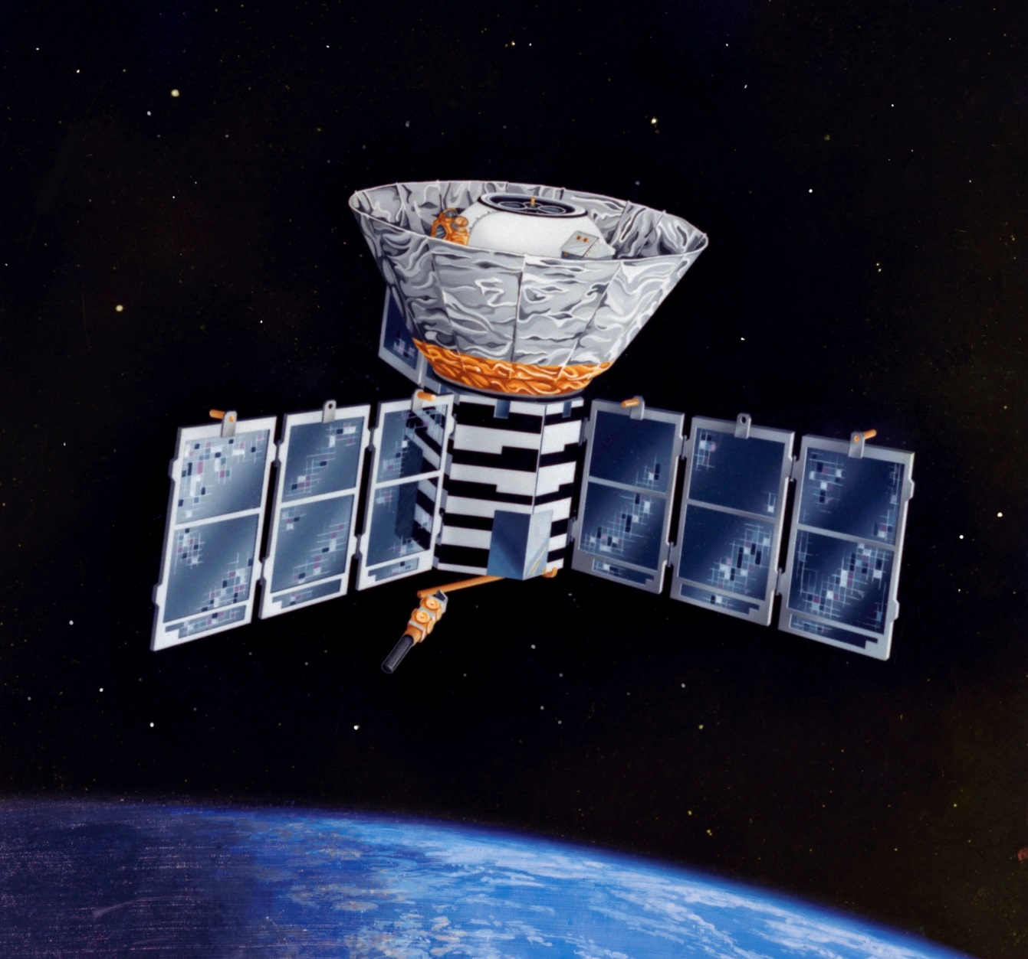
COBE 1989
FIRAS
NASA

Slide 26
FIRAS
Intensity
0.03 0.3 3 30 300
Wavelength (cm)
NASA
Notes:
nasaIntensity of CMB radiation measured by various techniques
Both x and y axes plotted logarithmically
Shallow slope at LHS is RJ regime
Steeper slope at shorter wvelengths is the Wien regime
Deviation from a perfect black body is less than 50 parts per million

Slide 27
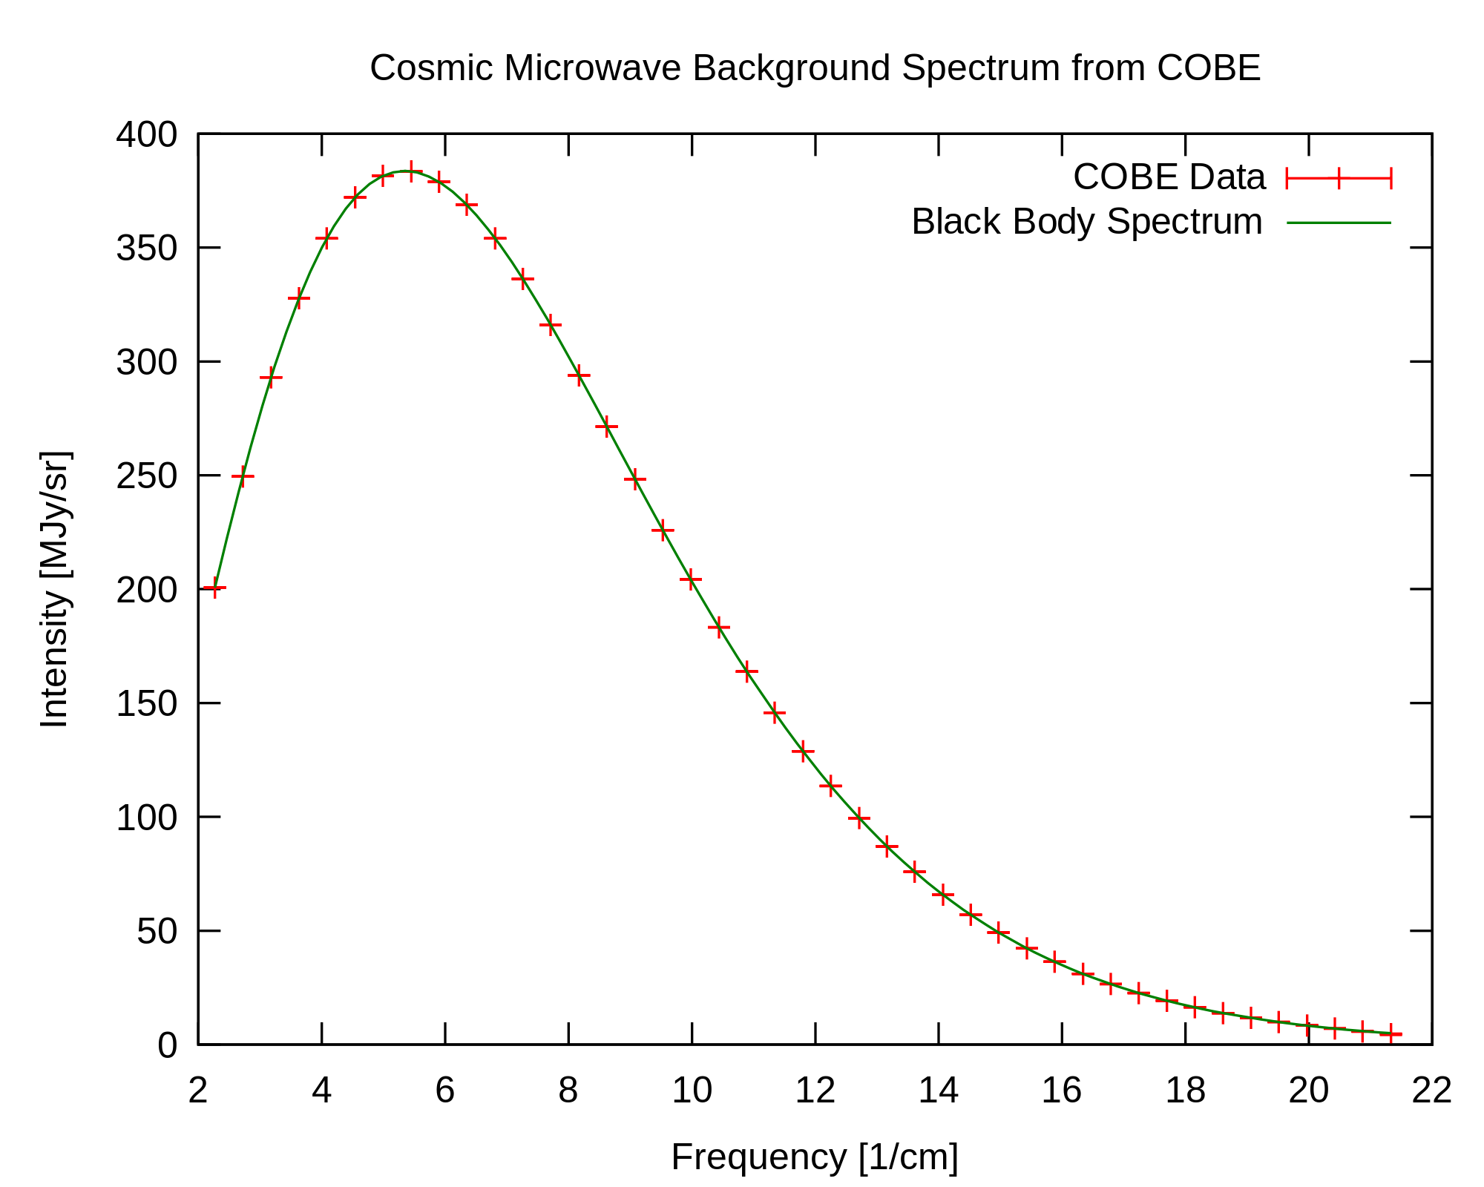
NASA
Notes:
nasa

Slide 28
COBE
Anisotropies
DMR
Temperature variations = density fluctuations
NASA
Notes:
COBE science working group / NASA

Slide 29
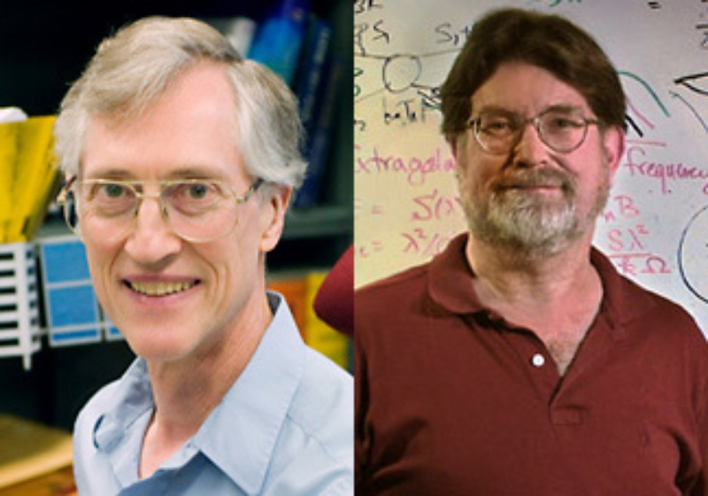
COBE
John Mather George Smoot
NASA

Slide 30
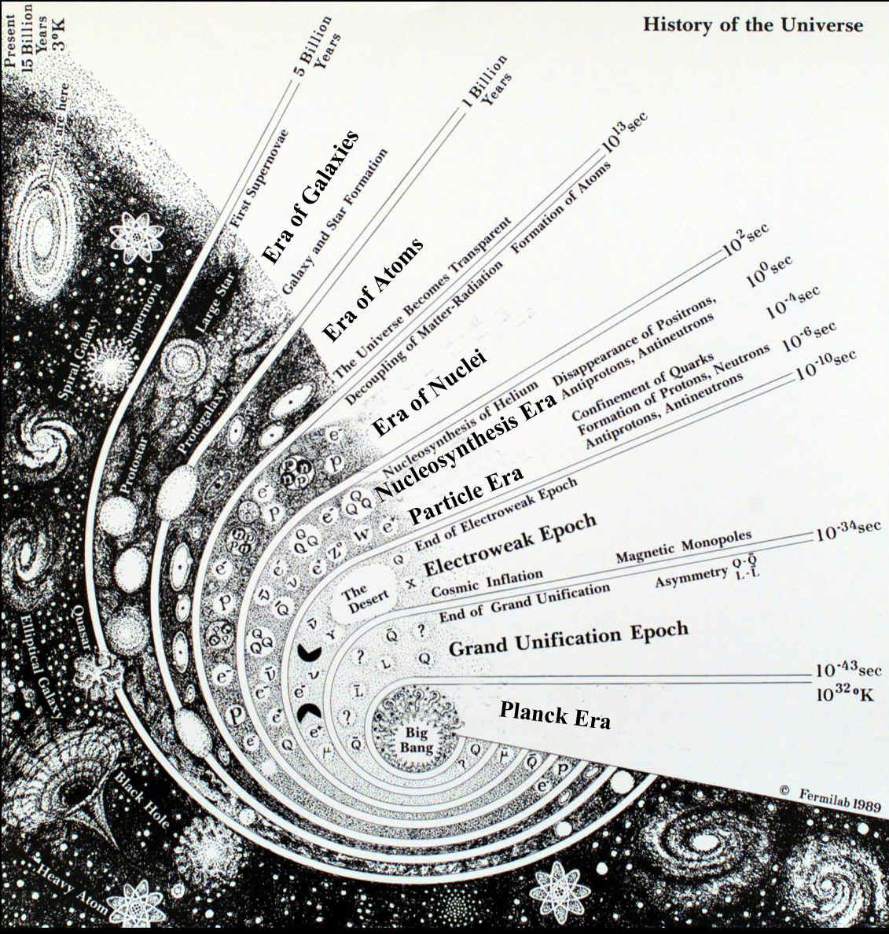
Fermilab
Notes:
Credit Fermilab

Slide 31
The flatness problem
Notes:
mage credit: Ned Wright's

Slide 32
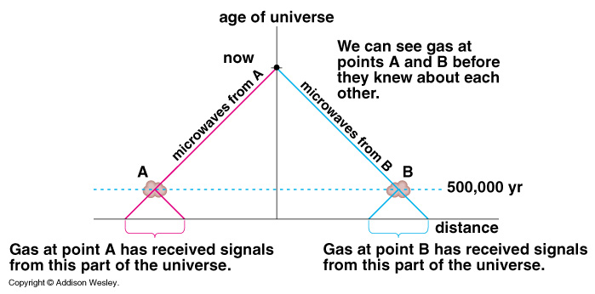
The horizon problem
Addison Wesley
Notes:
Addison Wesley

Slide 33
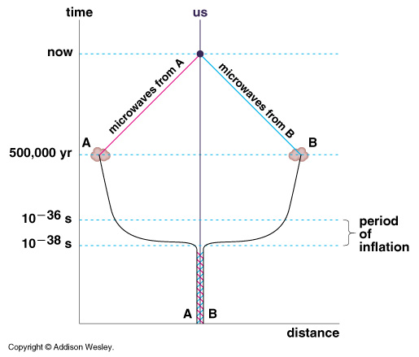
The horizon problem
Addison Wesley
Notes:
Addison Wesley

Slide 34
CMBR
Radiation-dominated era
Fermilab
Notes:
Credit Fermilab

Slide 35
Notes:
Apologies, provenance of plot unknown

Slide 36
CMBR
baryon-radiation fluid
Radiation-dominated era
Fermilab
Notes:
Credit Fermilab

Slide 37
Temperature variations = density fluctuations
NASA

Slide 38
ordinary matter pulls together under gravity
radiation pressure of photons pushes outwards
dark matter clusters under gravity
the ordinary (baryonic) matter bounces to create oscillations in the density
W Hu

Slide 39
Temperature variations = density fluctuations
NASA

Slide 40
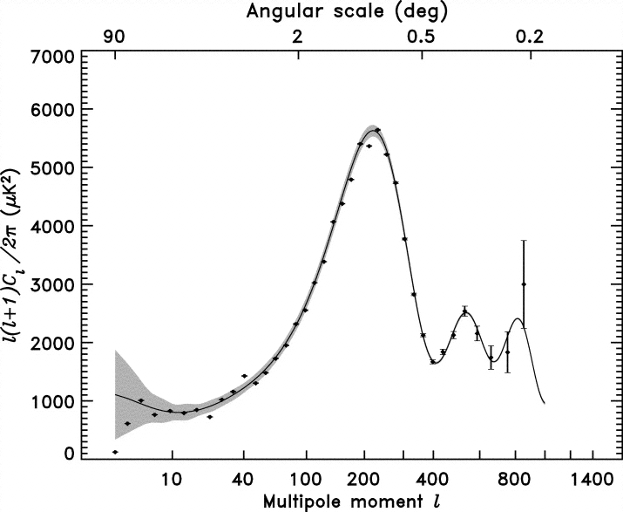
The Power Spectrum
WMAP Hinshaw et al
Notes:
Hinshaw et al
Final angular power spectrum from WMAP
solid line shows the best-fit CDM model from Spergel et al.
gray band around the model is the 1 uncertainty due to cosmic variance on the cut sky

Slide 41
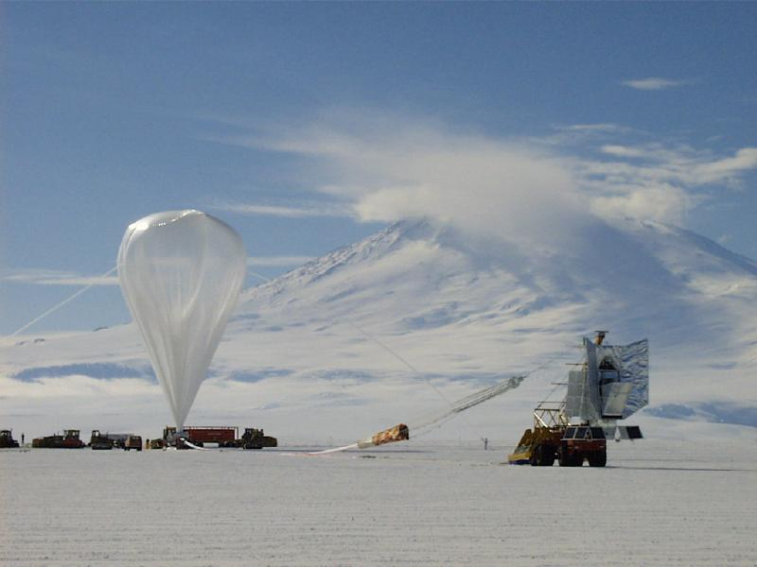
BOOMERanG experiment

Slide 42
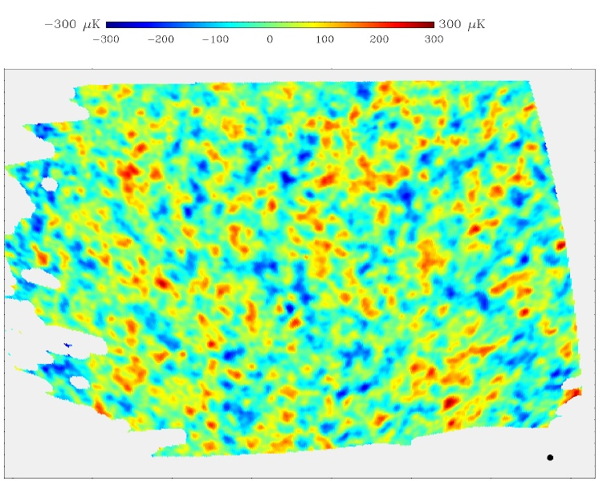
BOOMERanG experiment

Slide 43
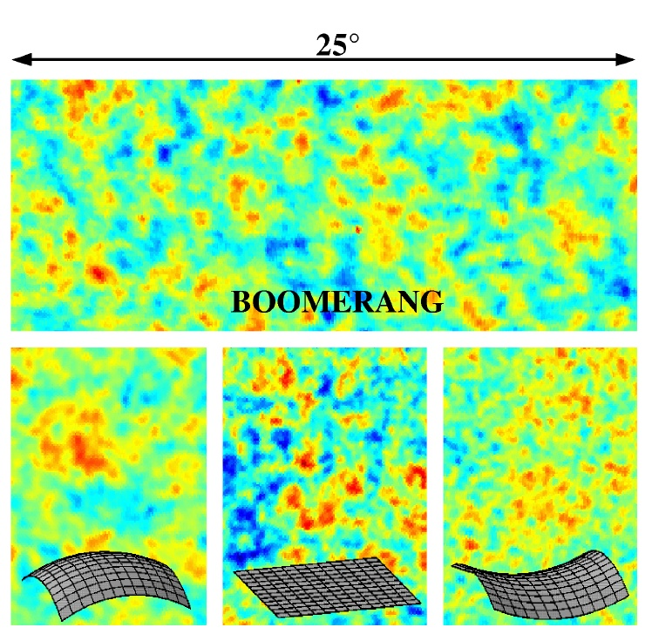
BOOMERanG experiment

Slide 44
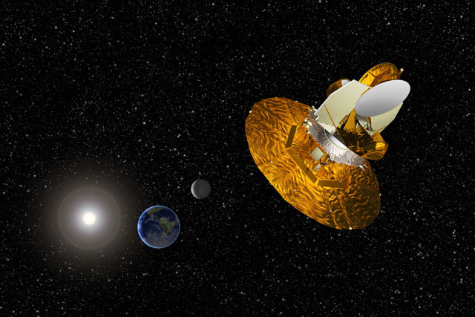
WMAP 2001
NASA

Slide 45
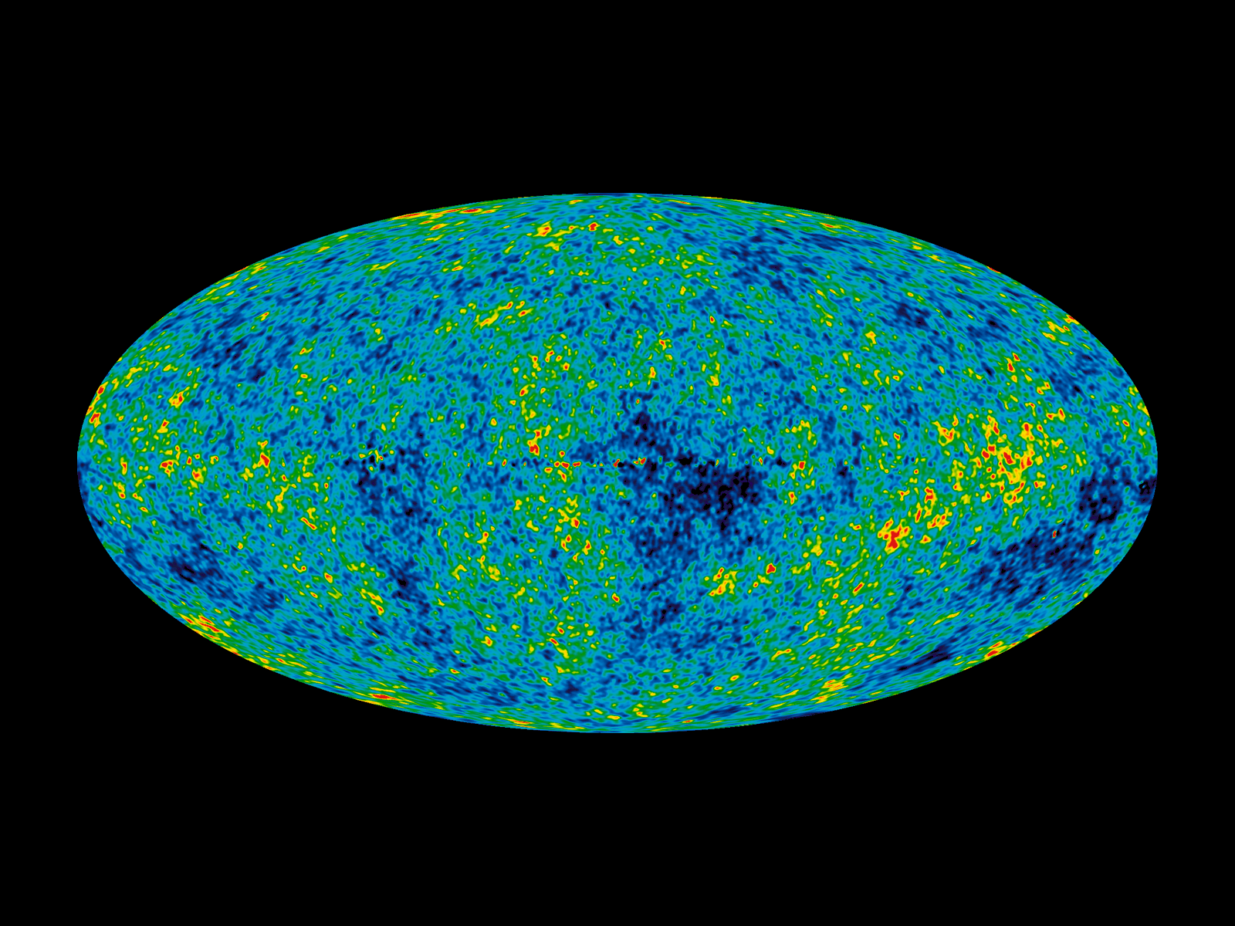
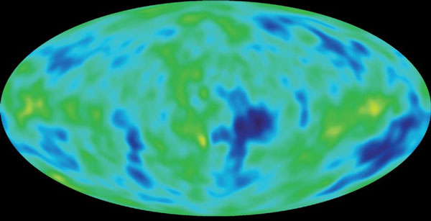
WMAP
COBE
NASA

Slide 46
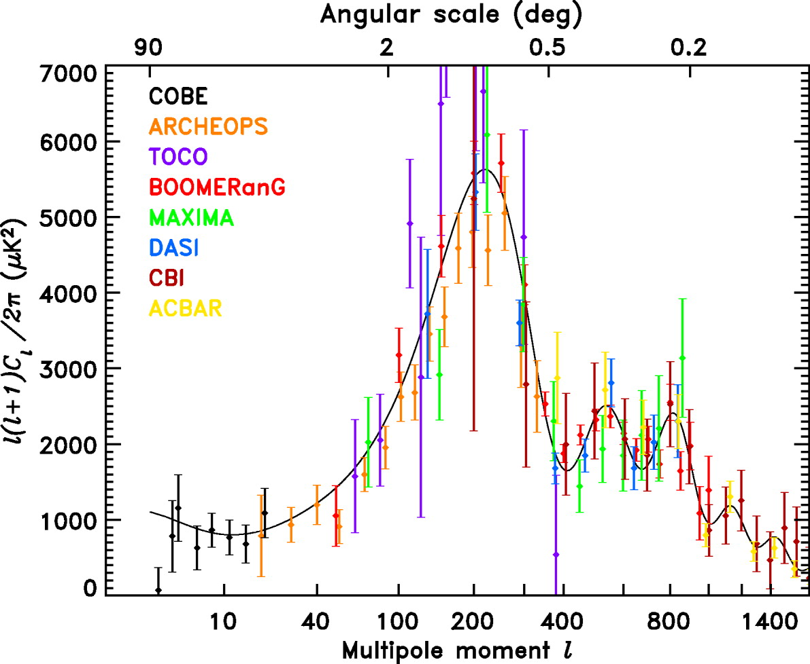
WMAP Hinshaw et al
Notes:
Hinshaw et al

Slide 47
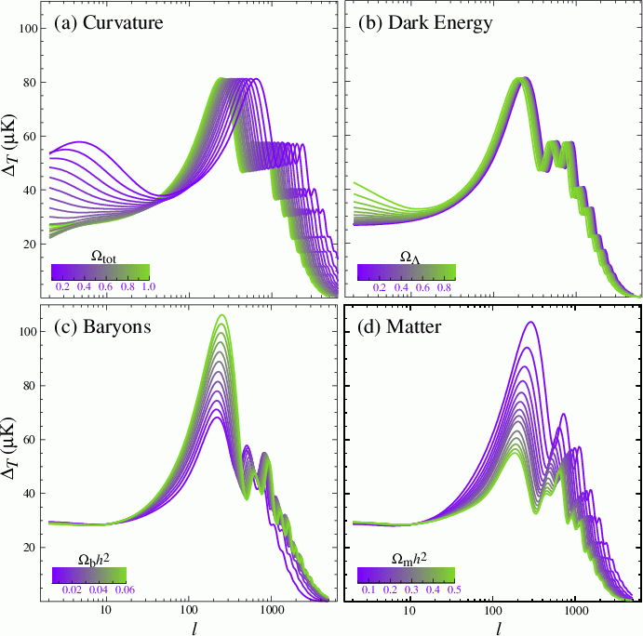
Total matter content (curvature of space)
Dark energy
Ω_{Λ}
Ω_{total}
Ordinary matter
Dark + ordinary matter
Ω_{baryons}
Ω_{mass}
Hu & Dodelson
Notes:
Hu & Dodelson 2002

Slide 48
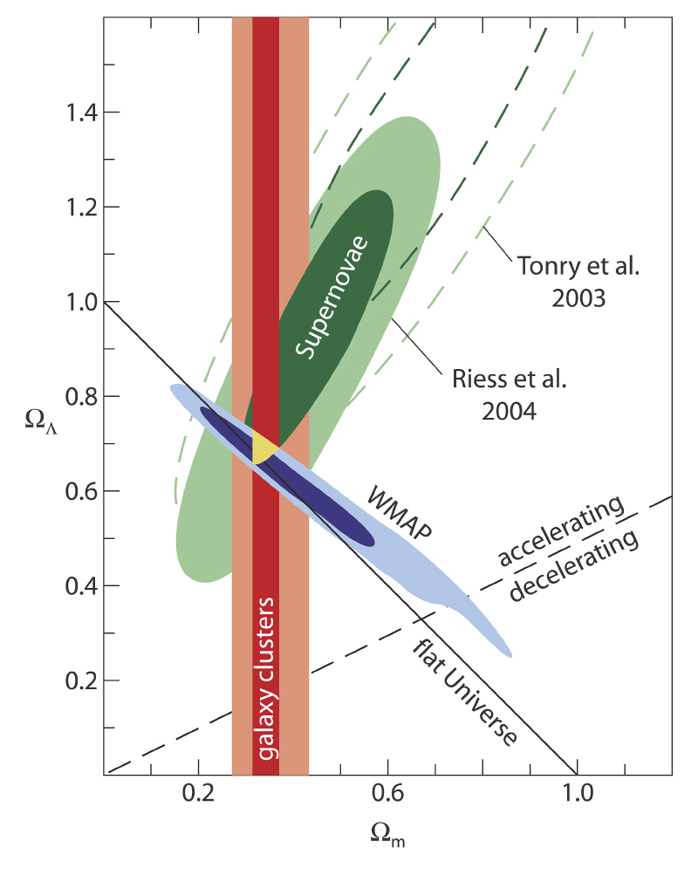
ESO
Notes:
ESO

Slide 49
WMAP
age of Universe 13.772±0.059 billion years

Slide 50
v
NASA/JPL-Caltech/ESA
Notes:
Image credit: NASA/JPL-Caltech/ESA

Slide 51
ESA / Planck collaboration
Notes:
ESA and the Planck Collaboration

Slide 52
Planck
WMAP
ESA / Planck collaboration
Notes:
Credit: NASA / WMAP Science Team
The WMAP 7-year total-intensity image of the CMB after subtraction of the dipole anisotropy and the radio-source foreground. The intensity range is only 200K centered on the mean brightness T0=2725 K.

Slide 53
WMAP
age of Universe 13.772±0.059 billion years

Slide 54
Planck

Slide 55
NASA / WMAP Science team
Notes:
(Image: NASA/WMAP Science Team)

Slide 56
How the Earth Moves
Wed 3rd April 1pm

