Slide 1
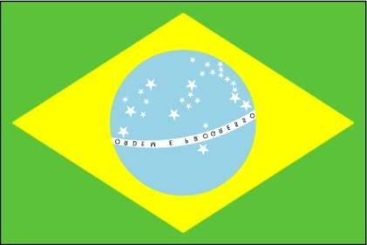
Brazil’s Challenges: Development or Decay?
Presentation to Gresham College (Brazil: Order and Progress) (21/05/15)
A.W. Pereira
Director, Brazil Institute
King’s College London

Slide 2
Outline
1 Images of Brazil
2 Recent economic and political changes
3 The Brazilian state: national-developmentalism; social protection; and lethal violence
4 Three challenges: redistribution, representation, and recognition
Notes:
Brazil’s coat of arms was designed and promulgated a few days after the armed forces deposed Emperor Dom Pedro II and declared the country a republic on the 15th of November, 1889. The branches on each side of the star represent important export crops – coffee on the left, and tobacco on the right. In the blue circle is the Southern Cross, and the ring of stars represents Brazil’s 26 states and 1 Federal district. The official name of the country, the Federative Republic of Brazil, appears on the first blue banner at the bottom of the coat of arms. The name Brazil comes from pau Brasil (Brazilwood), prized by Europeans of the 16th century as an ingredient of red dye for clothing, and the country’s first major export before the development of the sugar industry.

Slide 3
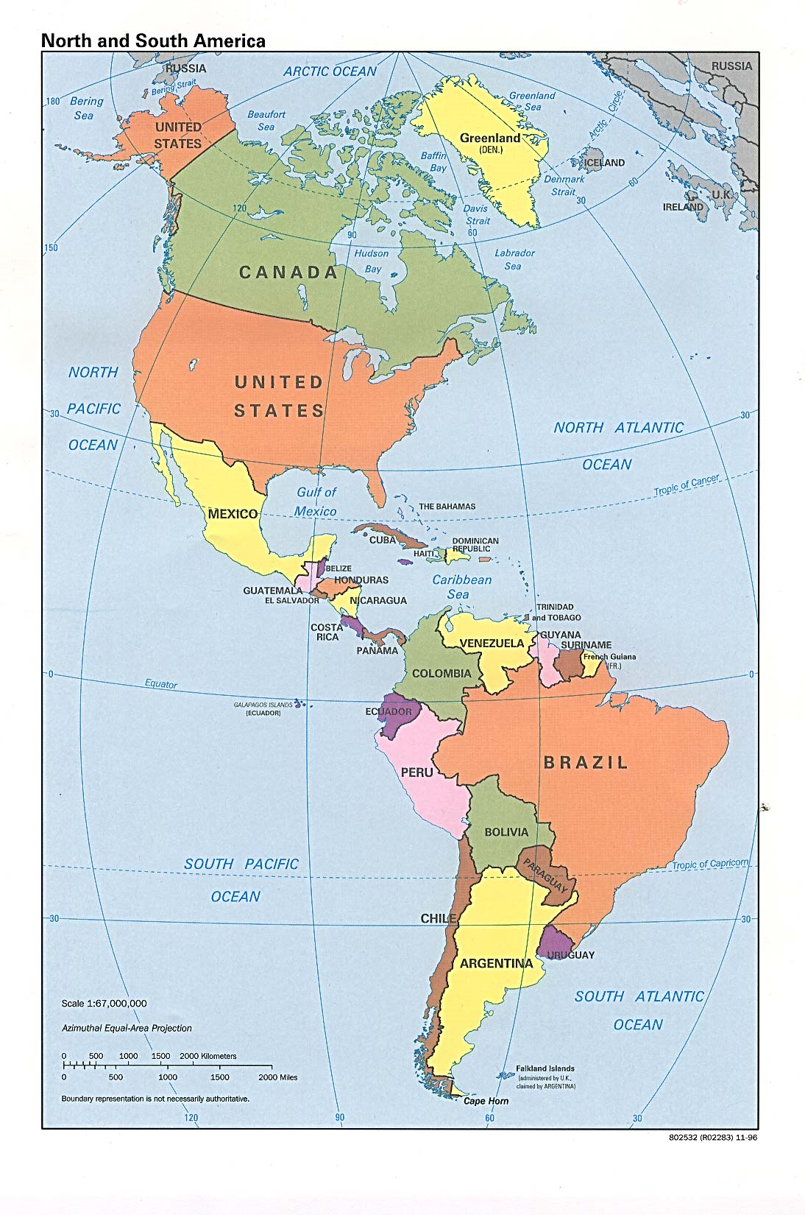
Notes:
Map of Brazil in the Western Hemisphere. Brazil’s territory is larger than the continental USA.

Slide 4
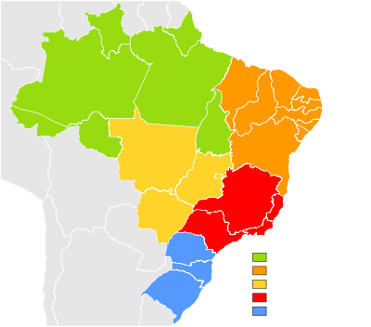

Slide 5
A quote
“Brazil is not for
beginners.”
Tom Jobin
Notes:
Tom Jobin was a carioca (resident of Rio) who composed the music for “Girl from Ipanema” and many other Bossa Nova standards. He formed a songwriting team with the diplomat and poet Vinicius de Moraes. This quote indicates the complexity, diversity, and mutability of Brazil. There is much room for disagreement about Brazil. It may well be that the views expressed here differ considerably from those of one of the current students in the Royal College of Defence Studies – Brazilian Capitao Mar e Guerra Paulo Sergio Camillo de Toledo.

Slide 6
Historical Background
The Brazilian state is a fragment of a seaborne empire (the Portuguese) rather than a land empire.
British Ambassador to Brazil Alex Ellis: “Brazil is an archipelego, not a continent.”
Until recently, 80% of the population (now over 200 million) lived within 200 miles of the Atlantic coast.
For most of the 19th century, Brazil had a monarchy and was the largest slave society in the world.
The Brazilian nation is particularistic (like the UK). Its citizens tend to see the national experience as idiosyncratic, rather than of universal importance as in the cases of the USA and France.

Slide 7
What do we think of when we think of Brazil?
?

Slide 8
Notes:
Supermodels.

Slide 9
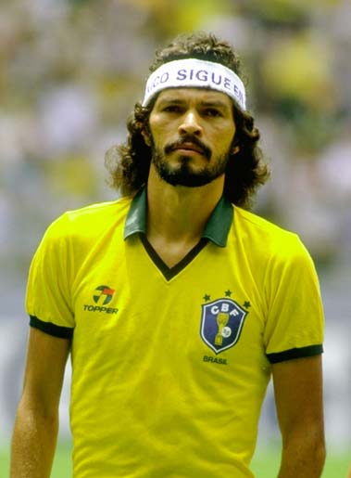
Notes:
Footballers who can be identified with only one name, like Socrates.

Slide 10
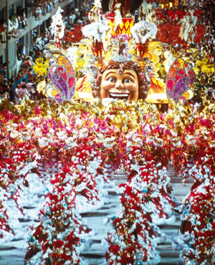
Notes:
Samba schools parading in the Sambodromo in Rio, dancers without very much on dancing samba.

Slide 11
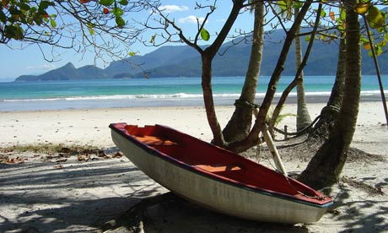
Notes:
Beaches like this one.

Slide 12
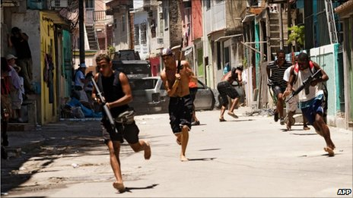
Notes:
Gangs in a favela. A scene from the film City of God, probably.

Slide 13
1 Developments Since 1985
1985: Return to civilian rule after a 21-year military dictatorship.
1988: Approval of new constitution.
1989: First direct election for president since 1960.
1994: Introduction of the Real Plan, establishing economic stability and liberalization.
1995 Pres. F. H. Cardoso (PSDB) (1995-2002).
2002 Pres. L. I. “Lula” da Silva (PT) (2003-2010).
2010 Pres. Dilma Rousseff (PT) (2011-present).

Slide 14
President Fernando Henrique Cardoso (PSDB), 1995-2002

Slide 15
The Cardoso Government
The Real Plan ends hyperinflation.
Privatization of state-owned firms and trade liberalization.
MERCOSUR facilitates the expansion of regional trade.
Social spending increases (Bolsa Escola) and land reform is accelerated.
1999: Creation of civilian Ministry of Defence (with 6 ministers in 10 years) .

Slide 16
President Luis Inacio “Lula” da Silva (PT), 2003-2010

Slide 17
The Lula government
Continuation of previous government’s economic policy; continued low inflation.
Increased social spending (Bolsa Familia).
Increase in minimum wage, some decrease in income inequality, a large decrease in poverty.
Change in social base of support in 2006 – Lula loses most of the middle class and secures support among the poor.
Growth of 7.5% in 2010.
Activism in foreign policy i.e. Copenhagen 2009.

Slide 18
President Dilma Rousseff (PT) 2011-present

Slide 19
Recent troubles
A slowdown in growth (2011-2014 = 1.5% per year on average; less than 1% in 2014; a projected -1.2% in 2015).
Major demonstrations in June-July 2013 and again in March-April 2015.
Tension between the private sector and government; the expansion of policies favouring specific sectors, especially in manufacturing.
Increased Federal spending.
Dilma was re-elected narrowly in October and is now moving towards economic orthodoxy by concentrating on deficit reduction.

Slide 20
The Brazilian State
The state collects about 35% of the GDP in tax revenues (roughly the same as the UK)
The “commanding heights” of the Federal bureaucracy is capable and relatively efficient.
In 2011 the Federal government launched a programme to send 100,000 students abroad to study STEM subjects.
EMBRAER, the third-largest airplane manufacturer in the world, started as a state-owned company in 1969.
Brazilian ranks 13th for scientific publications (quantity), with most research publicly funded.

Slide 21
A puzzle
Latin America is supposed to be a region of underdeveloped states (F. Fukuyama’s chapter on Latin America in Political Order and Political Decay is called “dogs that didn’t bark”).
Within Latin America, Brazil was seen as a laggard for much of the 20th century, especially in relation to Argentina.

Slide 22
National Developmentalism

Slide 23
Social Protection

Slide 24
State Violence

Slide 25
?
Notes:
According to the National Forum on Public Security, the Brazilian police killed 11,197 people between 2009 and 2013. This is from their report of November 2014.

Slide 26
The Country of the Future?
A capable and improving state ruled by an “upgrading coalition”.
Favourable domestic and regional conditions, including an abundance of natural resources, positive demographics and a peaceful region.
A global system moving towards greater multipolarity and the rise of Asia. Brazil is well-placed to meet Asian demand for food and raw materials.

Slide 27
The governments’ challenges

Slide 28
Brazil’s global priorities
Continued economic development is paramount.
“Nationalism is not an imposition of our peculiarities, nor is it a simple expression of our national characteristics. On the contrary, it is a means to an end: development.”
Celso Lafer, former Foreign Minister of Brazil
Notes:
From Celso Lafer, “Brazil and the World” in Ignacy Sachs et al, Brazil: A Century of Change (UNC Press, 2009), p. 110.

Slide 29
Brazilian advantages
Economic and political stability, a lack of religious, ethnic, regional or other major divisions (although racial inequality is a political issue).
An economy reasonably balanced between commodities, manufacturing, and services, with a broad mix of trade partners.
Strong recovery from the 2008-9 financial crisis.
Large inflows of foreign direct investment (about $65 billion in 2013, 1/3 of Latin American total and 5th largest in the world).
An active outward investor (more than 230 billion euros of Brazilian investment abroad; a Brazilian bought the Gerkin in London).
Large new oil deposits (Libra field auctioned in 2014).
Leadership in ethanol technology.
An abundant frontier of arable land and other natural resources

Slide 30
Problems
A slowdown in growth and problems with the “quality” of growth.
Political polarization (as manifested in the 2014 elections).
Poor infrastructure.
Poor state services in public transportation, health, public security, and education.
Alienation from the political system, especially among the young.
A high cost economy.

Slide 31
Problems
The beginnings of “deindustrialization”.
Volatility and imbalances in the global economy – will steady development be possible?
Economic inequality, poverty, violence, and environmental degradation (especially in the Amazon rain forest).
Regional problems: drug trafficking, potential instability in neighbor countries, resistance to Brazilian regional leadership.
A burdensome and complicated tax system.
Developing a coherent foreign policy – managing its ascent.
Having progress frustrated by faster progress elsewhere (especially Asia).

Slide 32
Three challenges
Redistribution – can recent gains be continued? Can the quality of public goods (healthcare, education, transportation, security) be improved?
Representation – what can be done about public disillusionment with political parties and the political system? Is any kind of political reform viable?
Recognition – can economic inclusion be accompanied by social inclusion?

Slide 33
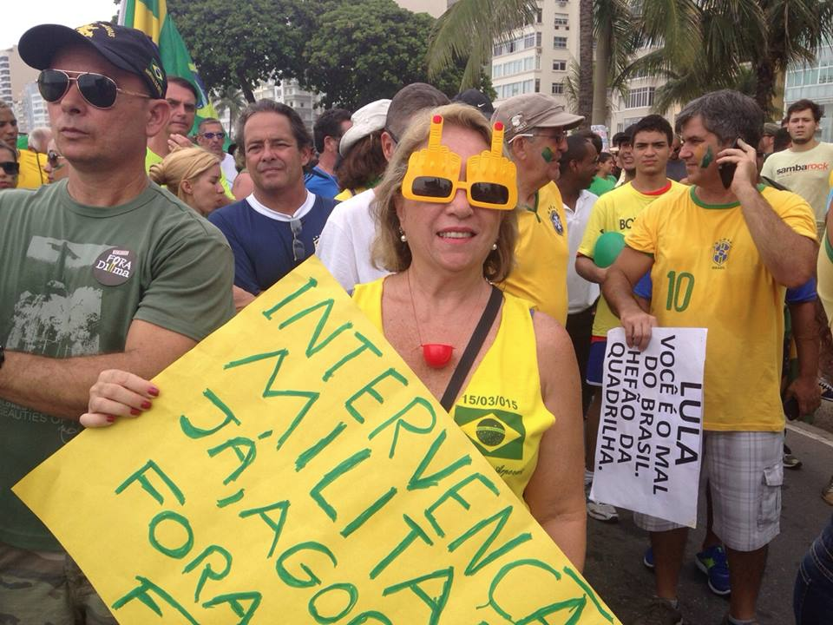

Slide 34
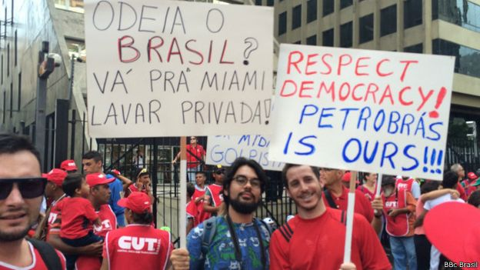

Slide 35
Obrigado (thank you!)
anthony.pereira@kcl.ac.uk

