Slide 1
The Right Stuff: moral reasoning and health care
Professor Gwen Adshead
February 2017
G.Adshead@nhs.net

Slide 2
In this talk:
What is a moral decision? What do we mean by a decision? The experience of making moral decisions
Moral decisions in health care
Principles and outcomes
Feelings, thoughts and brains
The trolley problem and medical care
What makes a ‘good’ doctor?
Acknowledgements: Professors Deborah Bowman, Bill Fulford and Nigel Eastman. Thanks also to Dr Brian Robinson and Mr Dan Ferris.

Slide 3
Ethical challenges in UK health care
Concerns about resource allocation
Concerns about doctors having to make complex decisions in relation to resources
Concerns about the ethical character of doctors and loss of professionalism
Who is making moral decisions in health care, and how are they doing it?

Slide 4
The nature of these challenges
Values and choices in health
Professional boundary violations by health workers: sexual and non-sexual
Doctors with behavioural problems: failures of ‘team working’
Concerns about racism, bullying & bigotry in health care: patients and staff
Resources: the injustice of allocation, how resources are managed, justice and exclusions

Slide 5
Ethics in medicine
Relationships characterised by disparities of power and knowledge
Regulated and overseen with Codes of ethics, and legal regulation
From the 4th century BC
The discourse of ‘ought’ and ‘should’, as opposed to can and must
What ‘should’ I do in this situation?
How do we decide what we ‘ought’ to do?

Slide 6
Ethics is different from...
What the legal position is. Laws follow ethics, not the other way round! A guide to ethical decision making
Religious duties that arise from faith based belief systems (but important for awareness of identity and cultural issues)
Governance and the duty to provide ‘good’ services, where ‘good’ has another meaning (meeting a practical standard).
A ‘good’ hospital is not the same as a ‘good’ doctor!
CQC? The loss of the garden in an old age facility

Slide 8
Facts and values
An old distinction: David Hume and the naturalistic fallacy
Clinical facts and personal values: what you can dio and what you should do
The story of Mr McMurchy [1949] Medical values confused with personal values
Mrs Murray was on the operating table having abdominal surgery. Mr McMurchy saw that her uterus was damaged and any pregnancy would be very dangerous for her. He decided to sterilise her by tying her fallopian tubes; and told her what he had done when she came round from the anaesthetic. Mrs Murray was not happy and successfully sued for negligence and battery.

Slide 9
Clinical outcomes and ethics
Medicine as a utilitarian process: always do that which brings about the best outcome for as many people as possible
But which outcomes will matter?
Ray Tallis, Atul Gawande: which outcomes matter and to whom? Who gets to decide?
What about bad outcomes in the pursuit of a good outcome: The Doctrine of Double Effect
What about a focus on duties not outcomes?
What about justice?

Slide 10
Common approaches to bioethics
Beauchamp & Childress (1979) The ‘four principles’: a mixture of duties and consequences
A duty to respect autonomy/personal choice (the right to be left alone and to privacy)
A duty to respect the process of justice (usually in terms of fair resource allocation)
Attention to consequences: maximise good and do no harm
Attention to scope: how far do your duties extend?
Respect for autonomy has primacy

Slide 11
Some problems with principles approach
What to do if principles and duties conflict?
What to do if patients lack autonomy?
Model seems to imply a limited relationship between only two parties, who negotiate about a range of choices
But what if there are no ‘good’ choices?
What if there are more than two parties?
What if there is a complex relationship between all parties?
Justice as a trumping value to protect the vulnerable

Slide 12
Thinking about autonomy and choice in health care
Many people with long term conditions or psychiatric /brain conditions lack autonomy for extended periods
Both lack of autonomy and psychological intimacy makes people vulnerable
Using people as a means to an end: research, risk
Some patients will be in long-term dependency relationships with services: how to balance autonomy and dependence
For some people, they need relationships with others to exercise autonomy: e.g. young people, the elderly

Slide 13
Example
Mr Jenkins has a long history of alcohol addiction which has had an impact on his work and psychosocial function. His wife and daughter (who care for him) tell you that they water down the alcohol he drinks at home, and ask you not to tell him. Mr Jenkins confidently tells you that he ‘can handle’ his drink, and doesn’t have a problem. Mr Jenkins's wife dies suddenly, and his daughter takes an overdose.

Slide 14
Moral reasoning is not about information processing
It is not just a process of weighing up different information choices
Moral reasoning involves emotional discomfort
It involves reflection on the type of person you, the values you hold, and the relationships you have with those around you
Not a simple binary choice between two options, one of which is clearly good and/or better than the other
Gilligan on abortion; Tan on treatment refusal, Gutridge on self harm

Slide 15
Moral reasoning, agency and identity
We develop our moral identities as narratives; stories about the choices we have made and what went into that process
These are reflective and relational narratives about the kind of person we want to be
To be a moral agent ( McAdam 2015)
Influenced by our personality dispositions and traits
Our early attachments, family and culture

Slide 16
Brain research in moral reasoning
FMRI studies of what happens when people make moral decisions
What is happening in the brain: are all moral decisions the same?
Different areas of the brain involved for moral and non-moral decisions; and different types of moral reasoning
Different levels of emotion involved and different perspectives ( Boccia et al 2016)

Slide 17
Different kinds of moral action activate different neural systems

Slide 18
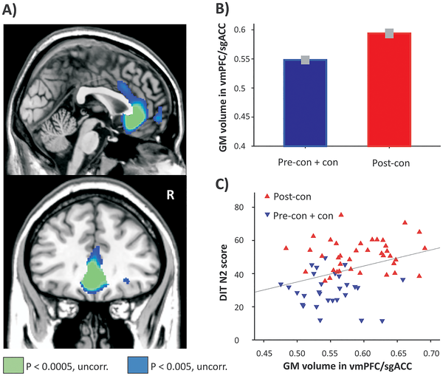
Different types of Moral reasoning and gray matter volume.
Prehn K, Korczykowski M, Rao H, Fang Z, Detre JA, et al. (2015) Neural Correlates of Post-Conventional Moral Reasoning: A Voxel-Based Morphometry Study. PLOS ONE 10(6): e0122914. doi:10.1371/journal.pone.0122914
http://journals.plos.org/plosone/article?id=10.1371/journal.pone.0122914

Slide 19
Moral decisions: personal or impersonal

Slide 20
Sommer et al 2010 Neuropsychologia

Slide 21
Values and Relational ethics
Moral dilemmas look different depending on our different roles and relationships
Attention to the different roles, duties and the different ethical perspectives that go with them
The values that arise in our work and perspective
Emotional meaning that arises in different roles and relationships
The ethic of care differs from an ethic of justice but they complement each other (Gilligan 1982; 2012)

Slide 22
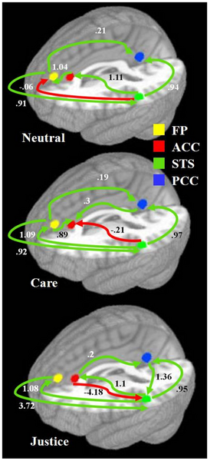
Figure 1. Model of brain regions involved in moral cognition: the frontal pole (yellow), rostral anterior cingulate cortex (red), left superior temporal sulcus (green), and precuneus/ posterior cingulate cortex (blue).
Cáceda R, James GA, Ely TD, Snarey J, et al. (2011) Mode of Effective Connectivity within a Putative Neural Network Differentiates Moral Cognitions Related to Care and Justice Ethics. PLoS ONE 6(2): e14730. doi:10.1371/journal.pone.0014730
http://www.plosone.org/article/info:doi/10.1371/journal.pone.0014730

Slide 23
The trolley problem
Edmonds 2014: Would you kill the fat man?
A thought experiment: a tram ( trolley in the USA) is out of control and is about to hit and kill five unfortunate people who are stuck on the track. You can change the tram’s course by moving a lever which will move the trolley onto another track where there is only one man stuck.
Will you pull the lever?
Notes:
90% will do so

Slide 24
The Doctrine of Double effect
Philippa Foot (1967) drawing on Aquinas: it is permissible to carry out a good intention, with good consequence: even if your action also has bad consequences
Used widely in medicine: doing harm to do good
High risk Surgery, chemotherapy, palliative care
Dr Leonard Arthur
Dr Roozrokh ( Edmonds 2014)
Can a doctor bring about a death with the best of intentions?

Slide 25
The trolley problem (2)
Now imagine a different scenario:
The tram is out of control and going to kill five people. But you can stop it by pushing a man onto the track. This man will die but his death will save five others.
Will you push him onto the track?
Notes:
Far fewer: 28%?

Slide 26
Why don’t people push the man onto the track?
They don’t feel comfortable
It feels like direct harm
The doctrine of double effect doesn't protect them from anxiety
Fairness and justice: the victim gets no say in his sacrifice
Risk to the vulnerable: if one person can be sacrificed, why not more?

Slide 27
Bartels & Pizarro 2011

Slide 28
How to deal with these challenges?
Increased legal powers and protections: tribunals and due process
Increased regulation and monitoring
Codes of ethics : But are they enforceable?
Clinical Ethics Committees
Attention to ethical decision making processes as part of daily clinical services e.g. Values Based Practice?
Do we need a different approach to ethics in health care?

Slide 29
Radden & Sadler (2010)
Radden & Sadler argue that we need a different approach to ethics in health care situations where there are discrepancies in power and vulnerability
Especially where these are a feature of the condition
Vulnerability implicit in intimacy, care seeking and neediness
How to get ‘good’ doctors?
Building up virtuous character through training and self-reflection

Slide 30
The ‘good’ doctor
Is empathic, compassionate, and able to take different perspectives
Builds wisdom and knowledge across working life span
Strives for integrity and honesty at all times
Respectful of others’ vulnerability
Thoughtful about the exercise of power
Sounds like a lovely person!
How to achieve an ideal in non-ideal circumstances?
When doctors are employees not independent professionals?

Slide 31
Attention to feelings and experience in relationships
Values based practice
Communication skills
Exploration of consensus and ‘dissensus’
Articulation of ‘difficult’ feelings: anxiety, frustration, anger, belittlement
Articulation of different personal perspectives on dilemmas
Articulation of different relationships with patients

Slide 32
Different types of truth
Historical truth/facts and narrative truth/fact
Stereotypes and beliefs that range in ‘truthiness’
More and more empirical ‘facts’ may not help much in a clash of interpretation of ‘facts’
A hermeneutics of faith (where we interpret what is known and seen) and a hermeneutics of suspicion (where we consider what is not said and may be invisible)

Slide 33
Making better moral decisions
Considering more than one perspective
Moving away from adversarial clash of rights or rights vs. harms/wrongs
Developing a narrative approach may be helpful: how did this story start? Who are the players? Who sees what from what perspective?
Attention to process of discussion: honesty, transparency, plurality of perspective
Voices, values and agency: not just outcomes and action

Slide 34
Example
Kevin is a paranoid, irascible man who copes amazingly well in the community with medication and CP support. He has no history of violence, despite being very paranoid about his neighbours. His neighbours get up a petition to have Kevin moved from his council flat, saying that he scares them; and the housing office want your view. Kevin refuses to engage with the medical assessment, saying he is fine; it’s just that his neighbours hate him.

Slide 35
Example
Kevin is in long term secure care, where he refuses to take his medication. But he is so much better on his medication that the team decide to medicate him without telling him, by giving it to him in his drinks. Kevin gets much better and applies to be released on the grounds that he does not have a mental disorder and he is completely well on no medication….

Slide 36
The assisted suicide debate
A particular issue for psychiatry because suicide traditionally seen as medical emergency: and psychiatrists liable for failure to prevent.
But the meaning of life, and its value, is a domain that is explored in psychological relationships with patients
Hearing the voice of this person and paying attention to their values may mean conversations about the end of life

Slide 37
Example
Gloria is a civil rights lawyer in her early 40s, with children and a partner. She has discovered that her estranged mother died of Huntingdon’s disease; and is positive for the disorder. She is referred by the GP because she is making plans to kill herself. At interview, Gloria is calm, sad and determined to kill herself. She has all the relevant information. Her partner comes to the interview; and begs you to section Gloria to prevent her suicide.

Slide 38
Conclusion
Developing the moral identity of doctors is a career long task
Values and voices change over time and in different contexts
A duty to devote time to this as part of health care
Need to develop confidence and competence in telling ethical stories, finding our ethical voices, integrating feelings, facts and perspectives
What sort of voice do you have today?

Slide 39
References
Adshead, G. (2002). A different voice in psychiatric ethics. Healthcare ethics and human values, ( Eds. Dickenson & Fulford) . CUP. 56-62.
Radden, J. (2002). Notes towards a professional ethics for psychiatry*. Australian and New Zealand Journal of Psychiatry, 36(1), 52-59.
Radden, J. (2004). The debate continues: unique ethics for psychiatry. Australian and New Zealand Journal of Psychiatry, 38(3), 115-118.
Fulford, K. B. (2004). Ten principles of values-based medicine (VBM). Philosophy And Psychiatry, 50.
Bloch, S., & Green, S. A. (2006). An ethical framework for psychiatry. The British Journal of Psychiatry, 188(1), 7-12.
Robertson, M., & Walter, G. (2007). Overview of psychiatric ethics I: professional ethics and psychiatry. Australasian Psychiatry, 15(3), 201-206.
Radden, J., & Sadler, J. (2010). The virtuous psychiatrist: Character ethics in psychiatric practice. OUP USA.
Sommer, M., Rothmayr, C., Döhnel, K., Meinhardt, J., Schwerdtner, J., Sodian, B., & Hajak, G. (2010). How should I decide? The neural correlates of everyday moral reasoning. Neuropsychologia, 48(7), 2018-2026.
Bartels, D. M., & Pizarro, D. A. (2011). The mismeasure of morals: Antisocial personality traits predict utilitarian responses to moral dilemmas. Cognition, 121(1), 154-161.
Cáceda, R., James, G. A., Ely, T. D., Snarey, J., & Kilts, C. D. (2011). Mode of effective connectivity within a putative neural network differentiates moral cognitions related to care and justice ethics. PLoS One, 6(2), e14730.
Beauchamp, T. L., & Childress, J. F. (2013). Principles of biomedical ethics. 7th edition. Oxford University Press, USA.

