Slide 1
Two Losses Make a Win: How a Physicist Surprised Mathematicians
Tony Mann, 16 March 2015

Slide 2
Paradoxes and Games
19 January – This Lecture Will Surprise You: When Logic is Illogical
16 February – When Maths Doesn't Work: What we learn from the Prisoners' Dilemma
16 March – Two Losses Make a Win: How a Physicist Surprised Mathematicians

Slide 3
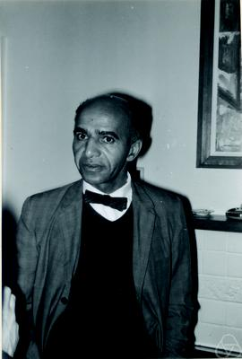
Games in the Blackwell Sense

Slide 4
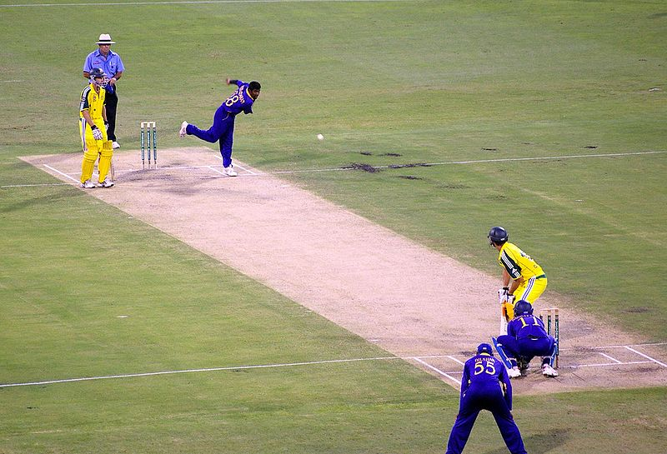
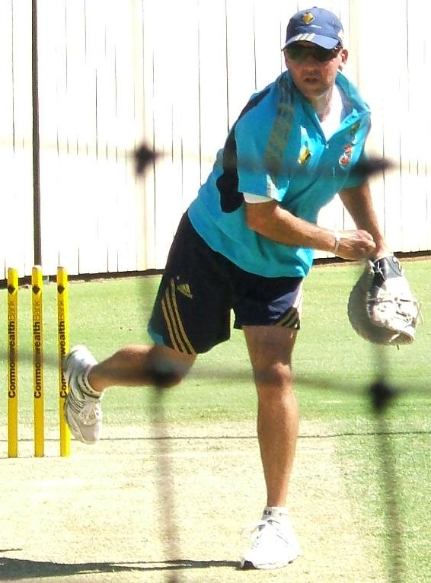
Is it always best to play the best move possible?

Slide 5
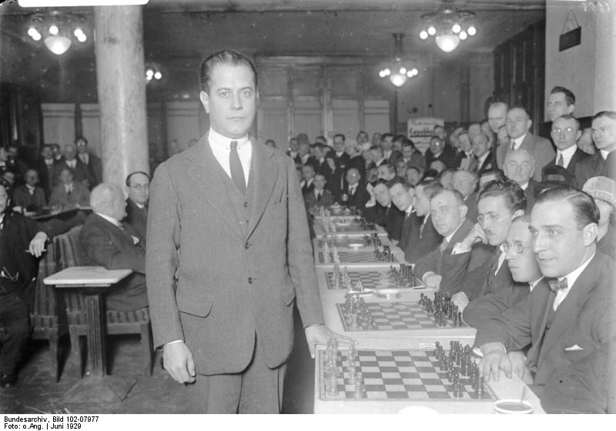
Capablanca
“You should think only about the position, but not about the opponent… Psychology bears no relation to it and only stands in the way of real chess.”

Slide 6
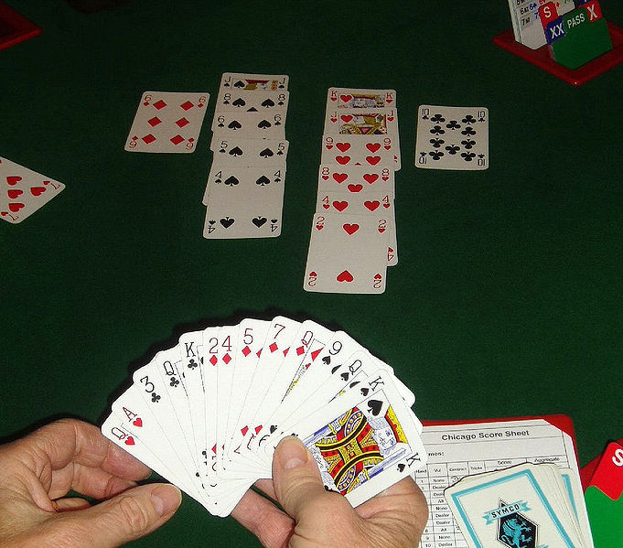
The Grosvenor Coup

Slide 7
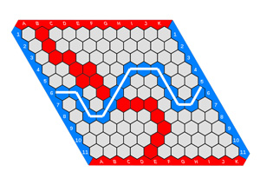
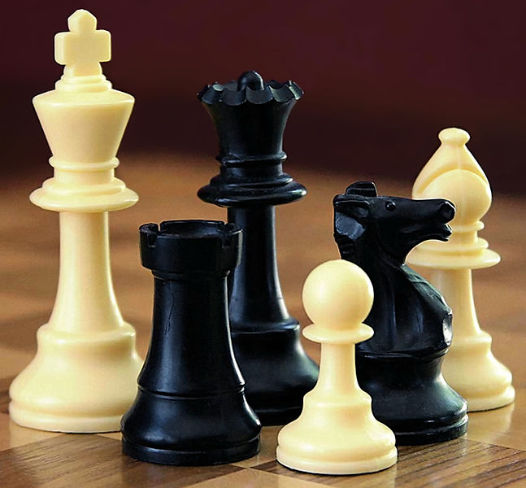
Finite games

Slide 8
Hypergame
Two-player game
First player nominates any finite two-player game
Second player then takes first move in that game
So Hypergame is a finite game

Slide 9
Hypergame
Last month I introduced Hypergame to Stephanie and Hurkan at the University of Greenwich Maths Arcade

Slide 10
Hypergame at Greenwich University

Slide 11
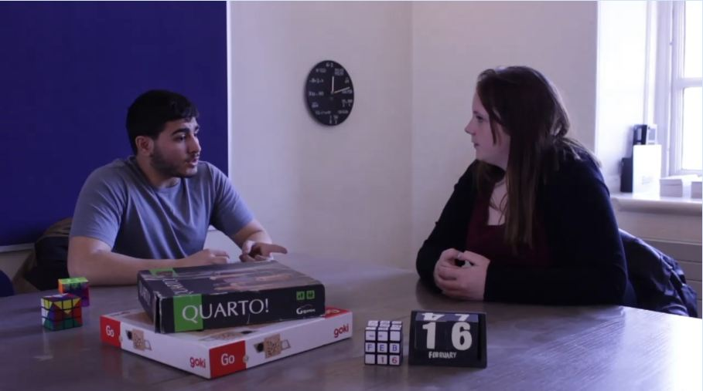
Hypergame at Greenwich University

Slide 12
Hypergame
Hypergame is a finite game
But it seems it can go on for ever!

Slide 13
Hypergame
If Hypergame is a finite game
then it can go on for ever, so it’s not a finite game
But if it’s not a finite game, first player can’t choose it
in which case it can’t go on for ever so it is a finite game

Slide 14
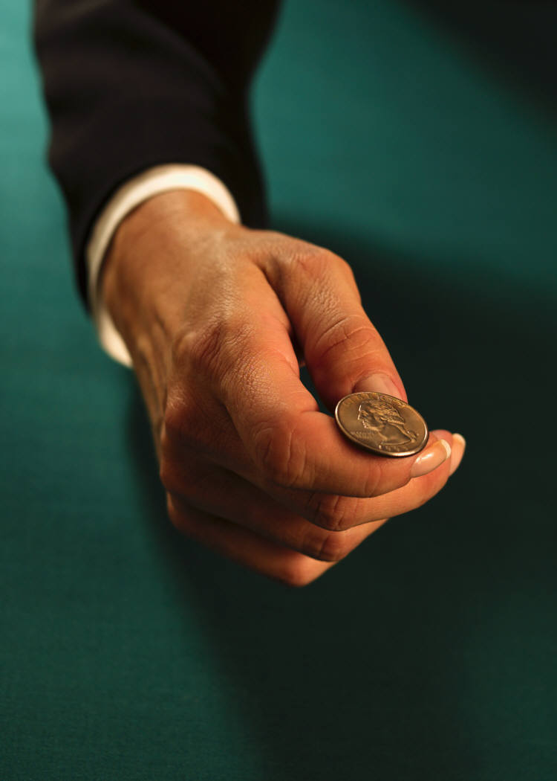
Another game
A fair coin is tossed repeatedy
We both choose a sequence of three possible outcomes
Eg you choose HTT
I choose HHT
Whoever’s sequence appears first, wins
Eg THTHTTH … - you win

Slide 15
Another game
A fair coin is tossed repeatedy
We both choose a sequence of three possible outcomes
Eg you choose HTT
I choose HHT
Whoever’s sequence appears first, wins
Eg THTHTTH … - you win

Slide 16
Penney Ante
You choose HHH
I choose THH
First sequence HHH occurs in tosses n, n+1 and n+2
If n = 1, you win (probability 1 in 8)
Otherwise, what was the result of toss n-1?
…..? H H H …
Must have been T, in which case I won!

Slide 17
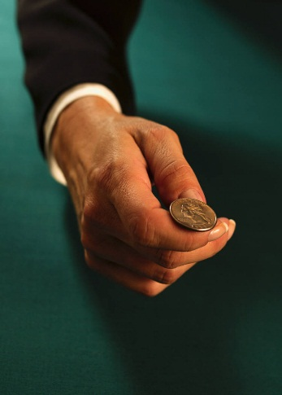
Penny Ante
Your choice | My choice | My chance of winning
HHH | THH | 7/8
THH | TTH | 2/3
THT | TTH | 2/3
TTH | HTT | 3/4

Slide 18
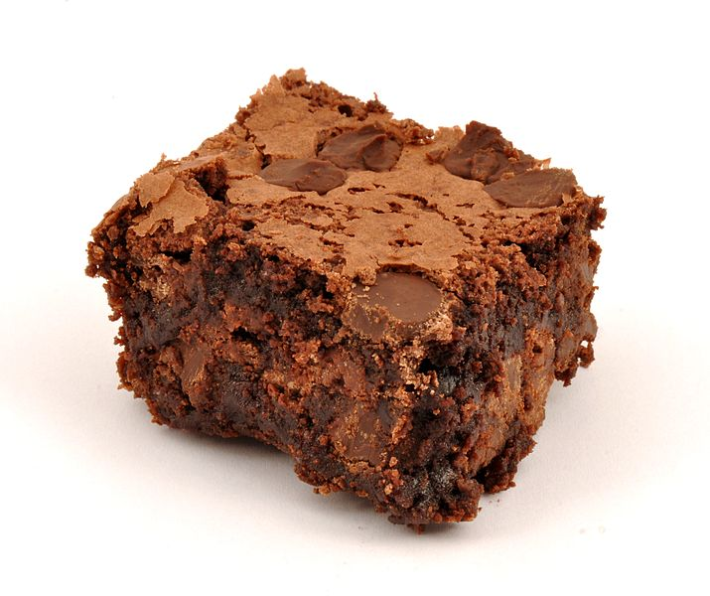
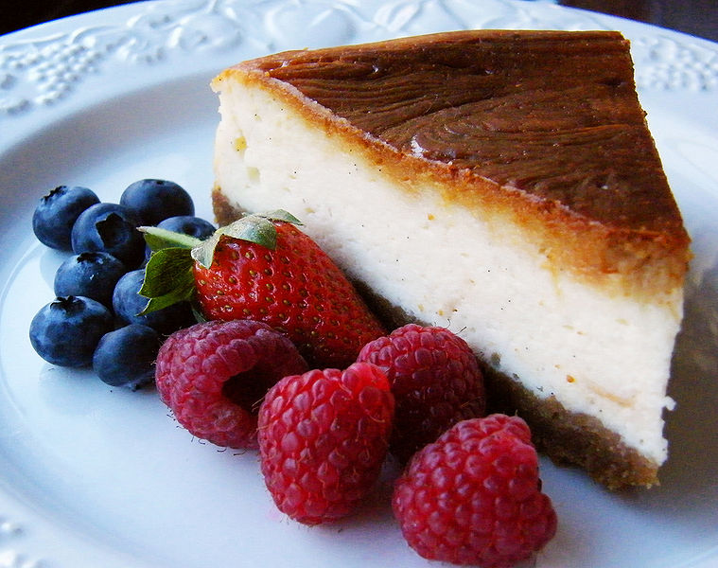
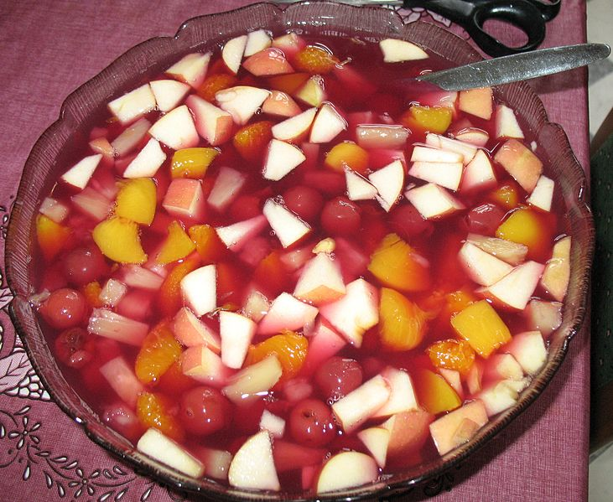
Transitivity

Slide 19
Intransitivity
TTH
BEATS
BEATS
HTT
THH
BEATS
BEATS
HHT

Slide 20
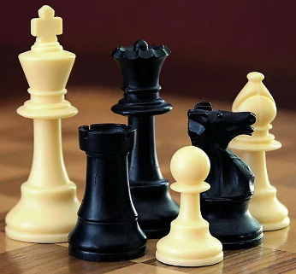
Chess Teams
Team A has players 1, 5 and 9
Team B has players 2, 6 and 7
Team C has players 3, 4 and 8
Team A versus Team B
Team A | Team B | Result
1 | 2 | 1 - 0
5 | 6 | 2 - 0
9 | 7 | 2 - 1
A beats B 2 - 1

Slide 21
Chess Teams
Team A has players 1, 5 and 9
Team B has players 2, 6 and 7
Team C has players 3, 4 and 8
Team B versus Team C
Team B | Team C | Result
2 | 3 | 1 - 0
6 | 4 | 1 - 1
7 | 8 | 2 - 1
A beats B 2 - 1
B beats C 2 - 1

Slide 22
Chess Teams
Team A has players 1, 5 and 9
Team B has players 2, 6 and 7
Team C has players 3, 4 and 8
Team C versus Team A
Team C | Team A | Result
3 | 1 | 0 - 1
4 | 5 | 1 - 1
8 | 9 | 2 - 1
A beats B 2 - 1
B beats C 2 - 1
C beats A 2 - 1

Slide 23
An interview
 | Industry Experience | Technical Skills | Communication ability
Best
2nd Best
3rd Best

Slide 24
An interview
 | Industry Experience | Technical Skills | Communication ability
Best | A
2nd Best | B
3rd Best | C

Slide 25
An interview
 | Industry Experience | Technical Skills | Communication ability
Best | A | B
2nd Best | B | C
3rd Best | C | A

Slide 26
An interview
 | Industry Experience | Technical Skills | Communication ability
Best | A | B | C
2nd Best | B | C | A
3rd Best | C | A | B

Slide 27
An interview
 | Industry Experience | Technical Skills | Communication ability
Best | A | B | A
2nd Best | B | A | B
Are we wrong to think A is better than B?
If not, how did C’s presence hide A’s superiority?

Slide 28
Our final paradox
Two coin-tossing games
With biased coins
Game A:
Coin lands heads with probability 0.5 – ε
where ε is small positive number
(eg ε = 0.005)

Slide 29
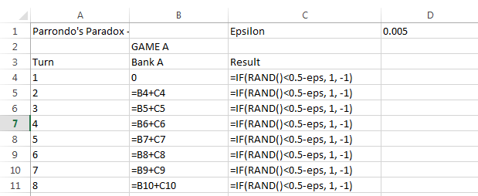
Game A in Microsoft Excel

Slide 30
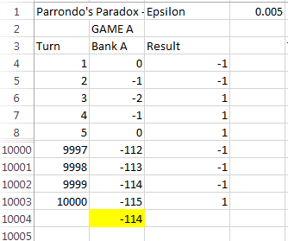
Game A in Microsoft Excel

Slide 31
Simulation results – Game A
100,000 trials of 1000 rounds
I came out on top 36,726 times
Average result: loss of 9.892p per 1000 tosses

Slide 32
Game B – Two Coins
First coin
Probabilty of heads is
0.1 - ε
Second coin
Probability of heads is
0.75 – ε
Use first coin if current capital is a multiple of 3, otherwise use second coin

Slide 33
Game B in Microsoft Excel

Slide 34
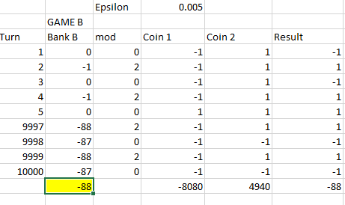
Game B in Microsoft Excel

Slide 35
Simulation results – Game B
100,000 trials of 1000 rounds
I came out on top 32,529 times
Average result: loss of 9.135p per 1000 tosses

Slide 36
Two Games
Game A and Game B are both games we expect to lose, in the long run
What if we combine them by switching between them randomly?

Slide 37
Random game in Microsoft Excel

Slide 38
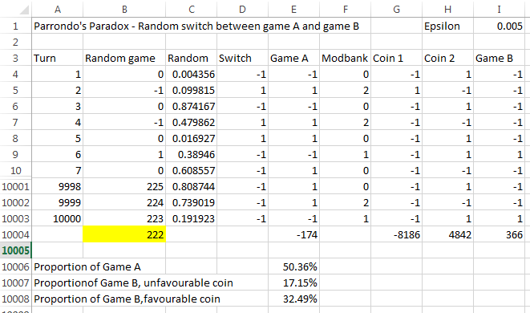
Random game in Microsoft Excel

Slide 39
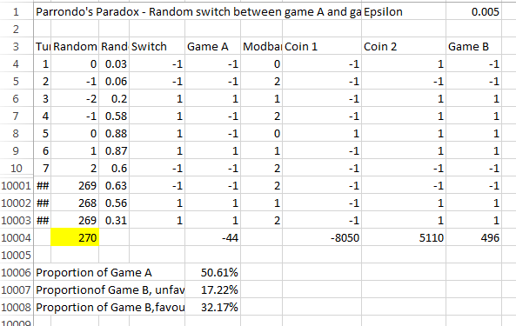
Random game in Microsoft Excel

Slide 40
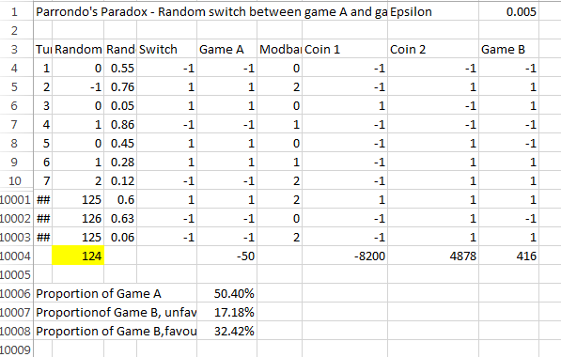
Random game in Microsoft Excel

Slide 41
Simulation results – Random Switching
100,000 trials of 1000 rounds
I came out on top in 68,755
Average result: gain of 15.401p per 1000 tosses

Slide 42
What’s going on?
When we play game B on its own, we use unfavourable first coin just under 40% of the time
When we play random game, we use that coin only 34% of the times when we play game B rather than game A

Slide 43
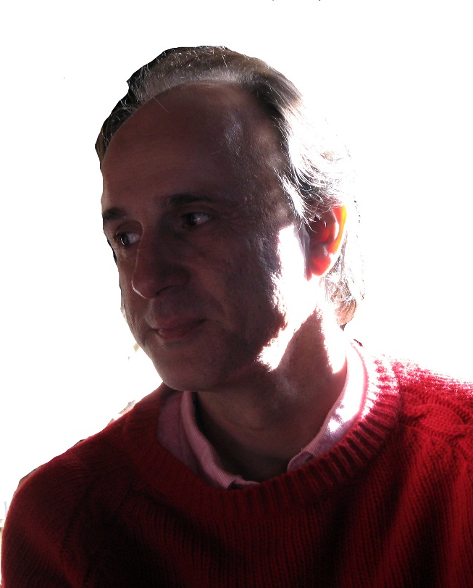
Parrondo’s Paradox
Juan Parrondo, quantum physicist
Working on Brownian Ratchet

Slide 44
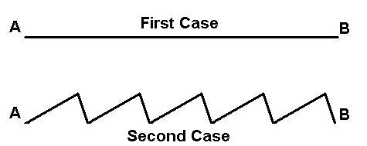
Brownian Ratchet
For animated simulation see http://elmer.unibas.ch/bm/

Slide 45
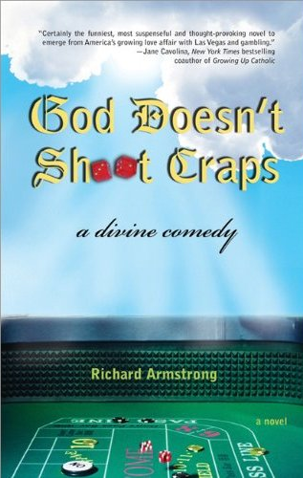
Applications
Casinos ?
Risk mitigation in financial sector ?
Biology, chemistry

Slide 46
Conclusion
Paradoxes in simple games
New discoveries
Maths can still surprise us!
Computers help our understanding
The value of simulation

Slide 47
Back to the Greenwich Maths Arcade

Slide 48
Back to the Greenwich Maths Arcade

Slide 49
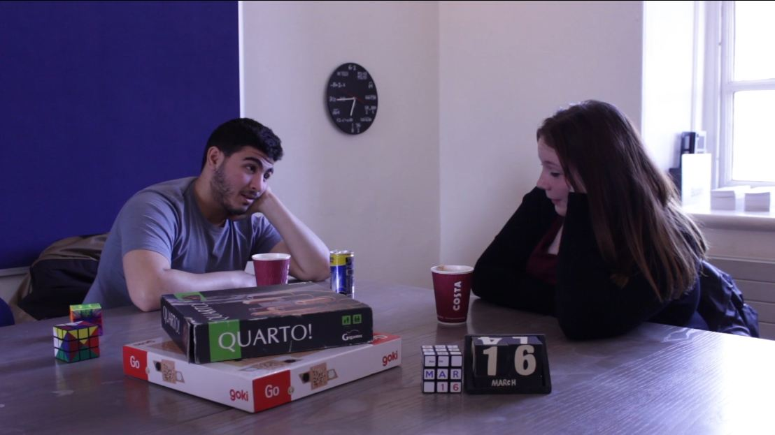
Many thanks to Stephanie Rouse, Hurkan Suleyman and Rosie Wogan

Slide 50
Thanks
Friends, colleagues, students
Everyone at Gresham College
You, the audience

Slide 51
Thank you for listening
a.mann@gre.ac.uk
@Tony_Mann

Slide 52
Acknowledgments and picture credits
Thanks to Noel-Ann Bradshaw
and everyone at Gresham College
Video filming and production: Rosie Wogan
Games players – Hurkan Suleyman and Stephanie Rouse
Slide design – Aoife Hunt
Picture credits
Images from Wikimedia Commons they are used under a Creative Commons licence: full details can be found at Wikimedia Commons
Lecturer: Noel-Ann Bradshaw
David Blackwell: Konrad Jacobs, Mathematisches Forschungsinstitut Oberwolfach gGmbH, Creative Commons License Attribution-Share Alike 2.0 Germany.
Cricket: Muttiah Muralitharan bowls to Adam Gilchrist, 2006, Rae Allen, Wikimedia Commons
Tim Nielsen: YellowMonkey/Blnguyen, Wikimedia Commons
Capablanca: German Federal Archives, Wikimedia Commons
Bridge: Alan Blackburn, Wikimedia Commons: public domain
Chess pieces: Alan Light, Wikimedia Commons
Hex: Jean-Luc W, Wikimedia Commons
Coin toss: Microsoft ClipArt
Chocolate brownie: anonymous, Wikimedia Commons
Cheesecake: zingyyellow, Wikimedia Commons
Fruit salad: Bangin, Wikimedia Commons
Juan Parrondo: Lecturer
Brownian Ratchet diagram: Ambuj Saxena, Wikimedia Commons

