Slide 1
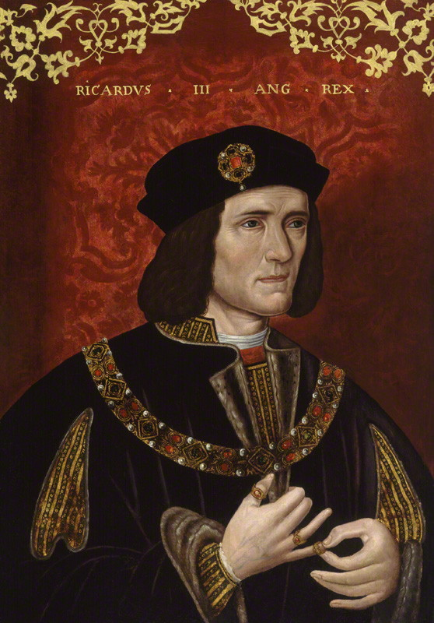
The King in the Car Park
The discovery and identification of Richard III
Prof K. Schurer
National Portrait Gallery
www.le.ac.uk/richardiii

Slide 2
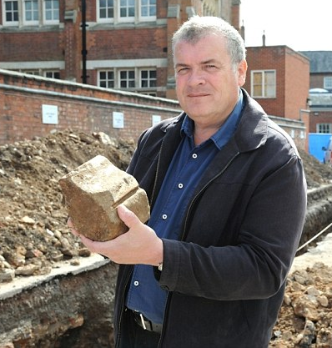
A Multidisciplinary Team from across the University of Leicester and beyond!
Richard Buckley
Co-director ULAS
Notes:
Kevin and I weren’t sure we would ever be needed. In fact, Richard assured me we would never find him.

Slide 3
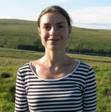
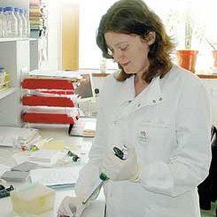
A Multidisciplinary Team from across the University of Leicester and beyond!
Richard Buckley
Co-director ULAS
Jo Appleby
Osteologist
Matt Morris
Fieldwork Director
Turi King
Geneticist
Notes:
Kevin and I weren’t sure we would ever be needed. In fact, Richard assured me we would never find him.

Slide 4
A Multidisciplinary Team from across the University of Leicester and beyond!
Richard Buckley
Co-director ULAS
Jo Appleby
Osteologist
Matt Morris
Fieldwork Director
Turi King
Geneticist
Sarah Hainsworth
Engineering
Notes:
Kevin and I weren’t sure we would ever be needed. In fact, Richard assured me we would never find him.

Slide 5
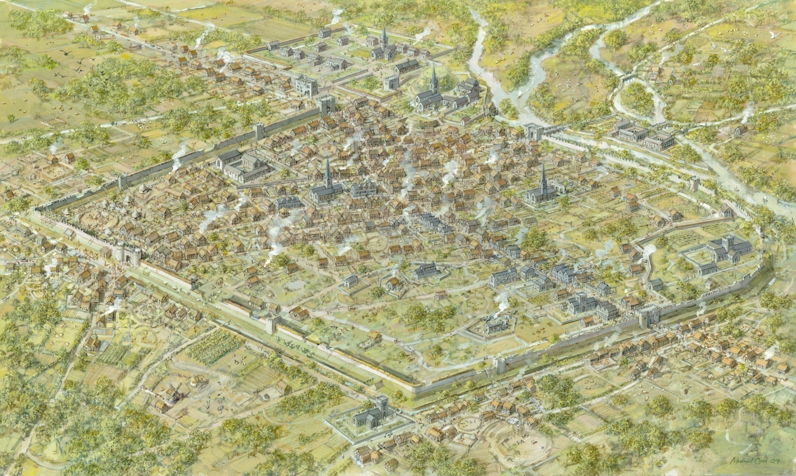
Medieval Leicester, c.1450 (artwork by Mike Codd)
Notes:
USE THIS SLIDE IF YOUR TALKING OUT OF COUNTY
This is an archaeological reconstruction of what we think medieval Leicester would have looked like in the mid 14th century, looking south-west.
It is based on archaeological excavations over the last 80 years.
Point out the Castle, The Newarke, Black Friars, Austin Friars etc.
CLICK
The three sites commonly associated with Richard III:
Blue Boar Inn where he spent a night before the battle of Bosworth
Bow Bridge over which he rode to Bosworth (legend that his spur struck a stone on the bridge as he left and it was prophesised that his head would strike the same stone on the way back). Also the bridge of which his body was supposedly thrown during the dissolution.
Grey Friars where he was buried

Slide 6
Bow Bridge
Grey Friars
Blue Boar Inn
Medieval Leicester, c.1450 (artwork by Mike Codd)
Notes:
USE THIS SLIDE IF YOUR TALKING OUT OF COUNTY
This is an archaeological reconstruction of what we think medieval Leicester would have looked like in the mid 14th century, looking south-west.
It is based on archaeological excavations over the last 80 years.
Point out the Castle, The Newarke, Black Friars, Austin Friars etc.
CLICK
The three sites commonly associated with Richard III:
Blue Boar Inn where he spent a night before the battle of Bosworth
Bow Bridge over which he rode to Bosworth (legend that his spur struck a stone on the bridge as he left and it was prophesised that his head would strike the same stone on the way back). Also the bridge of which his body was supposedly thrown during the dissolution.
Grey Friars where he was buried

Slide 7
Medieval Leicester, c.1450 (artwork by Mike Codd)
Notes:
USE THIS SLIDE IF YOUR TALKING OUT OF COUNTY
This is an archaeological reconstruction of what we think medieval Leicester would have looked like in the mid 14th century, looking south-west.
It is based on archaeological excavations over the last 80 years.
Point out the Castle, The Newarke, Black Friars, Austin Friars etc.
CLICK
The three sites commonly associated with Richard III:
Blue Boar Inn where he spent a night before the battle of Bosworth
Bow Bridge over which he rode to Bosworth (legend that his spur struck a stone on the bridge as he left and it was prophesised that his head would strike the same stone on the way back). Also the bridge of which his body was supposedly thrown during the dissolution.
Grey Friars where he was buried

Slide 8
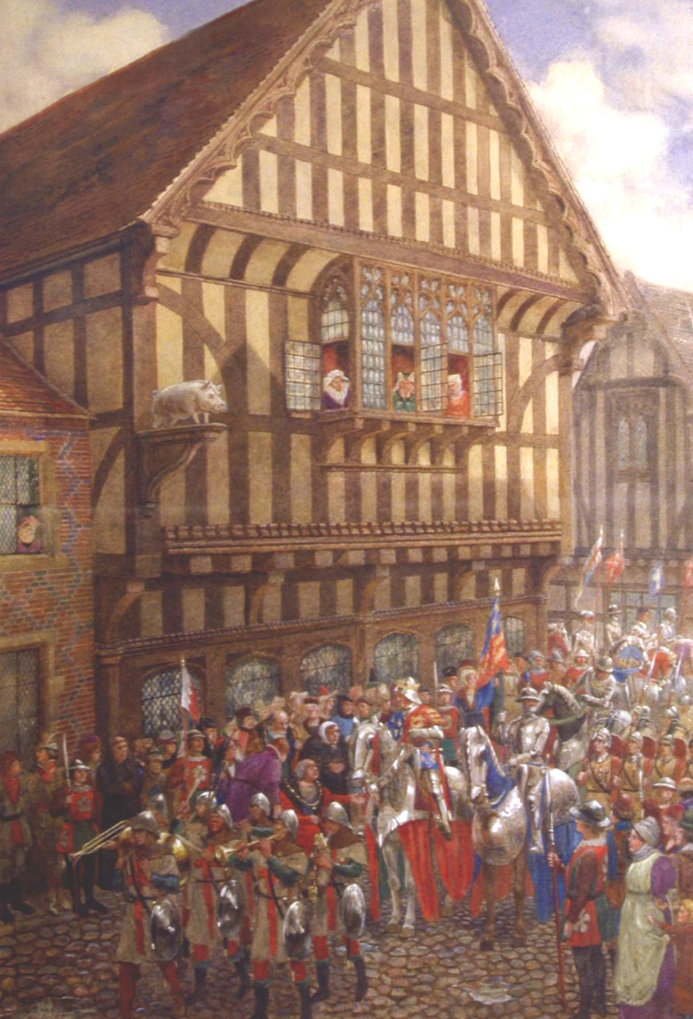
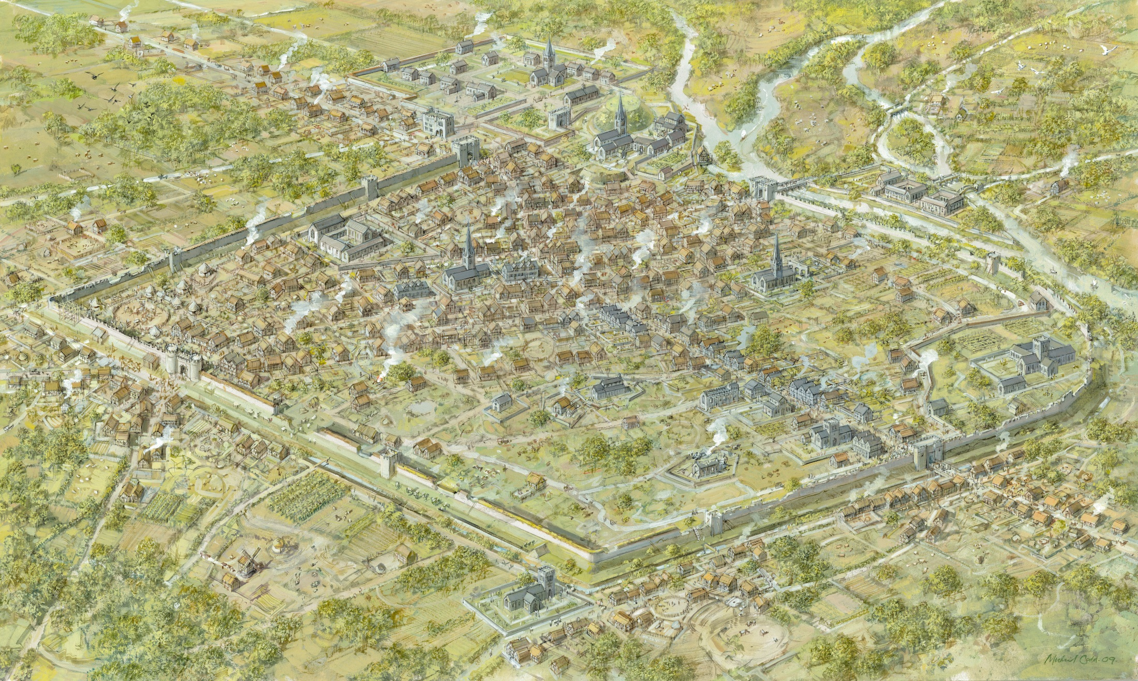
20 August, 1485
Notes:
IF YOU DON’T WANT TO TALK ABOUT THE BLUE BOAR INN MODEL TURN OF SLIDES 10, 11, 12 & 13 AND TURN ON SLIDE 14.
Richard III was in Nottingham when he learned of Henry Tudor’s rebellion.
He chose Leicester as the rallying point for the Royal army, arriving himself on 20 August 1485.
CLICK
He would have ridden into Leicester from the north, passing through the North Gate and riding along what was then the High Street (today Highcross Street).
He took up residence at the Blue Boar Inn for the night.
Why the Blue Boar Inn and not Leicester Castle? It is probable that the castle was not big enough for his retinue and may not have been prepared for his sudden arrival. The Blue Boar Inn on the other hand was a sizable coaching inn which could easily cater for all his needs.
The following day, Richard III marched out of Leicester…
CLICK
Over Bow Bridge and on towards Market Bosworth, 12 miles to the east of Leicester.
CLICK
The following day, 22 August, he was killed in battle against Henry Tudor.

Slide 9
20 August, 1485
21 August, 1485
Notes:
IF YOU DON’T WANT TO TALK ABOUT THE BLUE BOAR INN MODEL TURN OF SLIDES 10, 11, 12 & 13 AND TURN ON SLIDE 14.
Richard III was in Nottingham when he learned of Henry Tudor’s rebellion.
He chose Leicester as the rallying point for the Royal army, arriving himself on 20 August 1485.
CLICK
He would have ridden into Leicester from the north, passing through the North Gate and riding along what was then the High Street (today Highcross Street).
He took up residence at the Blue Boar Inn for the night.
Why the Blue Boar Inn and not Leicester Castle? It is probable that the castle was not big enough for his retinue and may not have been prepared for his sudden arrival. The Blue Boar Inn on the other hand was a sizable coaching inn which could easily cater for all his needs.
The following day, Richard III marched out of Leicester…
CLICK
Over Bow Bridge and on towards Market Bosworth, 12 miles to the east of Leicester.
CLICK
The following day, 22 August, he was killed in battle against Henry Tudor.

Slide 10
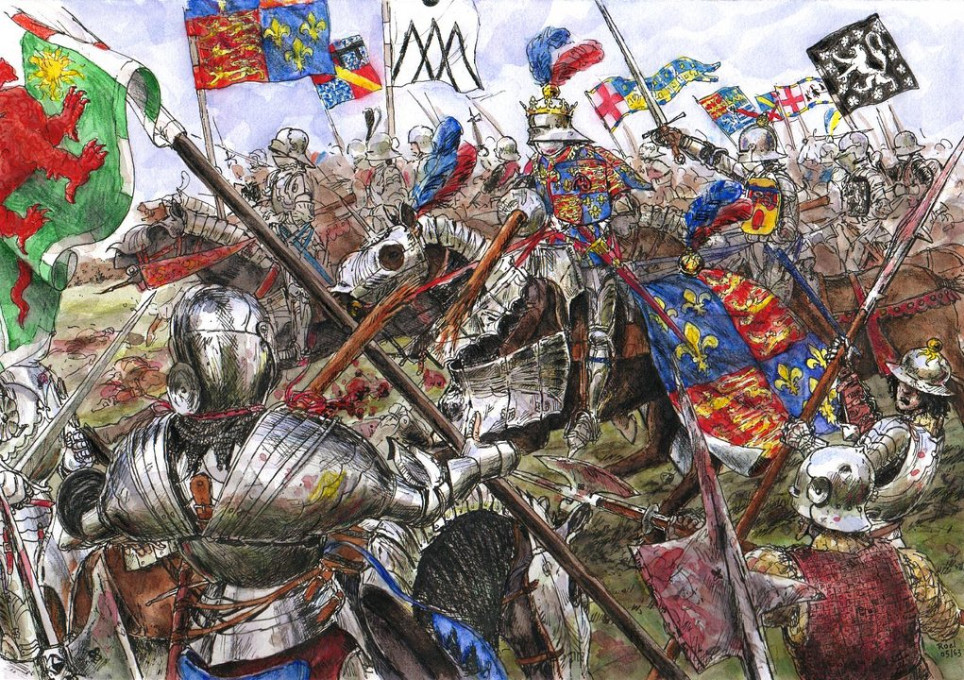
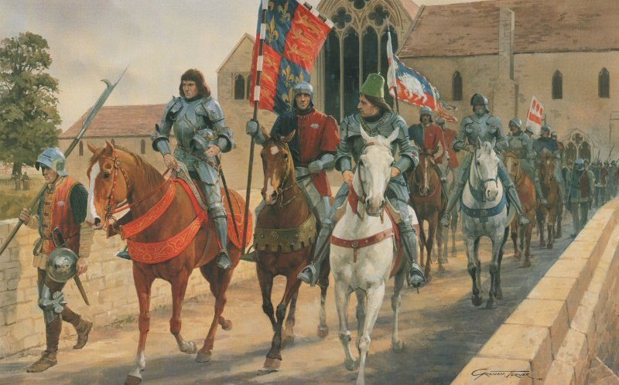
20 August, 1485
21 August, 1485
Battle of Bosworth: 22 August, 1485
Notes:
IF YOU DON’T WANT TO TALK ABOUT THE BLUE BOAR INN MODEL TURN OF SLIDES 10, 11, 12 & 13 AND TURN ON SLIDE 14.
Richard III was in Nottingham when he learned of Henry Tudor’s rebellion.
He chose Leicester as the rallying point for the Royal army, arriving himself on 20 August 1485.
CLICK
He would have ridden into Leicester from the north, passing through the North Gate and riding along what was then the High Street (today Highcross Street).
He took up residence at the Blue Boar Inn for the night.
Why the Blue Boar Inn and not Leicester Castle? It is probable that the castle was not big enough for his retinue and may not have been prepared for his sudden arrival. The Blue Boar Inn on the other hand was a sizable coaching inn which could easily cater for all his needs.
The following day, Richard III marched out of Leicester…
CLICK
Over Bow Bridge and on towards Market Bosworth, 12 miles to the east of Leicester.
CLICK
The following day, 22 August, he was killed in battle against Henry Tudor.

Slide 11
23-24 August, 1485
‘Richard’s body was found among the slain… Many other insults were heaped on it, and, not very humanely, a halter was thrown round the neck, and it was carried to Leicester…’
The Crowland Chronicles c.1486
Notes:
After the battle, Richard’s body was stripped naked, thrown over the back of a horse, and brought back to Leicester. His corpse was taken through the town to the Newarke where it was displayed in the Church of the Annunciation of the Blessed Virgin Mary, effectively a Lancastrian mausoleum (an added insult to a Yorkist king). This was to prove he really was dead.
Two or three days later it was taken from the church and speedily buried in the Franciscan friary church known as Greyfriars.
We don’t know why this church was chosen. It is possible the friars asked to bury him. However, Henry Tudor was devoted to the cult of St Francis and it is more likely that he ordered them to bury him.
CLICK
32 years later the friary was demolished as part of Henry VIII’s Dissolution of the Monasteries.
CLICK
The friary grounds were bought by Robert Herrick, a former mayor of Leicester, who built a mansion and gardens on the site. In his garden he erected a memorial pillar to Richard III.
This was recorded in the diary of Christopher Wren, the father of the famous architect, on a visit to Leicester.
Importantly, Herrick (a local man) clearly believes Richard III is still buried beneath his garden a year after the legend was published that he had been dug up and thrown in the river.

Slide 12
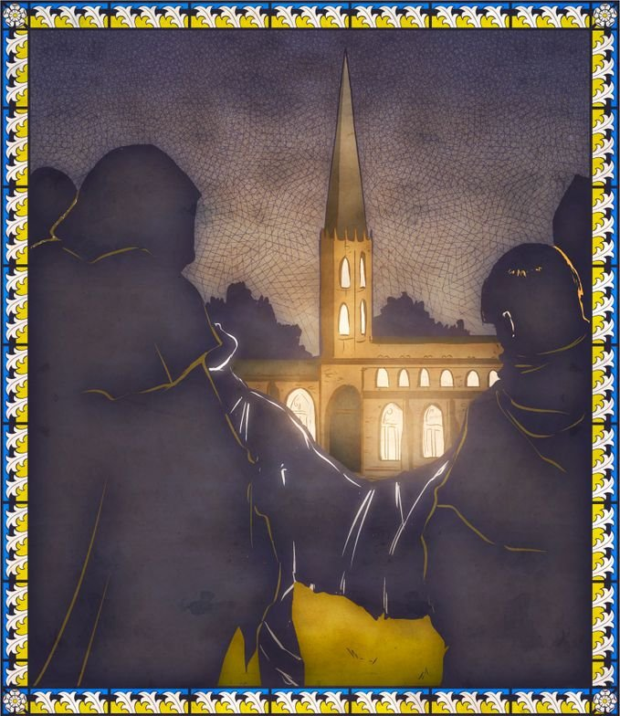
25 August, 1485
Notes:
After the battle, Richard’s body was stripped naked, thrown over the back of a horse, and brought back to Leicester. His corpse was taken through the town to the Newarke where it was displayed in the Church of the Annunciation of the Blessed Virgin Mary, effectively a Lancastrian mausoleum (an added insult to a Yorkist king). This was to prove he really was dead.
Two or three days later it was taken from the church and speedily buried in the Franciscan friary church known as Greyfriars.
We don’t know why this church was chosen. It is possible the friars asked to bury him. However, Henry Tudor was devoted to the cult of St Francis and it is more likely that he ordered them to bury him.
CLICK
32 years later the friary was demolished as part of Henry VIII’s Dissolution of the Monasteries.
CLICK
The friary grounds were bought by Robert Herrick, a former mayor of Leicester, who built a mansion and gardens on the site. In his garden he erected a memorial pillar to Richard III.
This was recorded in the diary of Christopher Wren, the father of the famous architect, on a visit to Leicester.
Importantly, Herrick (a local man) clearly believes Richard III is still buried beneath his garden a year after the legend was published that he had been dug up and thrown in the river.

Slide 13
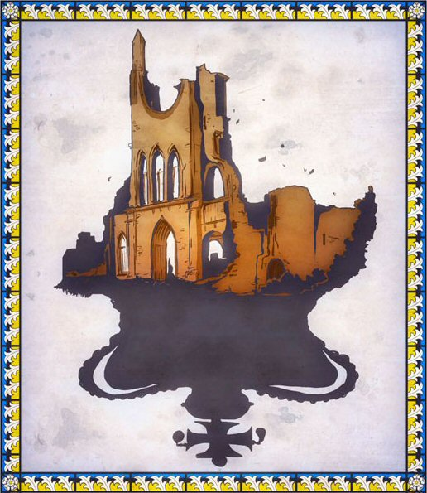
23-24 August, 1485
Notes:
After the battle, Richard’s body was stripped naked, thrown over the back of a horse, and brought back to Leicester. His corpse was taken through the town to the Newarke where it was displayed in the Church of the Annunciation of the Blessed Virgin Mary, effectively a Lancastrian mausoleum (an added insult to a Yorkist king). This was to prove he really was dead.
Two or three days later it was taken from the church and speedily buried in the Franciscan friary church known as Greyfriars.
We don’t know why this church was chosen. It is possible the friars asked to bury him. However, Henry Tudor was devoted to the cult of St Francis and it is more likely that he ordered them to bury him.
CLICK
32 years later the friary was demolished as part of Henry VIII’s Dissolution of the Monasteries.
CLICK
The friary grounds were bought by Robert Herrick, a former mayor of Leicester, who built a mansion and gardens on the site. In his garden he erected a memorial pillar to Richard III.
This was recorded in the diary of Christopher Wren, the father of the famous architect, on a visit to Leicester.
Importantly, Herrick (a local man) clearly believes Richard III is still buried beneath his garden a year after the legend was published that he had been dug up and thrown in the river.

Slide 14
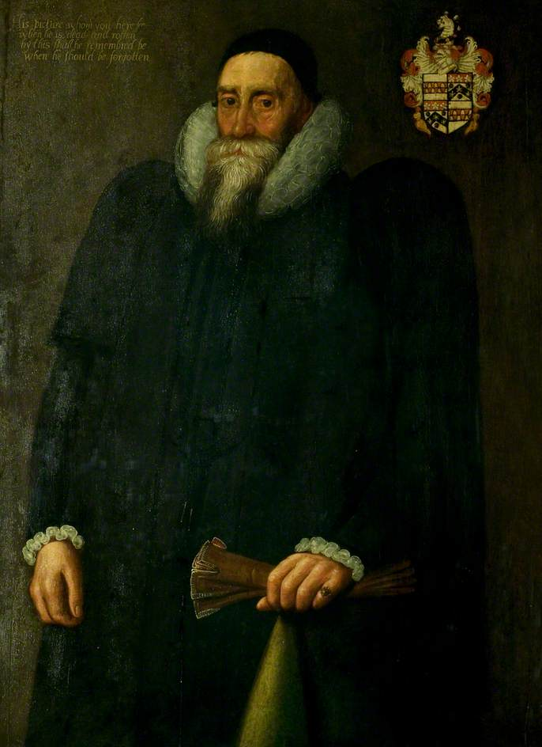
‘a handsome Stone Pillar, three Foot high, with this inscription, “Here lies the Body of Richard III. some Time King of England,”
Christopher Wren, 1612
Notes:
After the battle, Richard’s body was stripped naked, thrown over the back of a horse, and brought back to Leicester. His corpse was taken through the town to the Newarke where it was displayed in the Church of the Annunciation of the Blessed Virgin Mary, effectively a Lancastrian mausoleum (an added insult to a Yorkist king). This was to prove he really was dead.
Two or three days later it was taken from the church and speedily buried in the Franciscan friary church known as Greyfriars.
We don’t know why this church was chosen. It is possible the friars asked to bury him. However, Henry Tudor was devoted to the cult of St Francis and it is more likely that he ordered them to bury him.
CLICK
32 years later the friary was demolished as part of Henry VIII’s Dissolution of the Monasteries.
CLICK
The friary grounds were bought by Robert Herrick, a former mayor of Leicester, who built a mansion and gardens on the site. In his garden he erected a memorial pillar to Richard III.
This was recorded in the diary of Christopher Wren, the father of the famous architect, on a visit to Leicester.
Importantly, Herrick (a local man) clearly believes Richard III is still buried beneath his garden a year after the legend was published that he had been dug up and thrown in the river.

Slide 15
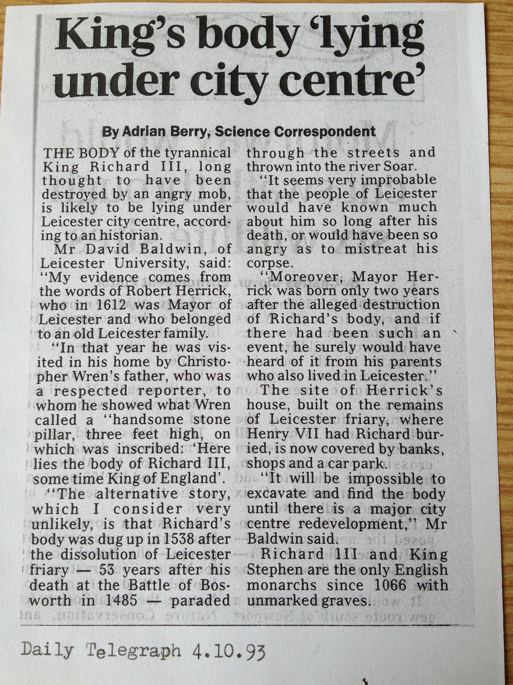
John Speede’s Map, 1610
Notes:
Use this slide if you want to talk about Speed’s map
This is John Speed’s map of Leicestershire, dated 1610.
On it he includes a small map of Leicester and a depiction of the Battle of Bosworth.
CLICK
Speed describes the friary as being ruined and Richard’s tomb as obscured by weeds.
In his History of England, published the following year Speed records a storey about how Richard’s body was dug up during the dissolution by a jeering mob and thrown off Bow Bridge into the river Soar. Speed is the first person to record this legend, over 70 years after it was supposed to have happened.
However, Speed may have never visited Leicester. If he did, he visited the wrong friary.
CLICK
Instead of visiting Greyfriars, which is located here
CLICK
He visited Blackfriars, here. The key to the map clearly shows them labelled the wrong way round.

Slide 16
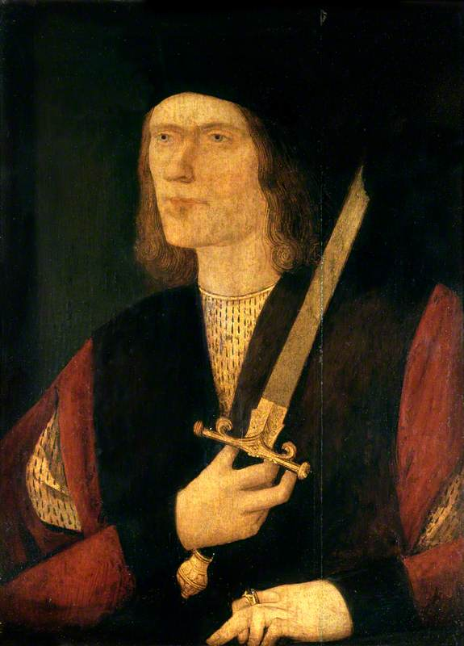
Richard III: what are we looking for?
Notes:
So, how do we identify a King…
Well, hidden amongst the Tudor hyperbole we do have a couple of contemporary descriptions of him.
But how reliable are they?

Slide 17
Richard III: what are we looking for?
In the choir of the Greyfriars in Leicester
Aged 32 at time of death
Battle injuries!
Possibly a hunchback with a slight build
Shakespeare – threw in a withered arm
Notes:
So, how do we identify a King…
Well, hidden amongst the Tudor hyperbole we do have a couple of contemporary descriptions of him.
But how reliable are they?

Slide 18
Richard III: what are we looking for?
In the choir of the Greyfriars in Leicester
Aged 32 at time of death
Battle injuries!
Possibly a hunchback with a slight build
Shakespeare – threw in a withered arm
Contemporary sources
‘…he [Richard III] was small of stature, with a short face and unequal shoulders, the right higher and the left lower.’
John Rous, late 1480s (chantry priest and chronicler)
‘King Richard is… a high-born prince, three fingers taller than I, but a bit slimmer and not as thickset as I am, and much more lightly built; he has quite slender arms and thighs, and also a great heart.’
Niclas von Popplau, 1484 (itinerant Silesian knight visiting England)
Notes:
So, how do we identify a King…
Well, hidden amongst the Tudor hyperbole we do have a couple of contemporary descriptions of him.
But how reliable are they?

Slide 19
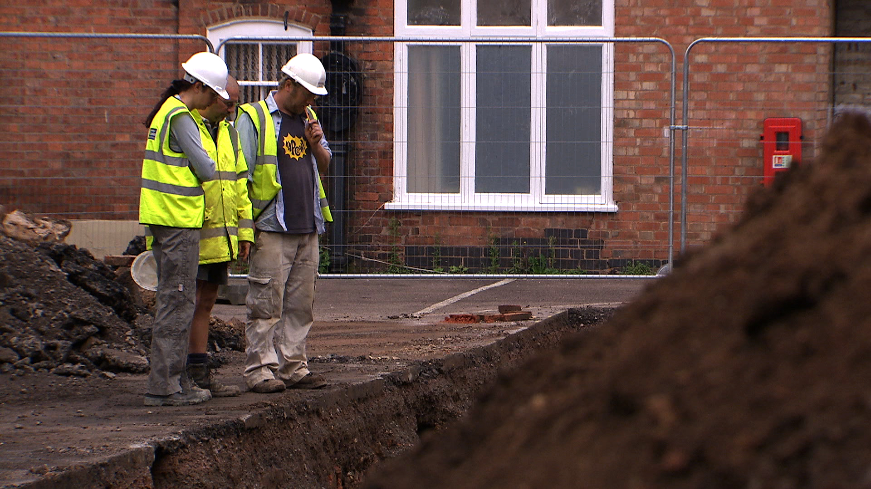
Notes:
The problem was where to dig, we could aimlessly dig a lot of holes and find nothing.
CLICK
With this in mind, we identified a series of five progressive research objectives.
CLICK
Which we gave increasing levels of improbability.
Going into the project we were pretty sure we would achieve the first 2 objectives and achieving the 3rd would have been a huge success.
We never imagined we would be able to achieve all 5! Or that we would actually manage to do no. 5 before the other 4!

Slide 20
1. Find the Franciscan friary buildings.
2. Within the friary, work out which bits had been found
3. Locate the friary church.
4. Locate the east end of the church, specifically the choir.
5. Locate the mortal remains of Richard III.
Notes:
The problem was where to dig, we could aimlessly dig a lot of holes and find nothing.
CLICK
With this in mind, we identified a series of five progressive research objectives.
CLICK
Which we gave increasing levels of improbability.
Going into the project we were pretty sure we would achieve the first 2 objectives and achieving the 3rd would have been a huge success.
We never imagined we would be able to achieve all 5! Or that we would actually manage to do no. 5 before the other 4!

Slide 21
1. Find the Franciscan friary buildings.
1. A reasonable expectation
2. Probable
2. Within the friary, work out which bits had been found
3. Possible
3. Locate the friary church.
4. Locate the east end of the church, specifically the choir.
4. An outside chance
5. Locate the mortal remains of Richard III.
5. Not realistically considered
Notes:
The problem was where to dig, we could aimlessly dig a lot of holes and find nothing.
CLICK
With this in mind, we identified a series of five progressive research objectives.
CLICK
Which we gave increasing levels of improbability.
Going into the project we were pretty sure we would achieve the first 2 objectives and achieving the 3rd would have been a huge success.
We never imagined we would be able to achieve all 5! Or that we would actually manage to do no. 5 before the other 4!

Slide 22
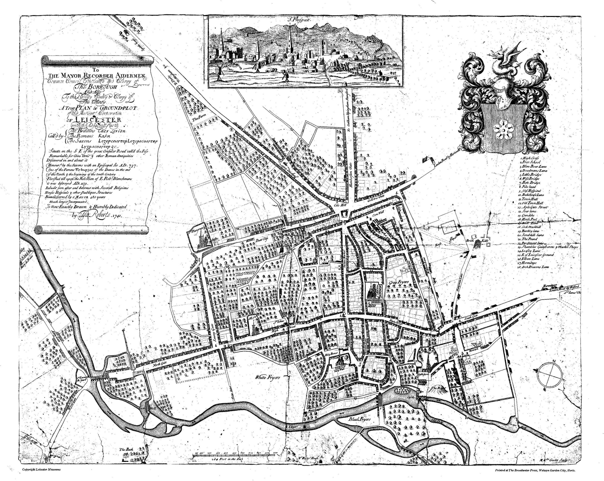
Thomas Robert’s map, 1741
Modern Ordnance Survey Map
Notes:
Thomas Robert’s 1741 map of Leicester is the first accurate map of the town.
CLICK
Helpfully, it still clearly marks a large rhomboidal area of land clearly labelled Grey Friars.
CLICK
The map is accurate enough that you can compare it with modern maps of Leicester.
CLICK
And when you overlay the two, you are instantly provided with a search area (red) in which there are several large open spaces (blue) which appear to have remained largely undeveloped since the friary’s dissolution.
It should be noted, however, that these still only constitute 17% of the friary precinct, not even a quarter of it.
Taking into count limitations on time and resources, only 1% of the friary precinct could be excavated.

Slide 23
Thomas Robert’s map, 1741
Modern Ordnance Survey Map
Notes:
Thomas Robert’s 1741 map of Leicester is the first accurate map of the town.
CLICK
Helpfully, it still clearly marks a large rhomboidal area of land clearly labelled Grey Friars.
CLICK
The map is accurate enough that you can compare it with modern maps of Leicester.
CLICK
And when you overlay the two, you are instantly provided with a search area (red) in which there are several large open spaces (blue) which appear to have remained largely undeveloped since the friary’s dissolution.
It should be noted, however, that these still only constitute 17% of the friary precinct, not even a quarter of it.
Taking into count limitations on time and resources, only 1% of the friary precinct could be excavated.

Slide 24
Thomas Robert’s map, 1741
Modern Ordnance Survey Map
Notes:
Thomas Robert’s 1741 map of Leicester is the first accurate map of the town.
CLICK
Helpfully, it still clearly marks a large rhomboidal area of land clearly labelled Grey Friars.
CLICK
The map is accurate enough that you can compare it with modern maps of Leicester.
CLICK
And when you overlay the two, you are instantly provided with a search area (red) in which there are several large open spaces (blue) which appear to have remained largely undeveloped since the friary’s dissolution.
It should be noted, however, that these still only constitute 17% of the friary precinct, not even a quarter of it.
Taking into count limitations on time and resources, only 1% of the friary precinct could be excavated.

Slide 25
Social Services Car Park
Thomas Robert’s map, 1741
Modern Ordnance Survey Map
Notes:
Thomas Robert’s 1741 map of Leicester is the first accurate map of the town.
CLICK
Helpfully, it still clearly marks a large rhomboidal area of land clearly labelled Grey Friars.
CLICK
The map is accurate enough that you can compare it with modern maps of Leicester.
CLICK
And when you overlay the two, you are instantly provided with a search area (red) in which there are several large open spaces (blue) which appear to have remained largely undeveloped since the friary’s dissolution.
It should be noted, however, that these still only constitute 17% of the friary precinct, not even a quarter of it.
Taking into count limitations on time and resources, only 1% of the friary precinct could be excavated.

Slide 26
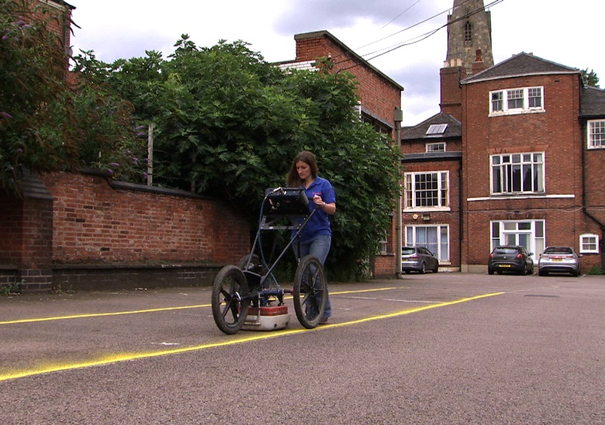
Notes:
So, where to look.
The first step was to do a ground penetrating radar survey of all three open spaces. It was hoped that this would pick up the walls of the friary without having to dig any holes and allow trenches to be targeted on specific areas.
It failed! All it picked up were anomalous spreads of rubble (green) which could be modern and modern service lines (red). In this it was useful as it meant we could avoid digging through anyone’s sewer or phone line.
CLICK
Where to dig. Well, if you consider a friary the majority of the walls are east/west. This is because Christian religious buildings are orientated east/west (such as Grey Friars at Walsingham in Norfolk).
CLICK
Therefore, if we dig long trenches orientated north/south (30m by 1.6), placed to transect as much of the site as possible, we should pick up lots of east/west walls and hopefully be able to work out where we are in the friary.

Slide 27
Grey Friars, Walsingham
Notes:
So, where to look.
The first step was to do a ground penetrating radar survey of all three open spaces. It was hoped that this would pick up the walls of the friary without having to dig any holes and allow trenches to be targeted on specific areas.
It failed! All it picked up were anomalous spreads of rubble (green) which could be modern and modern service lines (red). In this it was useful as it meant we could avoid digging through anyone’s sewer or phone line.
CLICK
Where to dig. Well, if you consider a friary the majority of the walls are east/west. This is because Christian religious buildings are orientated east/west (such as Grey Friars at Walsingham in Norfolk).
CLICK
Therefore, if we dig long trenches orientated north/south (30m by 1.6), placed to transect as much of the site as possible, we should pick up lots of east/west walls and hopefully be able to work out where we are in the friary.

Slide 28
Trench 1
Trench 2
Grey Friars, Walsingham
Notes:
So, where to look.
The first step was to do a ground penetrating radar survey of all three open spaces. It was hoped that this would pick up the walls of the friary without having to dig any holes and allow trenches to be targeted on specific areas.
It failed! All it picked up were anomalous spreads of rubble (green) which could be modern and modern service lines (red). In this it was useful as it meant we could avoid digging through anyone’s sewer or phone line.
CLICK
Where to dig. Well, if you consider a friary the majority of the walls are east/west. This is because Christian religious buildings are orientated east/west (such as Grey Friars at Walsingham in Norfolk).
CLICK
Therefore, if we dig long trenches orientated north/south (30m by 1.6), placed to transect as much of the site as possible, we should pick up lots of east/west walls and hopefully be able to work out where we are in the friary.

Slide 29
Notes:
So, putting the evidence together from the first 2 trenches:
We had found a long north/south corridor which could be on the western or eastern side of the cloister garth leading up to an east/west orientated building with benches built along its walls.
CLICK
A building like this is most likely going to be the friary’s chapter house. If you’ve visited a ruined monastery you will have seen its chapter house with benches running along its walls. Its where the friars would have met daily to discuses the business of the day.
This meant we had found the friary and worked out which parts we had found.
But where was the church? It could be to the north or the south, so where to put the third trench?
Well, I piece of documentary evidence refers to the church being accessed from the street today known as St Martin’s and in the 18th century human remains were found when the cellars for the houses north of Trench 1.
CLICK
We had also found a grave on the first day, and a large area of rubble which might be the remains of a large robbed wall, possibly the churches.
CLICK
Taking all this into account, we decided the best place to put the third trench was in the school playground to the east of Trench 1. We hoped the archaeology would be less disturbed here and it would allow us to complete the transect through the site up to the street.

Slide 30
Church?
Cloister Garth
Chapter House
Eastern Cloistral Walk
Church?
Notes:
So, putting the evidence together from the first 2 trenches:
We had found a long north/south corridor which could be on the western or eastern side of the cloister garth leading up to an east/west orientated building with benches built along its walls.
CLICK
A building like this is most likely going to be the friary’s chapter house. If you’ve visited a ruined monastery you will have seen its chapter house with benches running along its walls. Its where the friars would have met daily to discuses the business of the day.
This meant we had found the friary and worked out which parts we had found.
But where was the church? It could be to the north or the south, so where to put the third trench?
Well, I piece of documentary evidence refers to the church being accessed from the street today known as St Martin’s and in the 18th century human remains were found when the cellars for the houses north of Trench 1.
CLICK
We had also found a grave on the first day, and a large area of rubble which might be the remains of a large robbed wall, possibly the churches.
CLICK
Taking all this into account, we decided the best place to put the third trench was in the school playground to the east of Trench 1. We hoped the archaeology would be less disturbed here and it would allow us to complete the transect through the site up to the street.

Slide 31
Grave
Church?
Robbed wall?
Cloister Garth
Chapter House
Eastern Cloistral Walk
Church?
Notes:
So, putting the evidence together from the first 2 trenches:
We had found a long north/south corridor which could be on the western or eastern side of the cloister garth leading up to an east/west orientated building with benches built along its walls.
CLICK
A building like this is most likely going to be the friary’s chapter house. If you’ve visited a ruined monastery you will have seen its chapter house with benches running along its walls. Its where the friars would have met daily to discuses the business of the day.
This meant we had found the friary and worked out which parts we had found.
But where was the church? It could be to the north or the south, so where to put the third trench?
Well, I piece of documentary evidence refers to the church being accessed from the street today known as St Martin’s and in the 18th century human remains were found when the cellars for the houses north of Trench 1.
CLICK
We had also found a grave on the first day, and a large area of rubble which might be the remains of a large robbed wall, possibly the churches.
CLICK
Taking all this into account, we decided the best place to put the third trench was in the school playground to the east of Trench 1. We hoped the archaeology would be less disturbed here and it would allow us to complete the transect through the site up to the street.

Slide 32
Trench 3
Church?
Cloister Garth
Chapter House
Eastern Cloistral Walk
Church?
Notes:
So, putting the evidence together from the first 2 trenches:
We had found a long north/south corridor which could be on the western or eastern side of the cloister garth leading up to an east/west orientated building with benches built along its walls.
CLICK
A building like this is most likely going to be the friary’s chapter house. If you’ve visited a ruined monastery you will have seen its chapter house with benches running along its walls. Its where the friars would have met daily to discuses the business of the day.
This meant we had found the friary and worked out which parts we had found.
But where was the church? It could be to the north or the south, so where to put the third trench?
Well, I piece of documentary evidence refers to the church being accessed from the street today known as St Martin’s and in the 18th century human remains were found when the cellars for the houses north of Trench 1.
CLICK
We had also found a grave on the first day, and a large area of rubble which might be the remains of a large robbed wall, possibly the churches.
CLICK
Taking all this into account, we decided the best place to put the third trench was in the school playground to the east of Trench 1. We hoped the archaeology would be less disturbed here and it would allow us to complete the transect through the site up to the street.

Slide 33
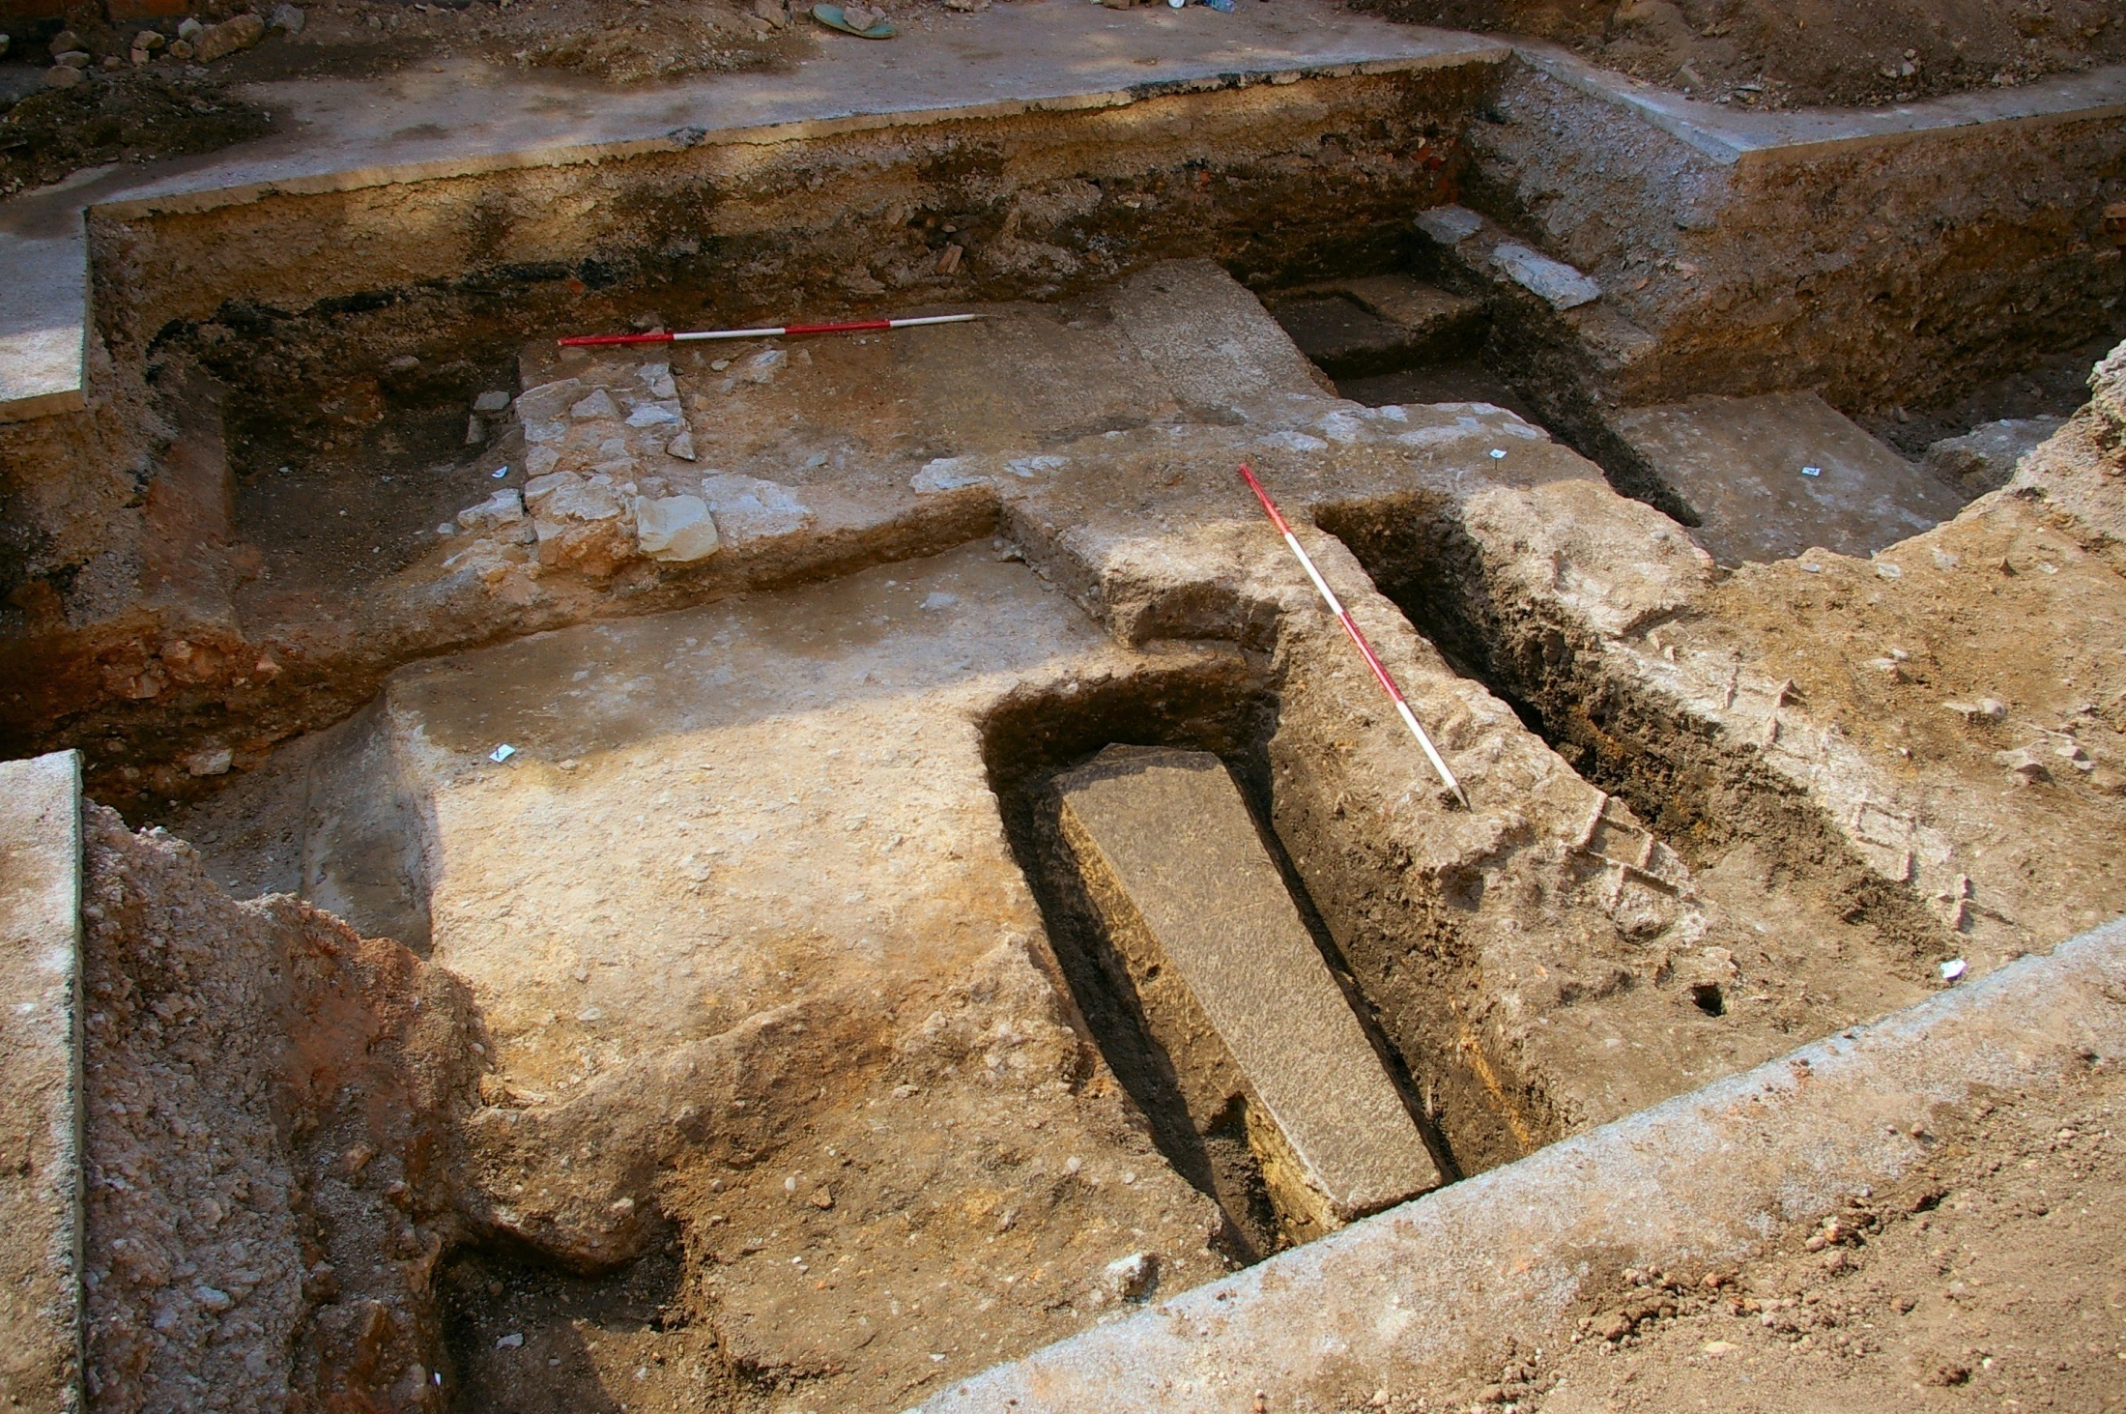
Trench 3
Floors
Wall lines
Notes:
In Trench 3 the archaeology was a lot shallower and better preserved.
CLICK
Straight away we found what appeared to be in-situ medieval floor tiles.
CLICK
However, once we had cleaned them up we realised the pavement is using 4 or 5 different types of medieval floor tile but probably isn’t medieval in date. This is one use the friary’s floor tiles had been put to after they had been stripped out of the friary. It could be one of Robert Herrick’s garden paths.
CLICK
As we continued excavating the trench we found to large robbed walls, both over 1m wide and spaced about 7.5m apart. One wall even appeared to have been buttressed. Between them was evidence for lots of floors and possibly more graves. A building this size was almost certainly the church.
As the archaeology survived so well in this trench, we decided to widen it.
CLICK
As we did, we found a small group of disarticulated bone, all seemingly from one person, most likely a woman. Her grave was probably disturbed during the demolition of the church and the lose bones had been reburied in a small pit.
We also found a large dump of window tracery.
CLICK
This appears to be from an early 15th century perpendicular window, most likely one of the southern church windows.
CLICK
Once widened, Trench 3 told us a lot about the interior of the church. CLICK. Here are the church walls (we’re looking west). Between them we can see a low L-shaped stone wall and different areas of floor tiling. At the top the tile impressions are parallel with the walls; at the bottom they are diamond patterned. CLICK. This suggests two different spaces in the eastern half of the church, the choir with its choir stalls, and the presbytery. CLICK. We also found several other graves, including one in a stone coffin. These were found after we had excavated the skeleton we believed was Richard III so we didn’t feel their was any need to excavate them.
CLICK
We were also finding lots of decorated floor tiles, this medieval silver halfpenny of Edward IV (Richard III’s brother), and a number of brass letters most likely from tomb inscriptions. It appears, when the church was demolished in 1538, all the tombs were broken up and their material recycled. Anything of value was salvaged, including metal which would have been melted down and reused. However, the destruction was only at floor level and no attempts were made to desecrate the underlying graves.

Slide 34
Trench 3
Floors
North wall
Wall lines
South wall
Notes:
In Trench 3 the archaeology was a lot shallower and better preserved.
CLICK
Straight away we found what appeared to be in-situ medieval floor tiles.
CLICK
However, once we had cleaned them up we realised the pavement is using 4 or 5 different types of medieval floor tile but probably isn’t medieval in date. This is one use the friary’s floor tiles had been put to after they had been stripped out of the friary. It could be one of Robert Herrick’s garden paths.
CLICK
As we continued excavating the trench we found to large robbed walls, both over 1m wide and spaced about 7.5m apart. One wall even appeared to have been buttressed. Between them was evidence for lots of floors and possibly more graves. A building this size was almost certainly the church.
As the archaeology survived so well in this trench, we decided to widen it.
CLICK
As we did, we found a small group of disarticulated bone, all seemingly from one person, most likely a woman. Her grave was probably disturbed during the demolition of the church and the lose bones had been reburied in a small pit.
We also found a large dump of window tracery.
CLICK
This appears to be from an early 15th century perpendicular window, most likely one of the southern church windows.
CLICK
Once widened, Trench 3 told us a lot about the interior of the church. CLICK. Here are the church walls (we’re looking west). Between them we can see a low L-shaped stone wall and different areas of floor tiling. At the top the tile impressions are parallel with the walls; at the bottom they are diamond patterned. CLICK. This suggests two different spaces in the eastern half of the church, the choir with its choir stalls, and the presbytery. CLICK. We also found several other graves, including one in a stone coffin. These were found after we had excavated the skeleton we believed was Richard III so we didn’t feel their was any need to excavate them.
CLICK
We were also finding lots of decorated floor tiles, this medieval silver halfpenny of Edward IV (Richard III’s brother), and a number of brass letters most likely from tomb inscriptions. It appears, when the church was demolished in 1538, all the tombs were broken up and their material recycled. Anything of value was salvaged, including metal which would have been melted down and reused. However, the destruction was only at floor level and no attempts were made to desecrate the underlying graves.

Slide 35
Trench 3
Choir
Floors
North wall
Wall lines
South wall
Presbytery
Choir stall footing
Notes:
In Trench 3 the archaeology was a lot shallower and better preserved.
CLICK
Straight away we found what appeared to be in-situ medieval floor tiles.
CLICK
However, once we had cleaned them up we realised the pavement is using 4 or 5 different types of medieval floor tile but probably isn’t medieval in date. This is one use the friary’s floor tiles had been put to after they had been stripped out of the friary. It could be one of Robert Herrick’s garden paths.
CLICK
As we continued excavating the trench we found to large robbed walls, both over 1m wide and spaced about 7.5m apart. One wall even appeared to have been buttressed. Between them was evidence for lots of floors and possibly more graves. A building this size was almost certainly the church.
As the archaeology survived so well in this trench, we decided to widen it.
CLICK
As we did, we found a small group of disarticulated bone, all seemingly from one person, most likely a woman. Her grave was probably disturbed during the demolition of the church and the lose bones had been reburied in a small pit.
We also found a large dump of window tracery.
CLICK
This appears to be from an early 15th century perpendicular window, most likely one of the southern church windows.
CLICK
Once widened, Trench 3 told us a lot about the interior of the church. CLICK. Here are the church walls (we’re looking west). Between them we can see a low L-shaped stone wall and different areas of floor tiling. At the top the tile impressions are parallel with the walls; at the bottom they are diamond patterned. CLICK. This suggests two different spaces in the eastern half of the church, the choir with its choir stalls, and the presbytery. CLICK. We also found several other graves, including one in a stone coffin. These were found after we had excavated the skeleton we believed was Richard III so we didn’t feel their was any need to excavate them.
CLICK
We were also finding lots of decorated floor tiles, this medieval silver halfpenny of Edward IV (Richard III’s brother), and a number of brass letters most likely from tomb inscriptions. It appears, when the church was demolished in 1538, all the tombs were broken up and their material recycled. Anything of value was salvaged, including metal which would have been melted down and reused. However, the destruction was only at floor level and no attempts were made to desecrate the underlying graves.

Slide 36
Trench 3
Graves
Choir
Floors
North wall
Wall lines
South wall
Presbytery
Choir stall footing
Stone coffin
Tile impressions
Notes:
In Trench 3 the archaeology was a lot shallower and better preserved.
CLICK
Straight away we found what appeared to be in-situ medieval floor tiles.
CLICK
However, once we had cleaned them up we realised the pavement is using 4 or 5 different types of medieval floor tile but probably isn’t medieval in date. This is one use the friary’s floor tiles had been put to after they had been stripped out of the friary. It could be one of Robert Herrick’s garden paths.
CLICK
As we continued excavating the trench we found to large robbed walls, both over 1m wide and spaced about 7.5m apart. One wall even appeared to have been buttressed. Between them was evidence for lots of floors and possibly more graves. A building this size was almost certainly the church.
As the archaeology survived so well in this trench, we decided to widen it.
CLICK
As we did, we found a small group of disarticulated bone, all seemingly from one person, most likely a woman. Her grave was probably disturbed during the demolition of the church and the lose bones had been reburied in a small pit.
We also found a large dump of window tracery.
CLICK
This appears to be from an early 15th century perpendicular window, most likely one of the southern church windows.
CLICK
Once widened, Trench 3 told us a lot about the interior of the church. CLICK. Here are the church walls (we’re looking west). Between them we can see a low L-shaped stone wall and different areas of floor tiling. At the top the tile impressions are parallel with the walls; at the bottom they are diamond patterned. CLICK. This suggests two different spaces in the eastern half of the church, the choir with its choir stalls, and the presbytery. CLICK. We also found several other graves, including one in a stone coffin. These were found after we had excavated the skeleton we believed was Richard III so we didn’t feel their was any need to excavate them.
CLICK
We were also finding lots of decorated floor tiles, this medieval silver halfpenny of Edward IV (Richard III’s brother), and a number of brass letters most likely from tomb inscriptions. It appears, when the church was demolished in 1538, all the tombs were broken up and their material recycled. Anything of value was salvaged, including metal which would have been melted down and reused. However, the destruction was only at floor level and no attempts were made to desecrate the underlying graves.

Slide 37
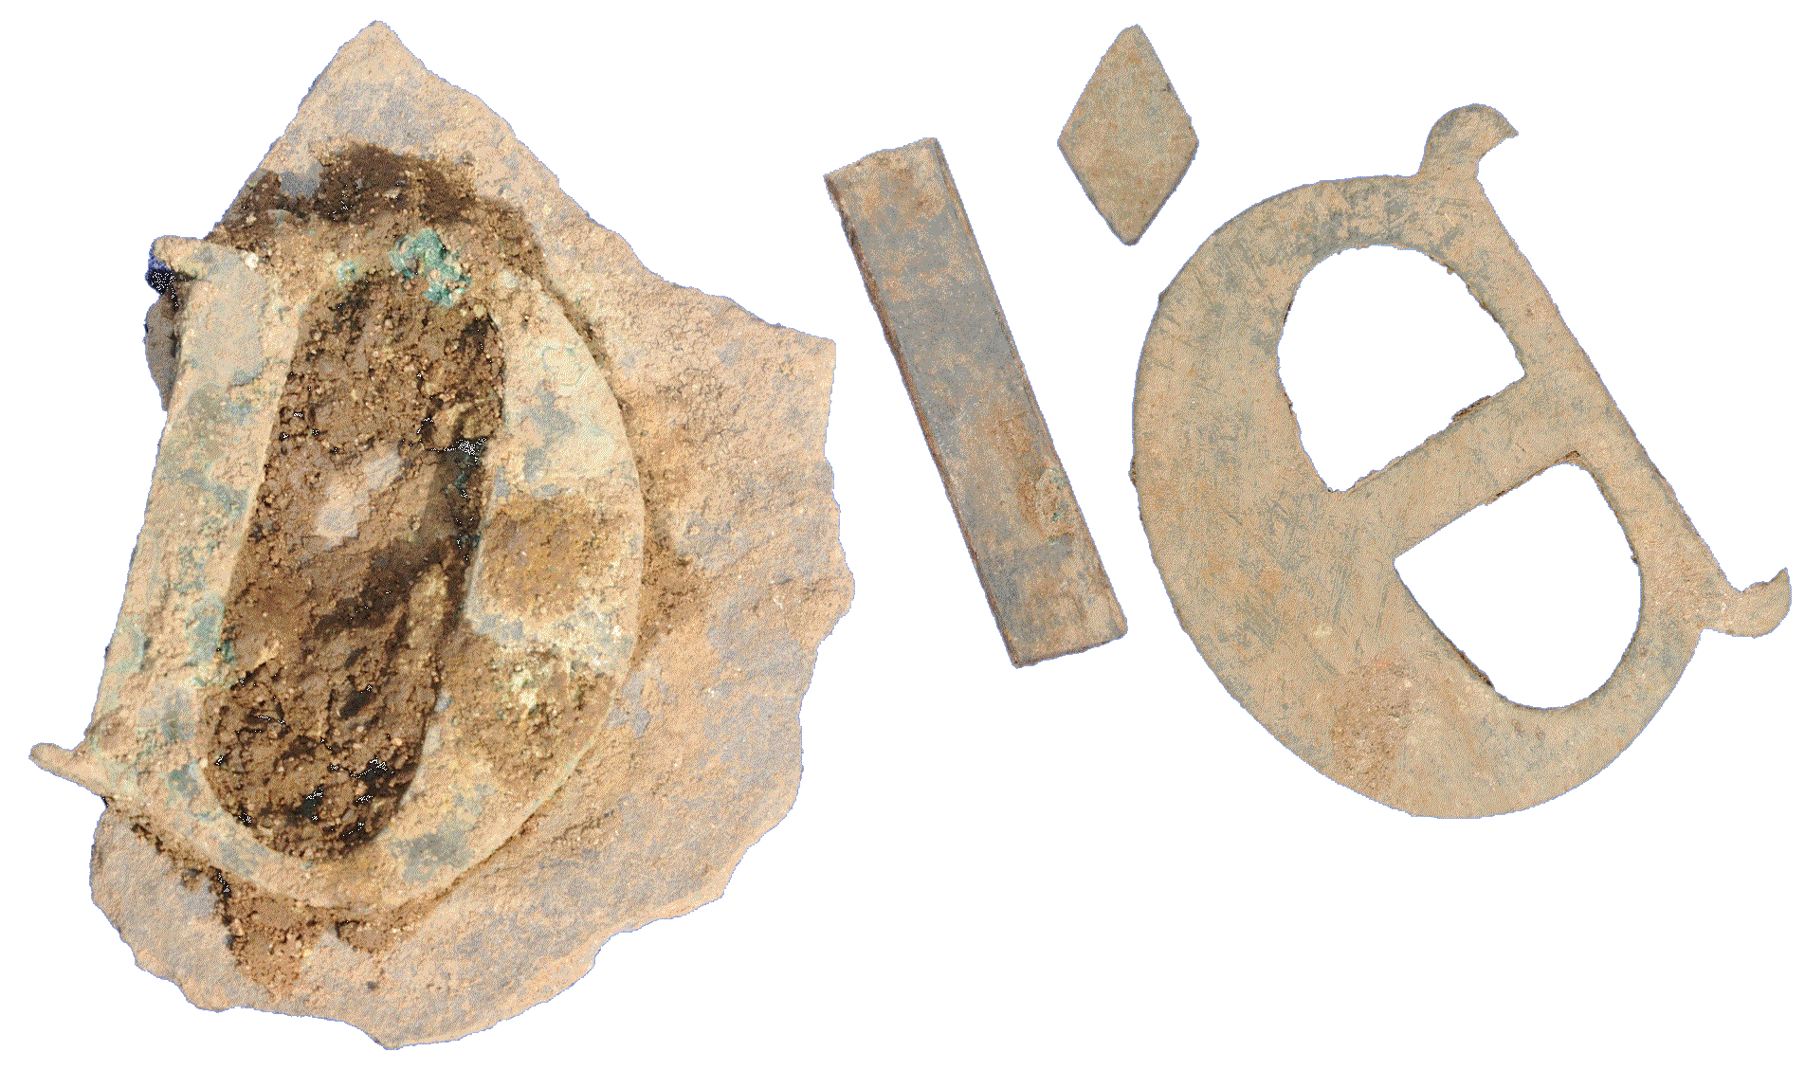
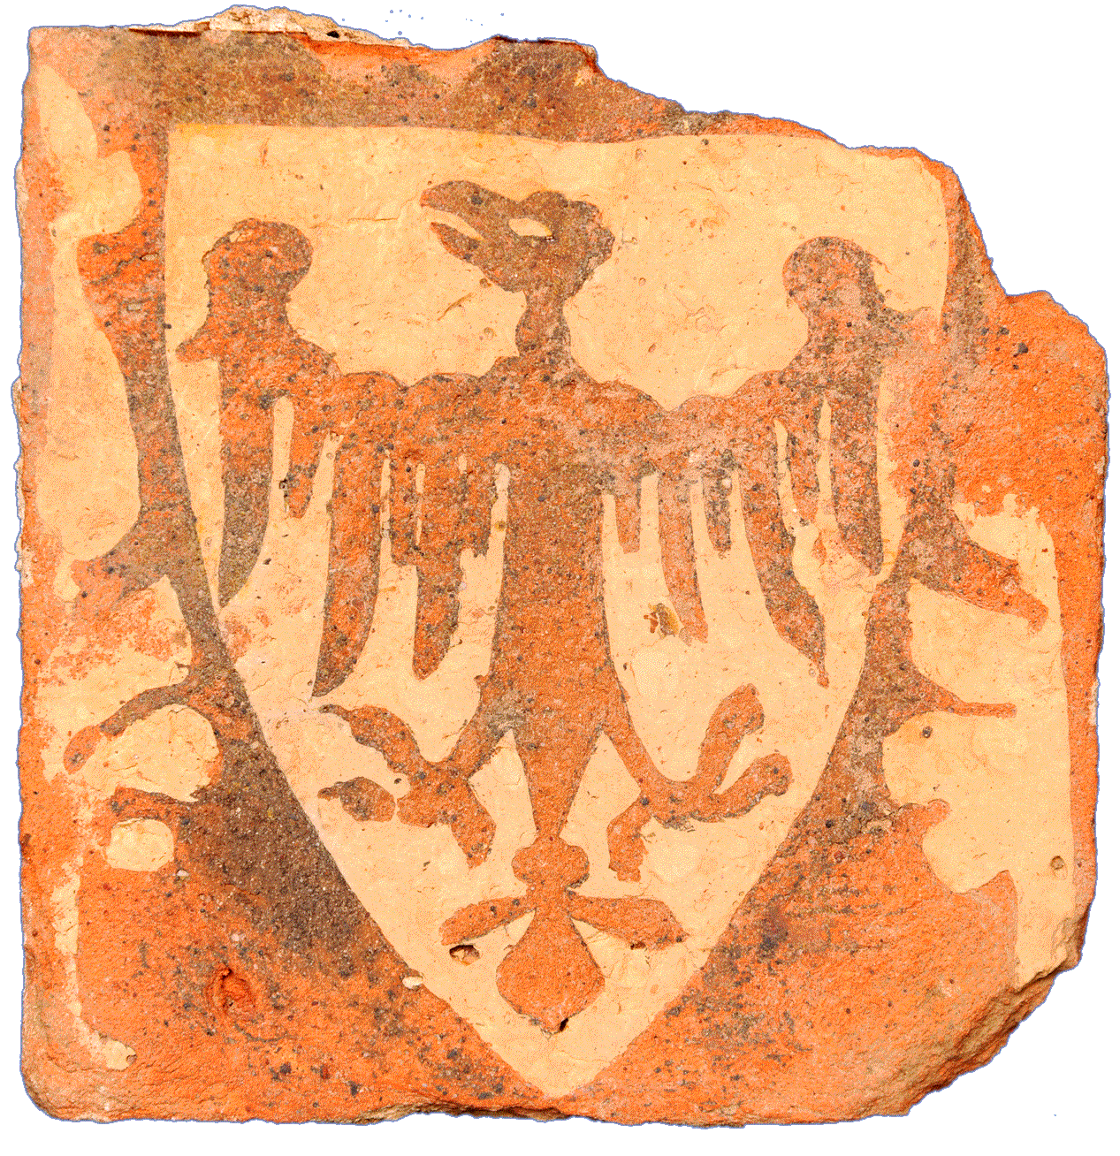
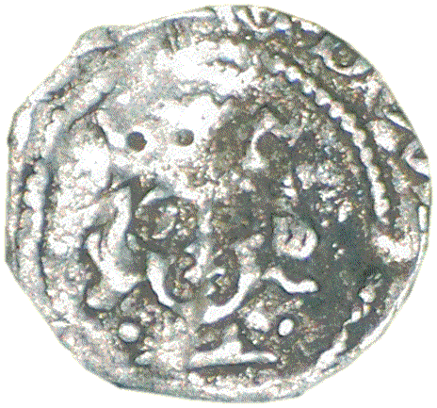
Trench 3
Floors
Wall lines
Tomb lettering c.1270-1350
Edward IV? silver halfpenny c.1468-9
Inlaid floor tile c.1277
Heraldic – Eagle displayed
Richard of Cornwall as King of the Romans
Notes:
In Trench 3 the archaeology was a lot shallower and better preserved.
CLICK
Straight away we found what appeared to be in-situ medieval floor tiles.
CLICK
However, once we had cleaned them up we realised the pavement is using 4 or 5 different types of medieval floor tile but probably isn’t medieval in date. This is one use the friary’s floor tiles had been put to after they had been stripped out of the friary. It could be one of Robert Herrick’s garden paths.
CLICK
As we continued excavating the trench we found to large robbed walls, both over 1m wide and spaced about 7.5m apart. One wall even appeared to have been buttressed. Between them was evidence for lots of floors and possibly more graves. A building this size was almost certainly the church.
As the archaeology survived so well in this trench, we decided to widen it.
CLICK
As we did, we found a small group of disarticulated bone, all seemingly from one person, most likely a woman. Her grave was probably disturbed during the demolition of the church and the lose bones had been reburied in a small pit.
We also found a large dump of window tracery.
CLICK
This appears to be from an early 15th century perpendicular window, most likely one of the southern church windows.
CLICK
Once widened, Trench 3 told us a lot about the interior of the church. CLICK. Here are the church walls (we’re looking west). Between them we can see a low L-shaped stone wall and different areas of floor tiling. At the top the tile impressions are parallel with the walls; at the bottom they are diamond patterned. CLICK. This suggests two different spaces in the eastern half of the church, the choir with its choir stalls, and the presbytery. CLICK. We also found several other graves, including one in a stone coffin. These were found after we had excavated the skeleton we believed was Richard III so we didn’t feel their was any need to excavate them.
CLICK
We were also finding lots of decorated floor tiles, this medieval silver halfpenny of Edward IV (Richard III’s brother), and a number of brass letters most likely from tomb inscriptions. It appears, when the church was demolished in 1538, all the tombs were broken up and their material recycled. Anything of value was salvaged, including metal which would have been melted down and reused. However, the destruction was only at floor level and no attempts were made to desecrate the underlying graves.

Slide 38
Graves
Choir
Walking Place?
Presbytery
Skeleton 1’s Grave
Choir stall
Notes:
First the position of the grave.
From all the evidence we can create a conjectural layout of the interior of the east end of the church.
Projecting the southern choir stall west from Trench 3 across Trench 1 shows that the grave containing Skeleton 1 (Richard’s official designation) is located at the west end of the choir against the southern choir stall.
This fits with the Rous’s record that he was buried in the choir of the Friars Minor at Leicester.
CLICK
This reconstruction of the interior of the choir gives you an idea of where he was buried.
Why bury him in the choir. Well, on the one hand it is a place of high honour and a suitable place to bury a king. However, it is also an area of the church not open to the public. By burying him here he was being placed out of sight, out of mind.

Slide 39
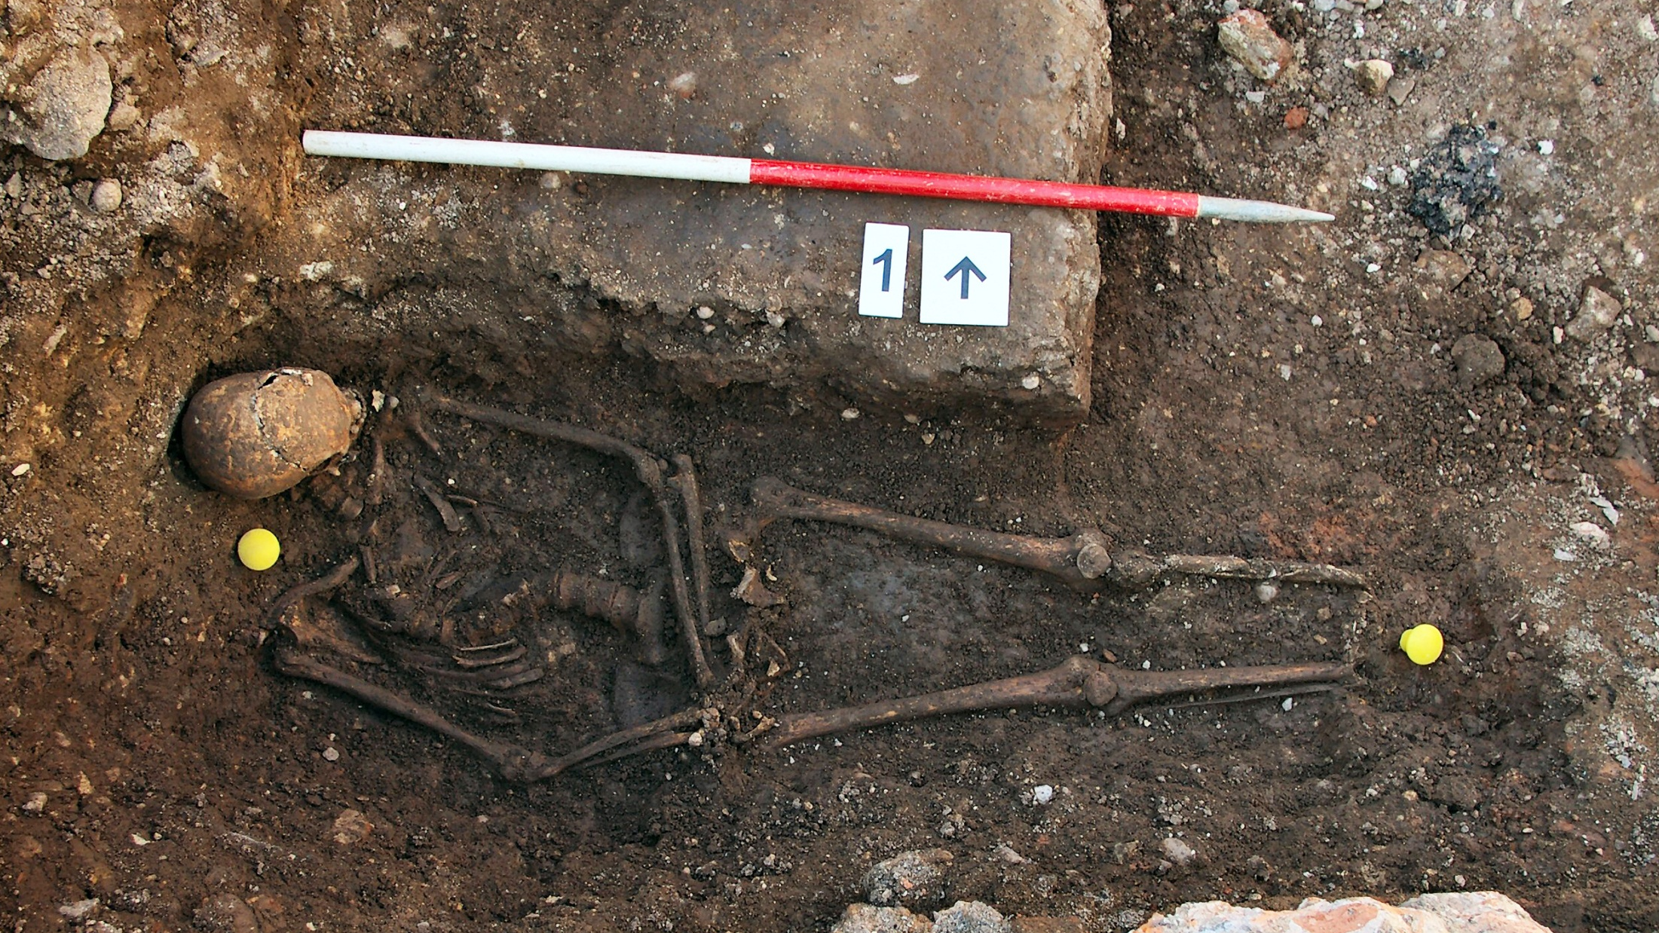
Notes:
The skeleton is in good condition except for the feet which are missing, almost certainly caused by post-mortem damage from later disturbance.
The curve in the vertebrae is clearly visible. This represents their position in life and is not a product of the awkward burial position.
The skeleton is laid awkwardly on the north side of the grave, with its torso twisted slightly to the north and its head propped up against one end.
This is probably because someone was standing in the grave to receive the body. They laid the feet down first, then the torso, finally finding that the head didn’t fit properly.
Again haste or minimal care is suggested. If they had taken the effort to rearrange the body after it was in the grave, pulling it more central, it would have fitted properly.
The position of the hands is interesting. They are place precariously, right over left, over the right hip. This is unusual and may suggest they were tied together.
If they weren’t tied, the right hand should have fallen to the side of the body.
There was no evidence for a coffin, shroud, clothes or any other personal ornaments.

Slide 40
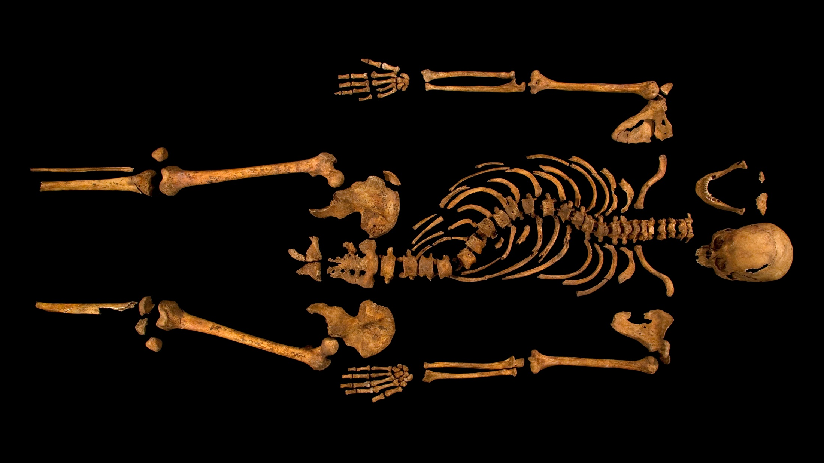
Notes:
Skeleton 1 is male, in his late 20s to late 30s, and has an unusually gracile or feminine build
This is in keeping with historical sources which describe Richard as being of very slight build.
Richard III was 32 when he died.
There is no indication of a withered arm – both arms are of the same size and were used normally during life.
Several teeth were lost before death; the rest are lightly worn, with some dental calculus (calcified plaque) and a few cavities.
This person suffers from idiopathic adolescent onset scoliosis – perhaps onset around the time of puberty. Although it is not known what might of caused this, it was not through trauma (which would have left identifiable markers on the vertebrae).
Without the spinal abnormality, the person would have stood roughly 5ft 8in (1.72m) high.
This is slightly above average height for a medieval man. However, bearing in mind his brother Edward IV was 6ft 2in tall (a difference of 6in) Richard would have looked small in comparison.
The curve of the spine would have also reduced his apparent height and may have lifted his right shoulder higher than his left.

Slide 41
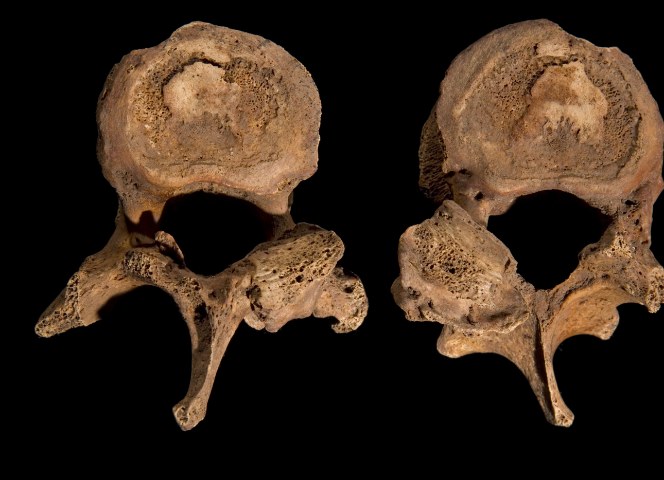

Slide 42
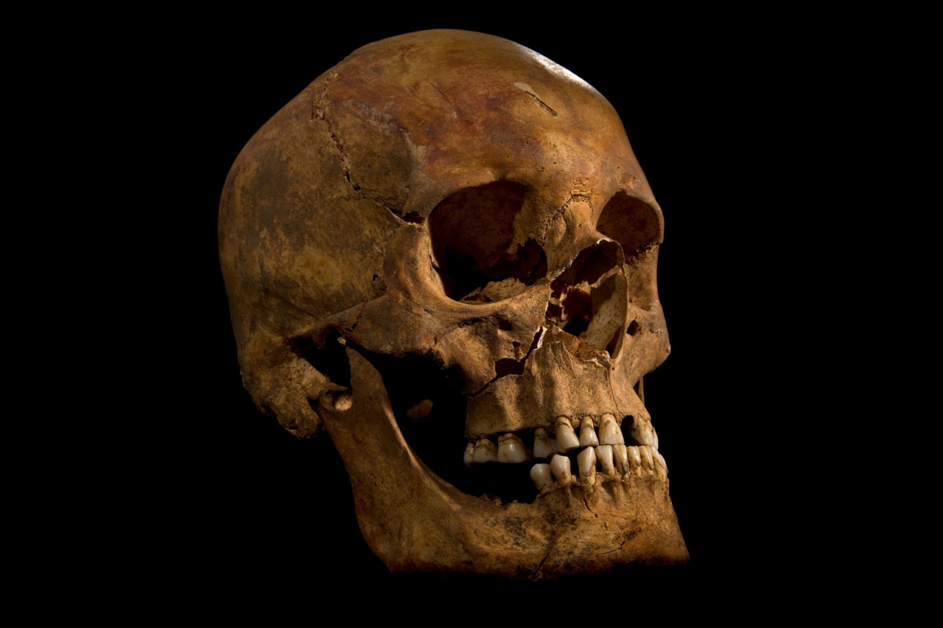
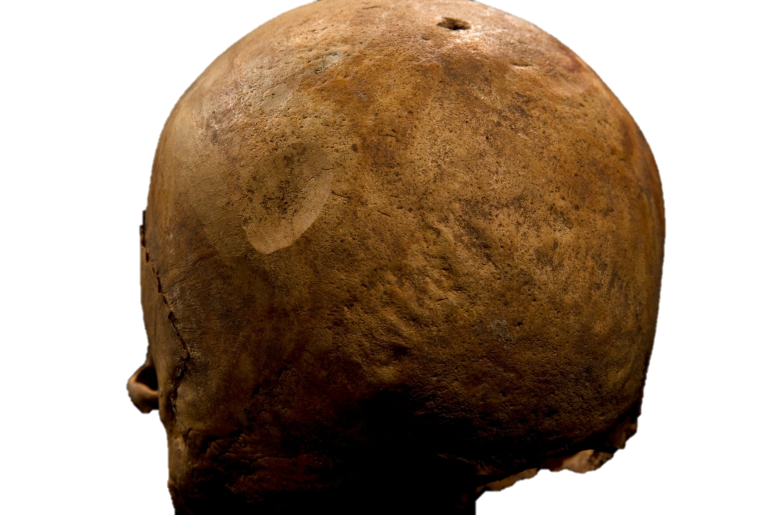
Notes:
On the face, two other wounds have been found.
CLICK
A small rectangular wound to the right cheek.
CLICK
And a cut to the right side of the jaw.
These are superficial, possibly caused by a dagger or similar piercing weapon.
None of the skull injuries would have been possible to inflict on someone wearing a helmet of the type favoured in the late 15th century.
We speculate that the helmet had been lost by this stage of the battle.
Although it cannot be proved, it is possible that the wounds to the face may have been symbolic ‘punishment blows’ delivered to the King’s body after death.
It is noticeable that there are fewer wounds to the face and on this body than others of the period, such as the dead from the battle of Towton in 1461.
The King’s face would have remained recognisable, which would have been important if he was to be publicly displayed.

Slide 43
Notes:
On the face, two other wounds have been found.
CLICK
A small rectangular wound to the right cheek.
CLICK
And a cut to the right side of the jaw.
These are superficial, possibly caused by a dagger or similar piercing weapon.
None of the skull injuries would have been possible to inflict on someone wearing a helmet of the type favoured in the late 15th century.
We speculate that the helmet had been lost by this stage of the battle.
Although it cannot be proved, it is possible that the wounds to the face may have been symbolic ‘punishment blows’ delivered to the King’s body after death.
It is noticeable that there are fewer wounds to the face and on this body than others of the period, such as the dead from the battle of Towton in 1461.
The King’s face would have remained recognisable, which would have been important if he was to be publicly displayed.

Slide 44
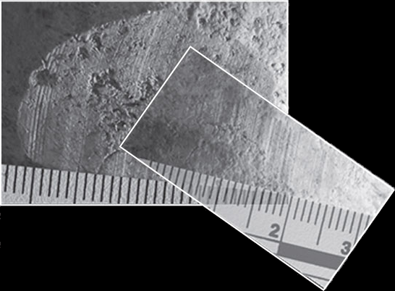
Notes:
On the face, two other wounds have been found.
CLICK
A small rectangular wound to the right cheek.
CLICK
And a cut to the right side of the jaw.
These are superficial, possibly caused by a dagger or similar piercing weapon.
None of the skull injuries would have been possible to inflict on someone wearing a helmet of the type favoured in the late 15th century.
We speculate that the helmet had been lost by this stage of the battle.
Although it cannot be proved, it is possible that the wounds to the face may have been symbolic ‘punishment blows’ delivered to the King’s body after death.
It is noticeable that there are fewer wounds to the face and on this body than others of the period, such as the dead from the battle of Towton in 1461.
The King’s face would have remained recognisable, which would have been important if he was to be publicly displayed.

Slide 45
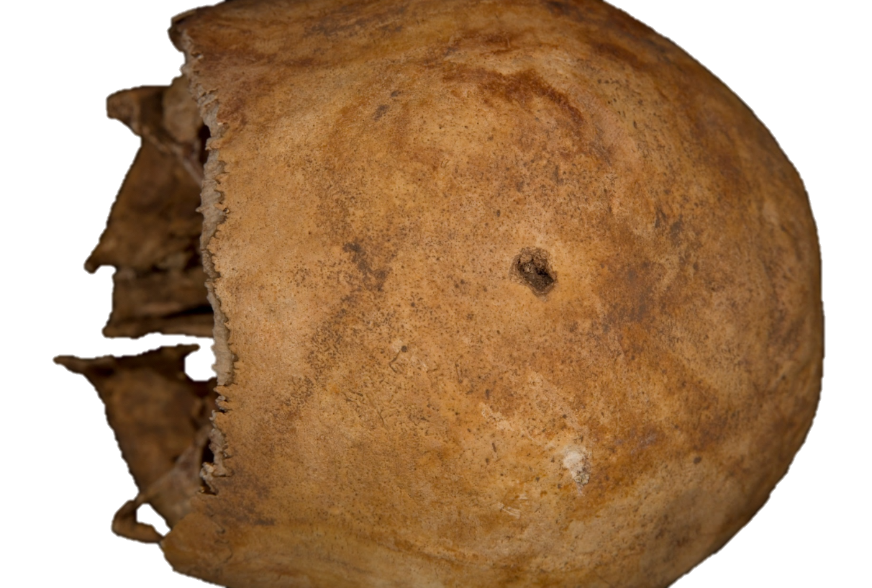
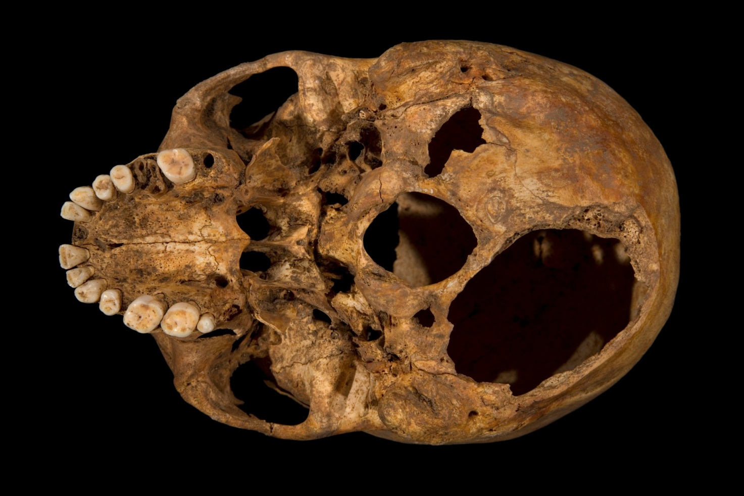

Slide 46
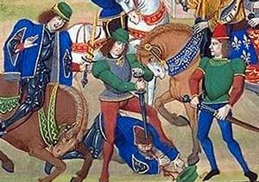
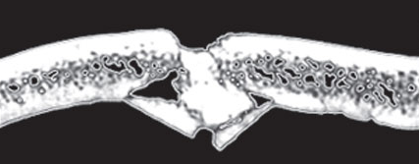

Slide 48
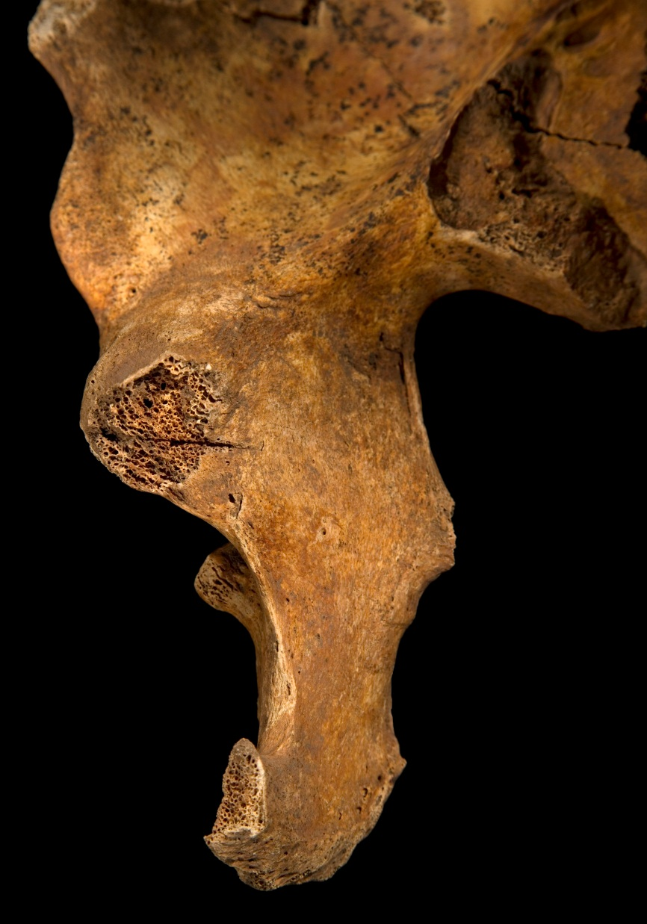
Notes:
And a cut on the inside of the right pelvis.
CLICK
The angle of the blow suggests that it was caused by a weapon being thrust through the right buttock in an upward movement.
Both blows would have been difficult to inflict during battle if the individual was protected by armour.
CLICK
But not impossible, as this medieval drawing shows.
It might suggest that these injuries caused post-mortem, as an act of humiliation.

Slide 49
Notes:
And a cut on the inside of the right pelvis.
CLICK
The angle of the blow suggests that it was caused by a weapon being thrust through the right buttock in an upward movement.
Both blows would have been difficult to inflict during battle if the individual was protected by armour.
CLICK
But not impossible, as this medieval drawing shows.
It might suggest that these injuries caused post-mortem, as an act of humiliation.

Slide 50
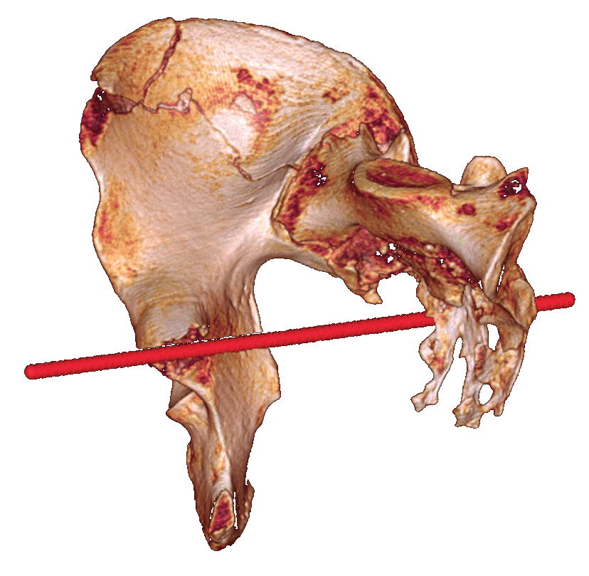
Notes:
And a cut on the inside of the right pelvis.
CLICK
The angle of the blow suggests that it was caused by a weapon being thrust through the right buttock in an upward movement.
Both blows would have been difficult to inflict during battle if the individual was protected by armour.
CLICK
But not impossible, as this medieval drawing shows.
It might suggest that these injuries caused post-mortem, as an act of humiliation.

Slide 51
Notes:
And a cut on the inside of the right pelvis.
CLICK
The angle of the blow suggests that it was caused by a weapon being thrust through the right buttock in an upward movement.
Both blows would have been difficult to inflict during battle if the individual was protected by armour.
CLICK
But not impossible, as this medieval drawing shows.
It might suggest that these injuries caused post-mortem, as an act of humiliation.

Slide 52
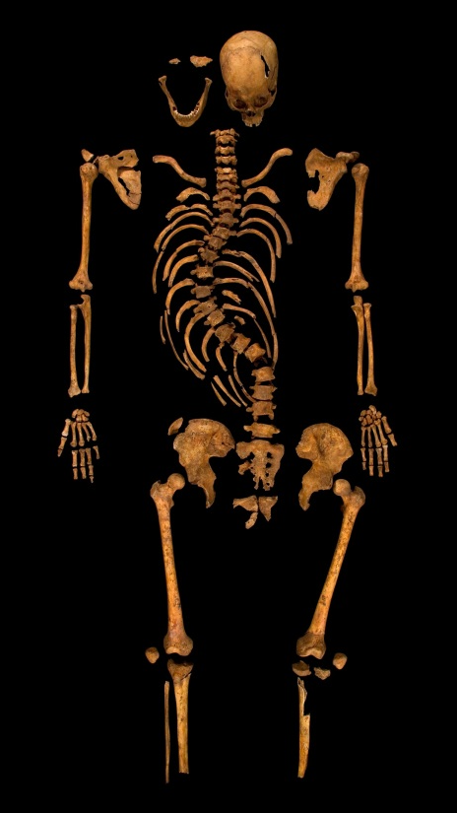
Richard III: The DNA analysis

Slide 53
Richard III: The DNA analysis
All the previous evidence strongly pointed to these being the remains of Richard III
Buried in the choir of the Greyfriars
Skeletal evidence
young male with battle injuries,
severe scoliosis
Radiocarbon data
Stable isotope data

Slide 54
Richard III: The DNA analysis
All the previous evidence strongly pointed to these being the remains of Richard III
Buried in the choir of the Greyfriars
Skeletal evidence
young male with battle injuries,
severe scoliosis
Radiocarbon data
Stable isotope data
Add the DNA evidence to the pot
The genetic analysis relies on the genealogical research
Richard left no descendants and not just any relative would do

Slide 55
Cannot use just any old bit of DNA or
just any old relative to do the DNA analysis
Mitochondrial DNA and the Y chromosome
Simple patterns of inheritance
Notes:
Now then, it’s all very well digging up a skellie and extracting his DNA but without anything to compare it to, we can’t say anything about his identity.
So here I have to give you a bit of a biology. I’ll try to keep it as painless as possible! lesson but it’s very important for the Richard III analysis as not just any old relative would do.
The vast majority of our DNA is a complete patchwork of that of our ancestors and it becomes impossible to know which bit has come from which ancestor. However, there are two pieces of our DNA which have a very simple pattern of inheritance: these are the Y chromosome
and mitochondrial DNA. So, the first of these is the Y chromosome
CLICK
Which is this little stick thing here. Now the Y chromosome has on it the gene for maleness so it can only be passed down through the male line. We’ll have a look at that in a minute.
CLICK
The other piece of our DNA that is passed down in a simple way is our mitochondrial DNA. Now then, the mitochondrial DNA we have is from our mothers. It’s in the egg, so a mother will pass it on to all of her children, but only daughters can pass it on.
So lets see how the Y chromosome is passed down
CLICK
So a man passes it down to his son but not to his daughter - so with any daughters, this genetic link is lost.
CLICK
But a son will pass it down to any of his sons in turn. So we can use the Y chromosome to look at the link between people who are related through the male line.
So now let’s look at the mitochondrial DNA. So a mother will pass it down to all of her children
CLICK
But sons can’t pass it on
CLICK
CLICK
CLICK
So it just gets passed down through the female line and so we can use mitochondrial DNA to look at the link between people who are related through the female line
Now it’s also important ot remember for ancient DNA work – in each of our cells, we have hundreds to thousands of copies of our mitochondrial DNA but a man will only have one copy of his Y chromosome in each of his cells.

Slide 56
Richard will have ~1-17 million relatives alive today who are descendants of his family (Richard left no descendants)
But can compare DNA between individuals only if they are linked in either an unbroken male-only or female-only line
R
Notes:
Now then, it’s all very well digging up a skellie and extracting his DNA but without anything to compare it to, we can’t say anything about his identity.
So here I have to give you a bit of a biology. I’ll try to keep it as painless as possible! lesson but it’s very important for the Richard III analysis as not just any old relative would do.
The vast majority of our DNA is a complete patchwork of that of our ancestors and it becomes impossible to know which bit has come from which ancestor. However, there are two pieces of our DNA which have a very simple pattern of inheritance: these are the Y chromosome
and mitochondrial DNA. So, the first of these is the Y chromosome
CLICK
Which is this little stick thing here. Now the Y chromosome has on it the gene for maleness so it can only be passed down through the male line. We’ll have a look at that in a minute.
CLICK
The other piece of our DNA that is passed down in a simple way is our mitochondrial DNA. Now then, the mitochondrial DNA we have is from our mothers. It’s in the egg, so a mother will pass it on to all of her children, but only daughters can pass it on.
So lets see how the Y chromosome is passed down
CLICK
So a man passes it down to his son but not to his daughter - so with any daughters, this genetic link is lost.
CLICK
But a son will pass it down to any of his sons in turn. So we can use the Y chromosome to look at the link between people who are related through the male line.
So now let’s look at the mitochondrial DNA. So a mother will pass it down to all of her children
CLICK
But sons can’t pass it on
CLICK
CLICK
CLICK
So it just gets passed down through the female line and so we can use mitochondrial DNA to look at the link between people who are related through the female line
Now it’s also important ot remember for ancient DNA work – in each of our cells, we have hundreds to thousands of copies of our mitochondrial DNA but a man will only have one copy of his Y chromosome in each of his cells.

Slide 57
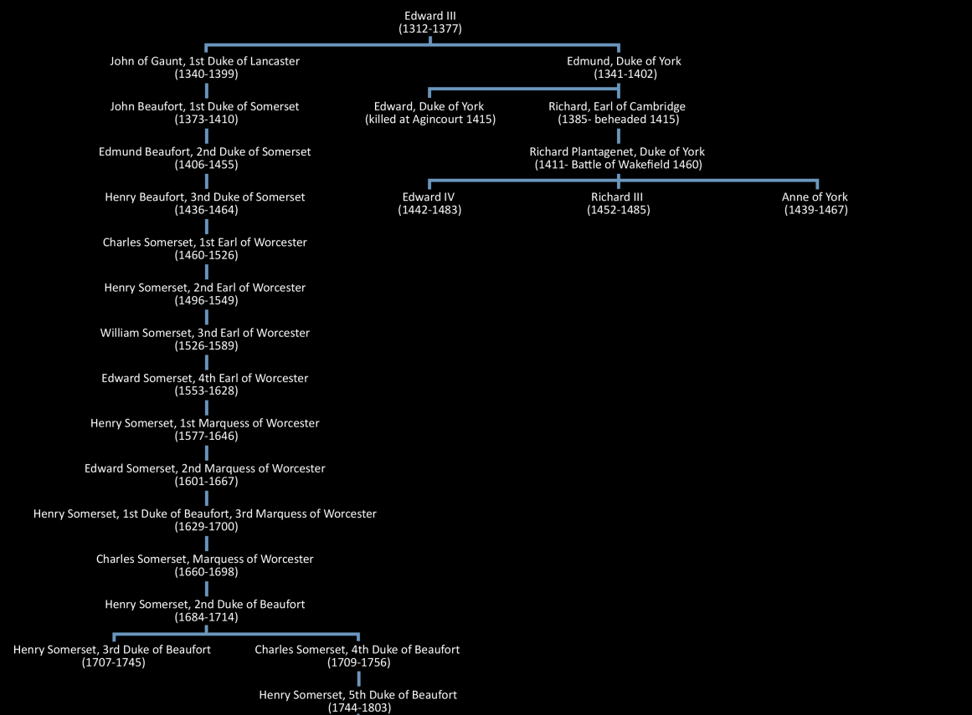

Slide 58
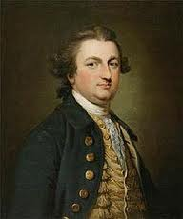
Five living male-line descendants
Henry Somerset
5th Duke of Beaufort

Slide 59
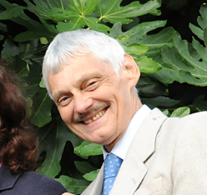
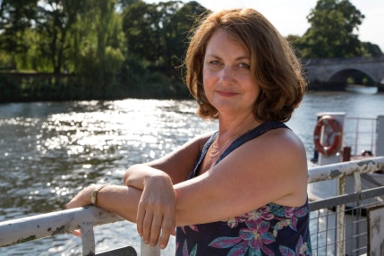
Richard Plantagenet (1411-1460), Duke of York m. Cecily Neville (1415-1495)
Anne of York
(1439-1476)
|
Anne St Leger (1476-1526)
|
Katherine Manners (c.1511-c.1547)
|
Barbara Constable (c.1531-c.1561)
|
Margaret Babthorpe (c.1550-1628)
|
Barbara Cholmley (c.1580-1618)
|
Barbara Belasyse (1609-1641)
|
Barbara Slingsby (c.1637-?)
|
Barbara Talbot (1665-1763)
|
Barbara Yelverton (1687-?)
|
Barbara Calthorpe (c.1717-1782)
|
Barbara Gough-Calthorpe (1744-1826)
|
Anne Spooner (1780-1873)
|
Charlotte Vansittart Neale (1817-1891)
|
Charlotte Vansittart Frere (1846-1917[?])
|
Muriel Stokes (1884-1961)
|
Joy Brown [Mrs Ibsen] (1926-2008)
|
Michael Ibsen
Richard III
(1452-1485)
Everhilda Constable (c.1535-?)
|
Katherine Crathorne (c.1555-1605)
|
Everhilda Creyke (?-?)
|
Everhilda Maltby (1605-?)
|
Frances Wentworth (1631-1693)
|
Dorothy Grantham (1659-1717)
|
Frances Holt (1681-1771)
|
Frances Winstanley (c.1703-1766)
|
Frances Truman (1726-1801)
|
Frances Read (1750-1801)
|
Harriet Villebois (1774-1821)
|
Harriet Plunkett (1809-1864)
|
Frances Gardiner (1828-1907)
|
Sophia Lysaght (1861-1945)
|
Marjorie Moore (1891-1954)
|
Gabrielle Whitehorn (1928-2004)
|
Known in various sources
John Ashdown
Hill
Wendy Duldig

Slide 60
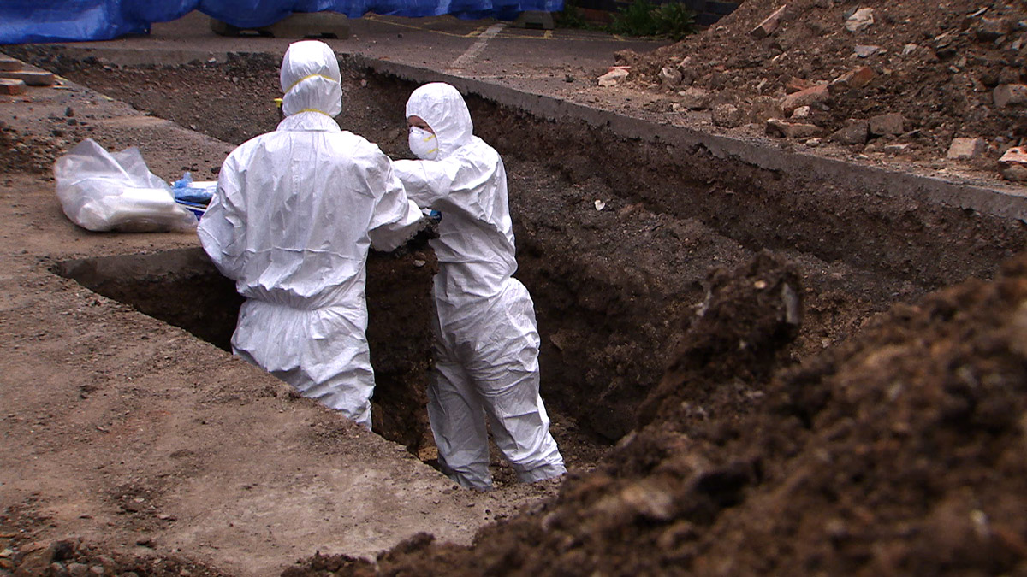
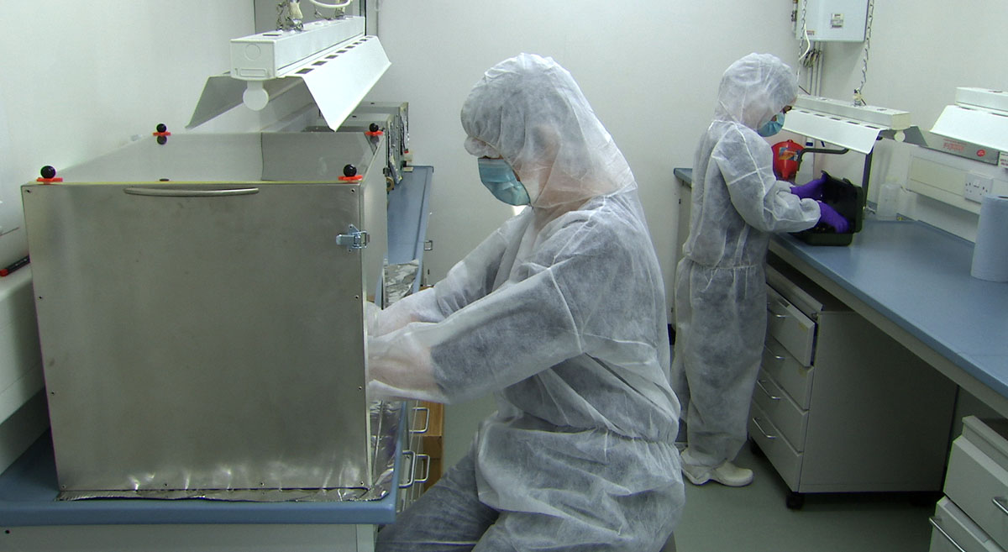
Ancient DNA

Slide 61
The Greyfriars Skeletal Remains: the DNA results
Dr Turi King
Michael Ibsen
Notes:
Modern DNA work carried out by Turi King at the University of Leicester.
Ancient DNA analysis was carried out by Turi King at a dedicated ancient DNA facility at the University of York and independently verified at the Universitie Paul Sabatier in Toulouse.
First step: determined whether the two female-line relatives – Michael Ibsen and Lineage 2 – shared the same mitochondrial DNA sequence.
CLICK
They do and it is a relatively rare mtDNA sequence.
Second step: try to retrieve ancient DNA from the Skeleton 1.
DNA breaks down over time and how quickly this happens is very dependent on the burial conditions. However, ancient DNA has been successfully retrieved.
Finally: the DNA sequence from Skeleton 1 was compared with the two maternal-line relatives of Richard III.
CLICK
There is a DNA match between the mtDNA from the family of Richard III and the skeleton.

Slide 62
The Greyfriars Skeletal Remains: the DNA results
Dr Turi King
Michael Ibsen
Wendy Duldig
Notes:
Modern DNA work carried out by Turi King at the University of Leicester.
Ancient DNA analysis was carried out by Turi King at a dedicated ancient DNA facility at the University of York and independently verified at the Universitie Paul Sabatier in Toulouse.
First step: determined whether the two female-line relatives – Michael Ibsen and Lineage 2 – shared the same mitochondrial DNA sequence.
CLICK
They do and it is a relatively rare mtDNA sequence.
Second step: try to retrieve ancient DNA from the Skeleton 1.
DNA breaks down over time and how quickly this happens is very dependent on the burial conditions. However, ancient DNA has been successfully retrieved.
Finally: the DNA sequence from Skeleton 1 was compared with the two maternal-line relatives of Richard III.
CLICK
There is a DNA match between the mtDNA from the family of Richard III and the skeleton.

Slide 63
The Greyfriars Skeletal Remains: the DNA results
Dr Turi King
Michael Ibsen
Wendy Duldig
Greyfriars Skeletal Remains (Skeleton 1)
Notes:
Modern DNA work carried out by Turi King at the University of Leicester.
Ancient DNA analysis was carried out by Turi King at a dedicated ancient DNA facility at the University of York and independently verified at the Universitie Paul Sabatier in Toulouse.
First step: determined whether the two female-line relatives – Michael Ibsen and Lineage 2 – shared the same mitochondrial DNA sequence.
CLICK
They do and it is a relatively rare mtDNA sequence.
Second step: try to retrieve ancient DNA from the Skeleton 1.
DNA breaks down over time and how quickly this happens is very dependent on the burial conditions. However, ancient DNA has been successfully retrieved.
Finally: the DNA sequence from Skeleton 1 was compared with the two maternal-line relatives of Richard III.
CLICK
There is a DNA match between the mtDNA from the family of Richard III and the skeleton.

Slide 64
The Greyfriars Skeletal Remains: the DNA results
Dr Turi King
Michael Ibsen
Wendy Duldig
Richard III
Notes:
Modern DNA work carried out by Turi King at the University of Leicester.
Ancient DNA analysis was carried out by Turi King at a dedicated ancient DNA facility at the University of York and independently verified at the Universitie Paul Sabatier in Toulouse.
First step: determined whether the two female-line relatives – Michael Ibsen and Lineage 2 – shared the same mitochondrial DNA sequence.
CLICK
They do and it is a relatively rare mtDNA sequence.
Second step: try to retrieve ancient DNA from the Skeleton 1.
DNA breaks down over time and how quickly this happens is very dependent on the burial conditions. However, ancient DNA has been successfully retrieved.
Finally: the DNA sequence from Skeleton 1 was compared with the two maternal-line relatives of Richard III.
CLICK
There is a DNA match between the mtDNA from the family of Richard III and the skeleton.

Slide 65
Y chromosome lineage
Edward III (1312-1377)
John of Gaunt (1340-1399)
Edmund, Duke of York (1341-1402)
I
Richard, Earl of Cambridge (1375-1415)
I
Richard, Duke of York (1411-1460)
I
|
John Beaufort, Earl of Somerset (c.1371-1410)*
|
Edmund, 2nd Duke of Somerset (c.1406-1455)
||
Henry, 3rd Duke of Somerset (1436-1464)
|
Charles Somerset, 1st Earl of Worcester (c.1460-1526)*
|
Henry Somerset, 2nd Earl of Worcester (1496-1549)
|
William Somerset, 3rd Earl of Worcester (c.1527-1589)
|
Edward Somerset,4th Earl of Worcester (c.1550-1628)
|
Henry Somerset, 1st Marquess of Worcester (1577-1646)
|
Edward Somerset, 2nd Marquess of Worcester (1603-1667)
|
Henry Somerset, 1st Duke of Beaufort, 3rd Marquess of Worcester (1629-1700)
|
Charles Somerset, Marquess of Worcester (1660-1698)
|
Henry Somerset, 2nd Duke of Beaufort (1684-1714)
Henry IV (1367-1413)
John, 1st Duke of Somerset**
(c.1404-1444)
|
Margaret Beaufort
(1443-1509)
|
Henry VII
(1457-1509)
Richard III
(1452-1485)
Henry Somerset
3rd Duke of Beaufort (1707-1745)
Charles Somerset, 4th Duke of Beaufort (1709-1756)
|
Henry Somerset, 5th Duke of Beaufort (1744-1803)
Henry Somerset
6th Duke of Beaufort
|
.
.
.
William Somerset (1784-1851)
|
4
|
2
|
|
2
|
William Somerset 1822-1902)
||
Charles Somerset (1862-1939)
|
William Somerset (1912-1981)
|
1
|
FitzRoy Somerset (1823-1901)
|
Arthur Somerset (1855-1937)
||
Arthur Somerset (1899-1957)
|
Boscavan Somerset (1833-1893)
|
William Somerset 1880-1946)
||
FitzRoy Somerset (1923-)
|
SOM 1
SOM 2
SOM 4
SOM 5
SOM 3
* indicates known occurrences of sons being born illegitimate and later legitimized.
SOM 3
** John Beaufort was created Duke of Somerset (1st Duke) in 1443. This technically expired with his death in 1444. His younger brother, Edmund, was later created Duke of Somerset in 1448. As this was a separate creation he was also technically the 1st Duke of this creation, however, many sources refer to him as the 2nd Duke. Subsequently his son Henry inherited the title under the same creation, thus technically he was the 2nd Duke under the second creation, yet is often referred to as the 3rd Duke.

Slide 66
Y chromosome lineage
Edward III (1312-1377)
John of Gaunt (1340-1399)
Edmund, Duke of York (1341-1402)
I
Richard, Earl of Cambridge (1375-1415)
I
Richard, Duke of York (1411-1460)
I
|
John Beaufort, Earl of Somerset (c.1371-1410)*
|
Edmund, 2nd Duke of Somerset (c.1406-1455)
||
Henry, 3rd Duke of Somerset (1436-1464)
|
Charles Somerset, 1st Earl of Worcester (c.1460-1526)*
|
Henry Somerset, 2nd Earl of Worcester (1496-1549)
|
William Somerset, 3rd Earl of Worcester (c.1527-1589)
|
Edward Somerset,4th Earl of Worcester (c.1550-1628)
|
Henry Somerset, 1st Marquess of Worcester (1577-1646)
|
Edward Somerset, 2nd Marquess of Worcester (1603-1667)
|
Henry Somerset, 1st Duke of Beaufort, 3rd Marquess of Worcester (1629-1700)
|
Charles Somerset, Marquess of Worcester (1660-1698)
|
Henry Somerset, 2nd Duke of Beaufort (1684-1714)
Henry IV (1367-1413)
John, 1st Duke of Somerset**
(c.1404-1444)
|
Margaret Beaufort
(1443-1509)
|
Henry VII
(1457-1509)
Richard III
(1452-1485)
No DNA match
At least two false-paternity events
One recently
One historical
Not surprising – historical non-paternity rate is 1-2% per generation
Does not affect overall identification
Henry Somerset
3rd Duke of Beaufort (1707-1745)
Charles Somerset, 4th Duke of Beaufort (1709-1756)
|
Henry Somerset, 5th Duke of Beaufort (1744-1803)
Henry Somerset
6th Duke of Beaufort
|
.
.
.
William Somerset (1784-1851)
|
4
|
2
|
|
2
|
William Somerset 1822-1902)
||
Charles Somerset (1862-1939)
|
William Somerset (1912-1981)
|
1
|
FitzRoy Somerset (1823-1901)
|
Arthur Somerset (1855-1937)
||
Arthur Somerset (1899-1957)
|
Boscavan Somerset (1833-1893)
|
William Somerset 1880-1946)
||
FitzRoy Somerset (1923-)
|
SOM 1
SOM 2
SOM 4
SOM 5
SOM 3
* indicates known occurrences of sons being born illegitimate and later legitimized.
SOM 3
** John Beaufort was created Duke of Somerset (1st Duke) in 1443. This technically expired with his death in 1444. His younger brother, Edmund, was later created Duke of Somerset in 1448. As this was a separate creation he was also technically the 1st Duke of this creation, however, many sources refer to him as the 2nd Duke. Subsequently his son Henry inherited the title under the same creation, thus technically he was the 2nd Duke under the second creation, yet is often referred to as the 3rd Duke.

Slide 67
A Bayesian Statistical Analysis

Slide 68
A Bayesian Statistical Analysis
As in any missing person’s case you bring all the strands of evidence together to come to a conclusion. Very conservative in our approach

Slide 69
A Bayesian Statistical Analysis
As in any missing person’s case you bring all the strands of evidence together to come to a conclusion. Very conservative in our approach
Remains found in choir of the church of the Grey Friars in Leicester

Slide 70
A Bayesian Statistical Analysis
As in any missing person’s case you bring all the strands of evidence together to come to a conclusion. Very conservative in our approach
Remains found in choir of the church of the Grey Friars in Leicester
Male aged 30-34 years old

Slide 71
A Bayesian Statistical Analysis
As in any missing person’s case you bring all the strands of evidence together to come to a conclusion. Very conservative in our approach
Remains found in choir of the church of the Grey Friars in Leicester
Male aged 30-34 years old
Multiple battle injuries

Slide 72
A Bayesian Statistical Analysis
As in any missing person’s case you bring all the strands of evidence together to come to a conclusion. Very conservative in our approach
Remains found in choir of the church of the Grey Friars in Leicester
Male aged 30-34 years old
Multiple battle injuries
Severe scoliosis of the spine

Slide 73
A Bayesian Statistical Analysis
As in any missing person’s case you bring all the strands of evidence together to come to a conclusion. Very conservative in our approach
Remains found in choir of the church of the Grey Friars in Leicester
Male aged 30-34 years old
Multiple battle injuries
Severe scoliosis of the spine
Radiocarbon dates: 1456-1530 AD (Richard died in 1485)

Slide 74
A Bayesian Statistical Analysis
As in any missing person’s case you bring all the strands of evidence together to come to a conclusion. Very conservative in our approach
Remains found in choir of the church of the Grey Friars in Leicester
Male aged 30-34 years old
Multiple battle injuries
Severe scoliosis of the spine
Radiocarbon dates: 1456-1530 AD (Richard died in 1485)
Stable isotope data fits – high status diet and geographical data

Slide 75
A Bayesian Statistical Analysis
As in any missing person’s case you bring all the strands of evidence together to come to a conclusion. Very conservative in our approach
Remains found in choir of the church of the Grey Friars in Leicester
Male aged 30-34 years old
Multiple battle injuries
Severe scoliosis of the spine
Radiocarbon dates: 1456-1530 AD (Richard died in 1485)
Stable isotope data fits – high status diet and geographical data
Y chromosome data does not match – unsurprising, false-paternity is relatively common – even with low rate, 16% chance in 19 generations

Slide 76
A Bayesian Statistical Analysis
As in any missing person’s case you bring all the strands of evidence together to come to a conclusion. Very conservative in our approach
Remains found in choir of the church of the Grey Friars in Leicester
Male aged 30-34 years old
Multiple battle injuries
Severe scoliosis of the spine
Radiocarbon dates: 1456-1530 AD (Richard died in 1485)
Stable isotope data fits – high status diet and geographical data
Y chromosome data does not match – unsurprising, false-paternity is relatively common – even with low rate, 16% chance in 19 generations
Mitochondrial DNA match with two distantly related female-line relatives

Slide 77
A Bayesian Statistical Analysis
As in any missing person’s case you bring all the strands of evidence together to come to a conclusion. Very conservative in our approach
Remains found in choir of the church of the Grey Friars in Leicester
Male aged 30-34 years old
Multiple battle injuries
Severe scoliosis of the spine
Radiocarbon dates: 1456-1530 AD (Richard died in 1485)
Stable isotope data fits – high status diet and geographical data
Y chromosome data does not match – unsurprising, false-paternity is relatively common – even with low rate, 16% chance in 19 generations
Mitochondrial DNA match with two distantly related female-line relatives
A 99.999 – 99.99999% probability that this is Richard III

Slide 78
A Bayesian Statistical Analysis
As in any missing person’s case you bring all the strands of evidence together to come to a conclusion. Very conservative in our approach
Remains found in choir of the church of the Grey Friars in Leicester
Male aged 30-34 years old
Multiple battle injuries
Severe scoliosis of the spine
Radiocarbon dates: 1456-1530 AD (Richard died in 1485)
Stable isotope data fits – high status diet and geographical data
Y chromosome data does not match – unsurprising, false-paternity is relatively common – even with low rate, 16% chance in 19 generations
Mitochondrial DNA match with two distantly related female-line relatives
A 99.999 – 99.99999% probability that this is Richard III
The evidence is overwhelming that these are the remains of Richard III

Slide 79
A Bayesian Statistical Analysis
As in any missing person’s case you bring all the strands of evidence together to come to a conclusion. Very conservative in our approach
Remains found in choir of the church of the Grey Friars in Leicester
Male aged 30-34 years old
Multiple battle injuries
Severe scoliosis of the spine
Radiocarbon dates: 1456-1530 AD (Richard died in 1485)
Stable isotope data fits – high status diet and geographical data
Y chromosome data does not match – unsurprising, false-paternity is relatively common – even with low rate, 16% chance in 19 generations
Mitochondrial DNA match with two distantly related female-line relatives
A 99.999 – 99.99999% probability that this is Richard III
The evidence is overwhelming that these are the remains of Richard III

Slide 80
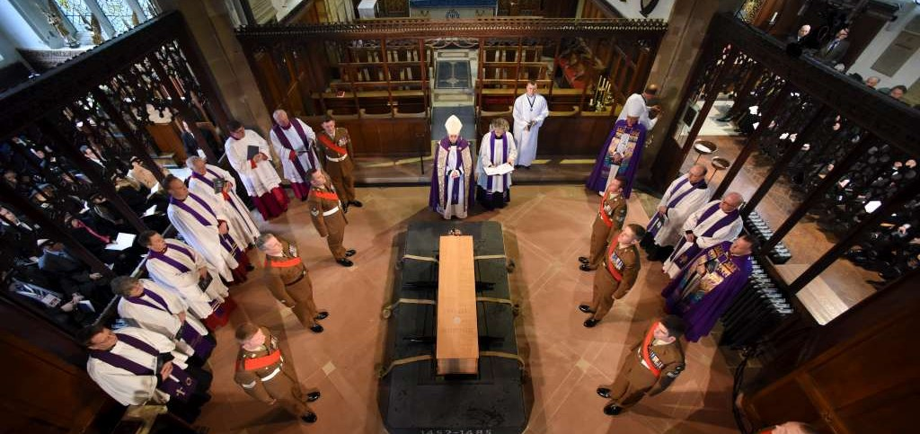
Leicester Cathedral March 26, 2015

Slide 81
Richard III
www.le.ac.uk/richardiii

